Slide 1

Financial Transparency
Working Group:
Equity Analyses
September 7, 2017
By:
Marguerite Roza
Edunomics Lab at Georgetown University

Slide 2
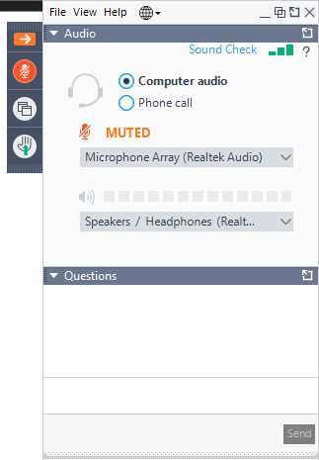
Communicating During the Call
To request to be unmuted, please use the hand raise tool
Use the question box to ask questions or make a comment, and we will reply all so the group can see the question/comment & answer
bscpcenter.org

Slide 3
Agenda
For the next meeting: State updates?
Transparency for use by whom?
Using financial data to explore Intra-District Equity
  Sample Equity Analyses
  What role will the SEA play?
  An equity tool to share with districts
Next meeting: Tuesday, Sept. 19, 1-2pm ET

Slide 4
1. Next Meeting: What Steps Have You Taken So Far?
Pilots
Local working groups/ Task force
Contract RFPs issued
Data analyses
Communication w/ LEAs
Sample data reports & visualizations
Other?
Please send an email to Katie Hagan at Katie.Hagan@georgetown.edu

Slide 5
Not that kind of equity!

Slide 6
Today’s focus: Intra-district Equity
Allocation of resources from districts to schools
School $
Federal $
District $
School $
State $
School $
Local $
School $

Slide 7
Spending varies across LEA. Is this an equitable distribution?
bscpcenter.org

Slide 8
Group schools by student mix for comparisons

Slide 9
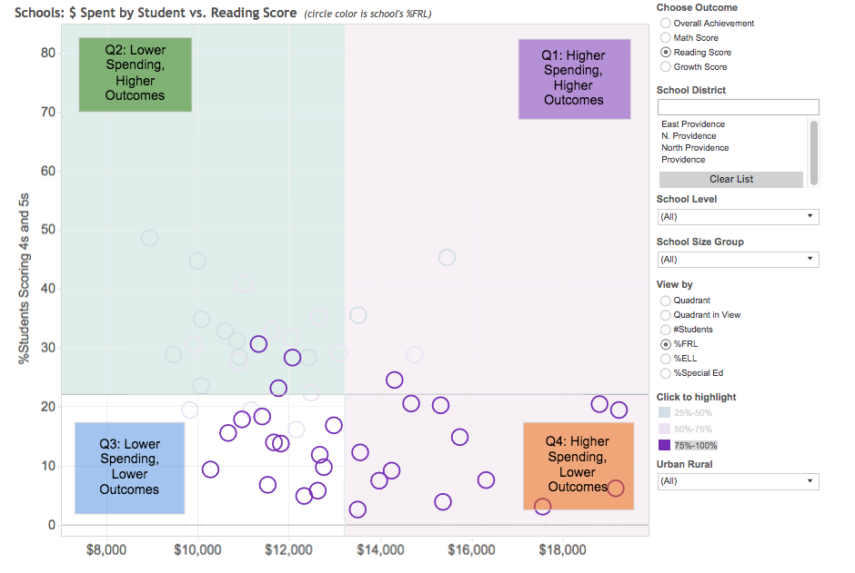
Use filters to highlight a set of schools and compare to all others.
Select different categories of student need

Slide 10
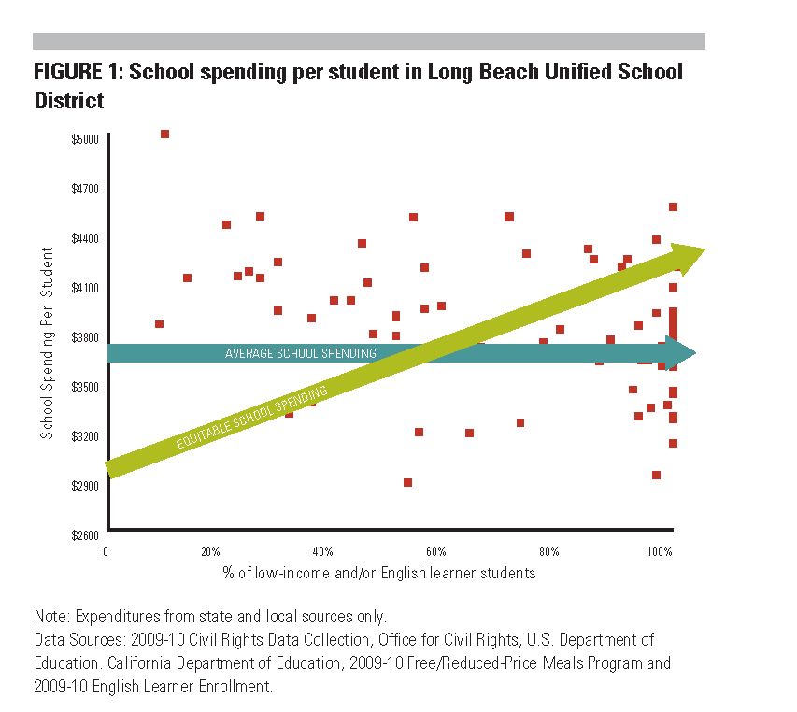
Array schools based on concentration of a student type
Ed Trust West: Tipping the Scale Toward Equity

Slide 11
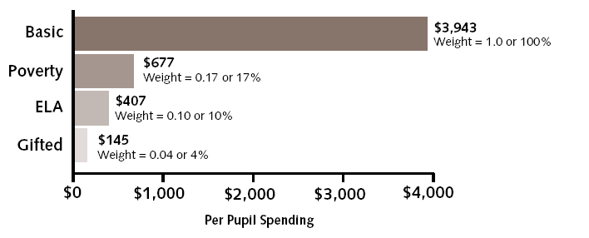
One method computes district-wide averages by student type…
Example weights
Sum all the district $ spent on ELA and divide by total # of bilingual ed students to get the district-wide average $407 per bilingual ed student on ELA
And then compare each school’s actual spending to those average

Slide 12
Afton Example: Displays how much each school gets above/below average per pupil type
$3.3M of above average spending at these seven schools, after approximating for student need
Source: District documents, Afton analysis.
Note: Derived from actual district figures, figures changed for the purposes of providing this example.

Slide 13
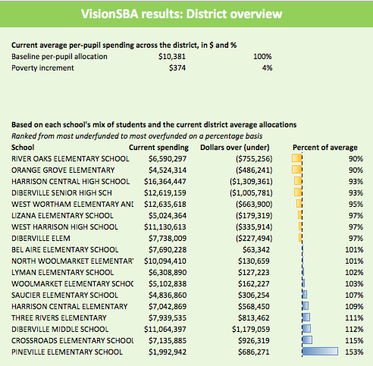
Vision SBA: Displays each school’s share of average funding by student type
bscpcenter.org

Slide 14
Spending for groups of schools relative to district-wide average per pupil type
Predominately White | 103%
Predominately Black | 103%
Predominately Latino | 96%
Region
North | 95%
South | 106%
West | 90%
Lakefront | 118%

Slide 15
Who’s job is it to run intra-district equity analyses?
Should the state financial transparency system provide equity analyses?
Will districts need tools?
Are districts thinking about this in your state?

Slide 16
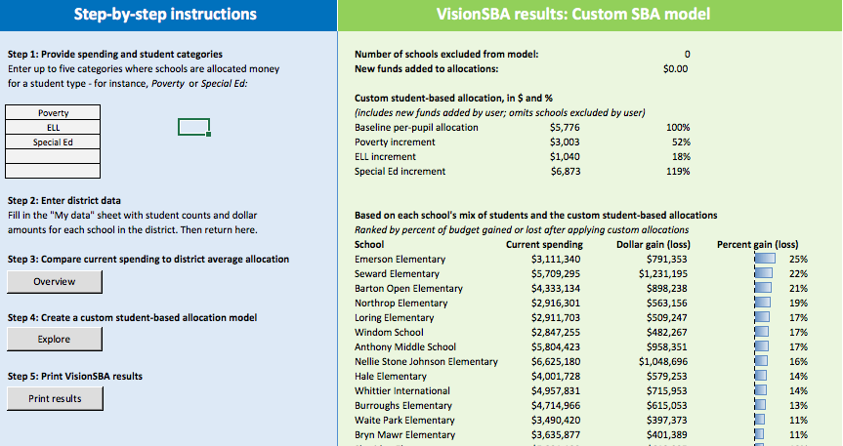
Feel free to share the VisionSBA tool for districts to explore their inequities
Manual and tool are available at http://edunomicslab.org/visionsba/
Districts enter data:
  Student demographics by school
  Spending by school
  Spending by need category
Tool produces numerical and visual equity analysis by school.
District leaders can consider alternate spending scenarios and explore effects by school.

Slide 17



FiTWiG Supporters
Next meeting: September 19, 1-2pm ET
In-person meeting coming up:
  Preferred month? (Jan? Feb?)
  Topics you’d like covered so we can plan valuable sessions?
bscpcenter.org

