Slide 1
ESSA Financial Transparency: View from the LEA Site-Level Per-Pupil Expenditure Analysis
February 9, 2017

Slide 2


Today’s Discussion
In this session, we will:
Focus on the opportunities from ESSA Financial Transparency requirements
Share concerns and provide feedback to FTWG if necessary
To achieve these goals, we will:
Reflect on morning sessions
Share examples of PPE analyses and their outcomes

Slide 3
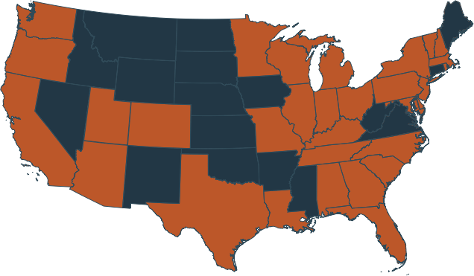
Afton Partners: Who We Are
5
Years
85+
Initiatives
32
States
2300+
Schools
Afton’s vision is that all of America’s public education organizations are using financial strategies, policies, and practices that sustain effective academic initiatives—allowing more students to succeed.
Three areas of work:
Sustainability Planning
Operational Efficiency & Effectiveness
Funding Equity & Fiscal Transparency
Notes:
In our first five years, Afton has worked on over 80 initiatives with public school districts, charter operators, state education agencies and education advocates, bringing a nationwide perspective to local situations.

Slide 4
Let’s get to work!
Write your thoughts on the two white papers on the walls.
As we prepare to meet ESSA Financial Transparency Requirements…
What OPPORTUNITIES do you foresee?
What CHALLENGES do you foresee or CONCERNS do you have?

Slide 5
ESSA adds school-level financial reporting
Actual Text From ‘Every Student Succeeds Act’
  ‘‘(C) MINIMUM REQUIREMENTS.—Each State report card required under this subsection shall include the following information:
  …
  (x) The per-pupil expenditures of Federal, State, and local funds, including actual personnel expenditures and actual nonpersonnel expenditures of Federal, State, and local funds, disaggregated by source of funds, for each local educational agency and each school in the State for the preceding fiscal year.”
  Source: S.1177 — 114th Congress.

Slide 6
Examples: Results of Site Level Reporting

Slide 7
Example 1
Per-pupil resource allocation across and within schools, and identifying opportunities to (a) rebalance for equity, and/or (b) rectify unintended overspending

Slide 8
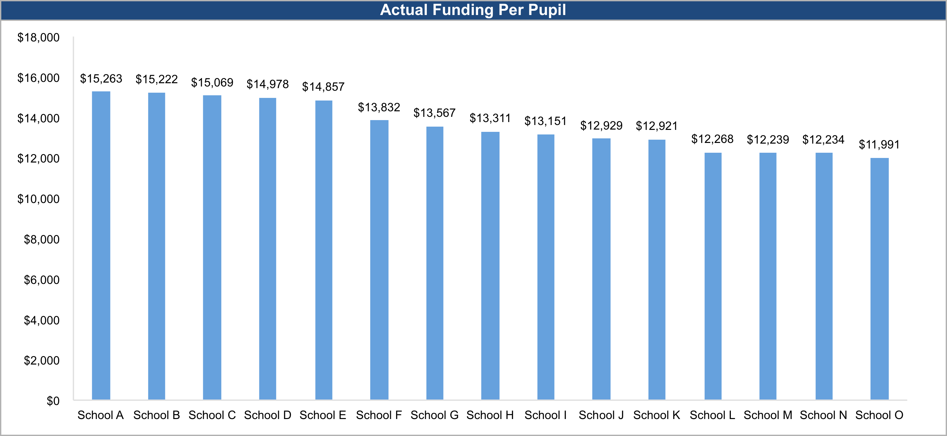
Per pupil spending varies widely across the District’s schools (range of $3,273), due in part to varying student needs at each school
Source: District documents, Afton analysis.

Slide 9
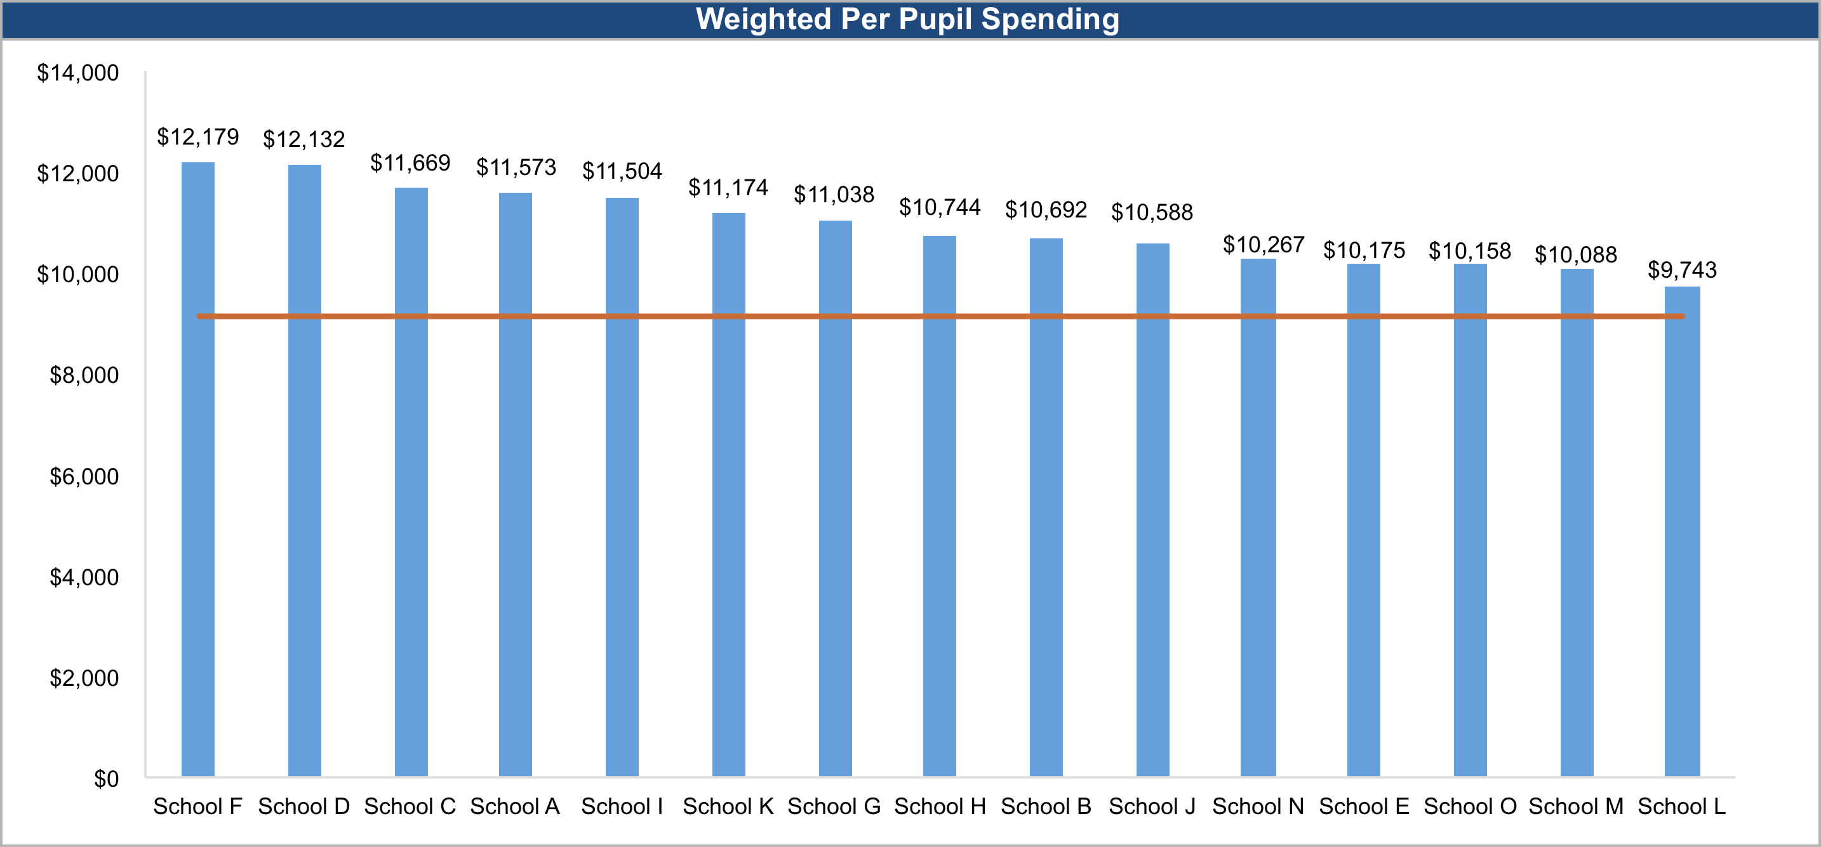
After accounting for student need using these weights, the range of per pupil spend continues to vary widely ($2,437) among the district’s schools
Equitable
Source: District documents, Afton analysis.

Slide 10
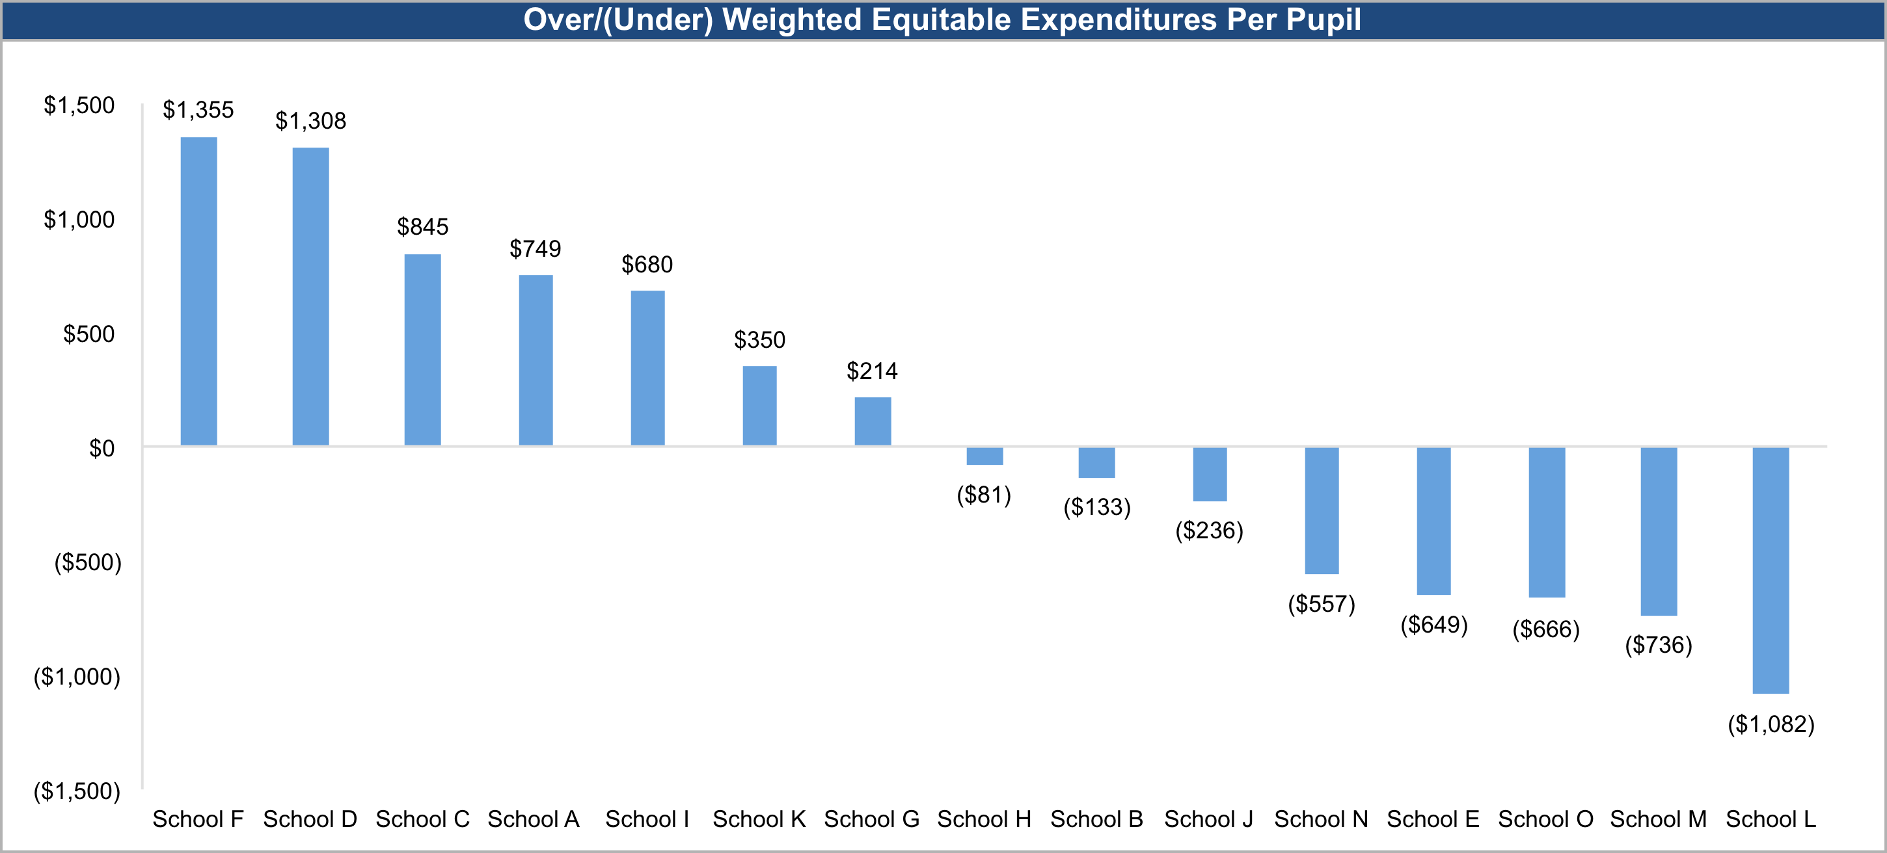
After accounting for student need, seven schools spend $214 - $1,355 more per pupil than the equitable average, representing $2.8 million
$2.8M of above average spending at these seven schools, after approximating for student need
Source: District documents, Afton analysis.

Slide 11
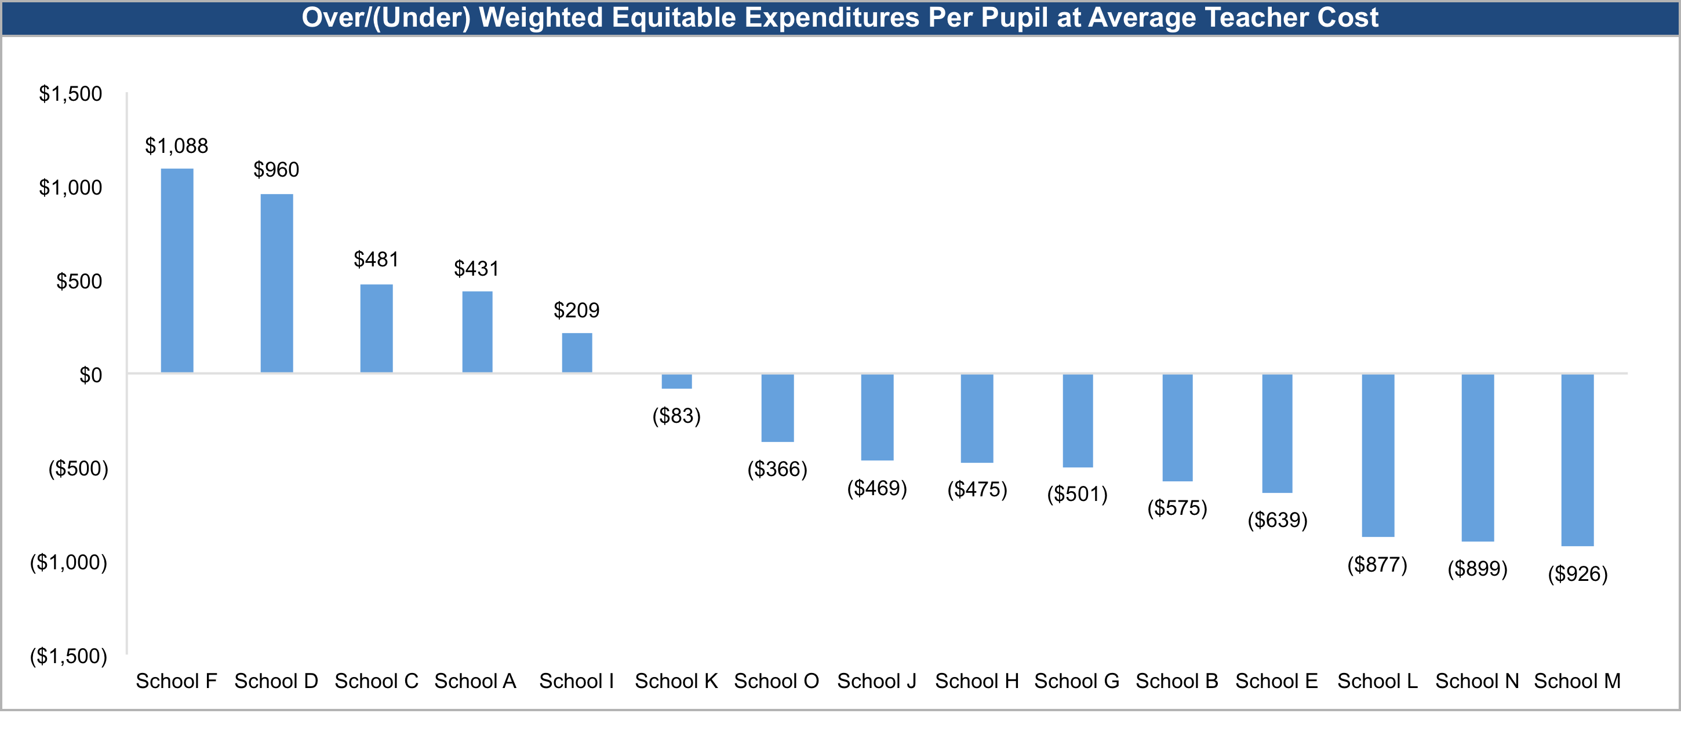
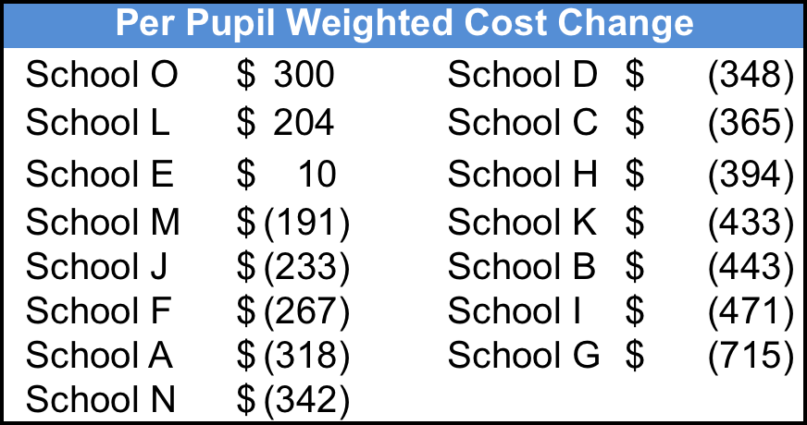
When we charge district average teacher cost instead of actual teacher cost, students at fewer schools are funded above the average ($1.6M of overfunding)
Source: District documents, Afton analysis.

Slide 12
Example 2
Site-level per-pupil spending vs. site-level academic outcomes, including charter and district-run schools

Slide 13
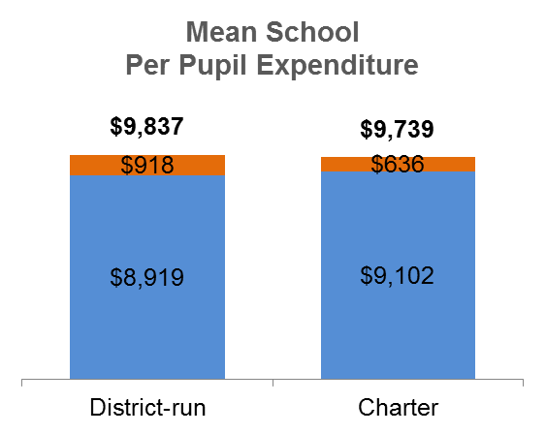
On average, District X spent approximately $100 more per pupil on district-run schools than charter schools under its purview
Federal, State, and Local Grants per pupil
General Purpose per pupil
The 1% difference in District and Charter school spending is driven by Federal, State and Local Grants. This analysis does not include any additional funds received (and spent) directly by Charter schools.
Notes:
Analysis excludes grants charter schools receive directly (i.e. do not flow through the district ledger, including start up grants and other state/federal grants which charter schools can apply for and don’t need to flow through the LEA)
District-run schools include certain federal and state grants that may not be available to charter schools, including Pre-K, Magnet School Assistance, Teacher Incentive and SIG
Analysis excludes capital expenditures
Per pupil expenditures reflect the average (mean) of schools’ per pupil expenditure by operator type. Per pupil expenditure varies by school.
District school figures exclude the following school types: Alternative Learning Centers, Special Education Schools, Non-traditional Schools.
Weighted Average Daily Membership (ADM) for PreK-12th grade is used as the denominator in per pupil expenditure calculation, in accordance with BEP formula. ADM is “weighted” as follows: 12.5% Month 2, 17.5% Month 3, 35% Month 6, 35% Month 7. Weighted ADM includes Pre-K 40th day enrollment figures as a proxy for Pre-K ADM.

Slide 14
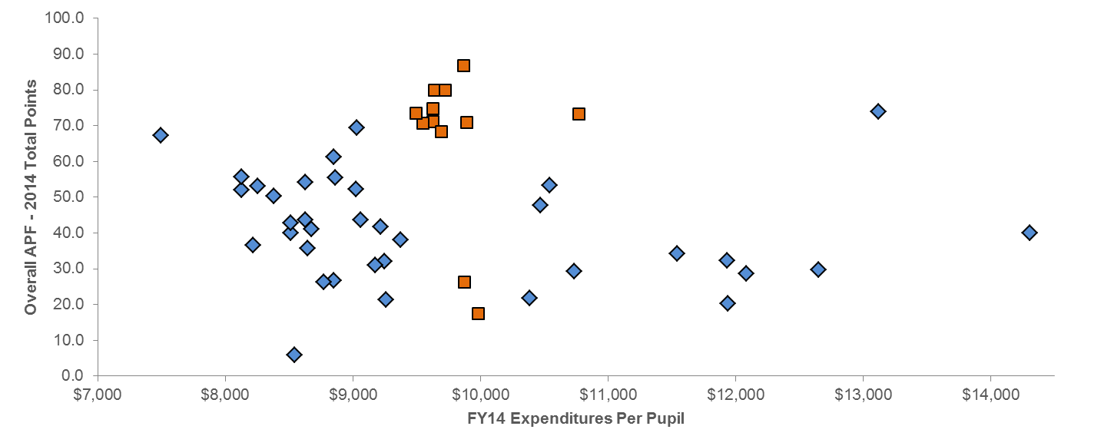
31% of middle schools spend less than average, and had materially higher Academic Results
FY14 Expenditures Per Pupil vs. Academic Score
Middle Schools – District and Charter
District-run schools (36)
1
Mean per pupil = $9,686
Charter Schools (12)
2
Mean APF = 47.5
3
4
Note: Figures include two district-run middle schools that were in transition to be converted in 2014. These two schools had the highest per pupil spend.

Slide 15
Example 3
Site-level per-pupil spending vs student needs → equity analysis

Slide 16
Total per-pupil funding by school shows higher funding with higher poverty, as expected

Slide 17
However, when we remove federal funding, we see an inverse relationship
Source: District documents, Afton analysis.
Note: Derived from actual district figures.

Slide 18
Site-level average teacher salary is higher in high poverty schools
Source: District documents, Afton analysis.
Note: Derived from actual district figures.

Slide 19
Wrap-up

Slide 20
ESSA Financial Transparency Requirement brings new opportunities
Our examples:
  Reallocating resources across and within schools (Equity? Cost savings?)
  Comparing spending to academic results
  Ensuring equitable allocation compared to student needs
Your Ideas!
How can we resolve key challenges? What support do you need from states?

Slide 22
Supplemental Materials

Slide 23
Site-Level Per-Pupil Expenditures Model

Slide 24
Site-Level Per-Pupil Expenditure Analysis - Overview
Purpose
Report and assess school-site spending within a district
Experience
Afton has performed intra-district analyses in multiple districts including:
  Chicago Public Schools (IL)
  Evanston (IL)
  North Chicago (IL)
  Metro Nashville Public Schools (TN)
  School District of Philadelphia (PA)
  Point Isabel Independent School District (TX)
Process Overview
Determine how much is spent on obligations and commitments outside of K-12 and how much truly goes to K-12 education
Allocate central K-12 spending to school locations to analyze intra-district spending on a site by site basis
Create weighted student model to calculate per pupil spending by school accounting for student needs

Slide 25



Site-Level Per-Pupil Expenditures Analysis — Methodology
1: Assign Coded Expenses to Schools
2: Allocate Central Expenses to Schools
Position File
Budget File
Transportation
Use FTE assignments and position types
Exclude non-operating expenses
Per FRL
Per Pupil
Per ELL
Per IEP
Per Pupil
Per Pupil
School Locations
School Locations
3: Determine Weights
4: Calculate Weighted Spend Per Campus
Divide Spending by Weighted Enrollment
Identify and sum all expenses related to:
Special Education
Free/Reduced Lunch
English Language Learners
Low Student Needs
High Student Needs

Slide 26
Unweighted (Unadjusted) vs. Weighted (Needs Adjusted) Per-Pupil Expenditures
Unweighted | Weighted
Divides total resources over actual number of students | Divides total resources over adjusted number of student
Each student counts equally | Students with special needs count as more than one student
Outcomes reflect level of equality of resources | Outcomes reflect level of equity of resources
ESSA Requirement | Beyond requirement of ESSA

Slide 27
Example: Weight Calculation
Base Per Pupil Used as Denominator To Determine Sped, ELL, And FRL Weights. Sped Example:
A)
B)
Total K-12 Sped Cost: $33.1mm
“Full-Time”
Sped Students:
412.4
“Full-Time”
Sped Per
Pupil Cost:
$80,233
C)
Source: District documents, Afton analysis.
Note: Derived from actual district figures.

Slide 28
Additional Materials for Examples

Slide 29
Correcting for intra-district funding inequities
Students at seven schools receive $2.8M more than the average spend, after adjusting for student needs at each school. The two magnet schools are among the top three “overfunded” schools.
$2.8M of above average spending at these seven schools, after approximating for student need
29
Source: District documents, Afton analysis.
DRAFT WORKING PAPERS
SUBJECT TO CHANGE & NOT FOR DISTRIBUTION

Slide 30
Correcting for intra-district funding inequities
Students at magnet schools are funded more than their counterparts in the District primarily due to significantly lower middle school grade class size and smaller overall school size in elementary grades
Middle school core subject teachers single biggest driver (see graph below) – inefficiencies with staffing small departmentalized middle schools within the magnet schools
Other reasons for the funding gap:
  Both magnets have APs; only 5 of 10 elementary schools do
  Electives teachers in total cost 27% more per pupil than total middle and elementary electives teachers per pupil due to lower student/teacher ratios: 100 to 1 at elementary schools versus 50 to 1 at magnets
  Support personnel more dense; 3 social workers, 3 psychologists, and 3 speech therapists among 2 magnet schools. Ratios lower at middle and elementary schools
Comparable
33% More at Magnet
⁽²⁾
30
Source: District documents.
Magnet K-5 teacher cost per pupil denominator includes only magnet grades K-5 students. Magnet core subject teacher cost per pupil denominator includes only magnet grades 6-8 students.
Includes cost of ACC and TWI teachers.

Slide 31
Correcting for intra-district funding inequities
$1.4M (or $1,179 per pupil) more is spent on magnet students vs. all other students (after accounting for student needs)
31
Source: District documents, Afton analysis.
Comparison includes cost of ACC and TWI.
Differential due to higher student teacher ratios at elementary schools than magnets: 100 to 1 at elementary schools v 50 to 1 at magnets.
Bilingual, Special Ed, Reading, Inclusion, Resource teachers.
Related to non-salaried, non-FTE expenses, mostly in program codes 107 (reading specialists), 212 (computer ed), 415 (special services), and 615 (lunchroom services).
Both Rhodes and King Lab have APs; only 5 of 10 elementary schools have APs.

Slide 32
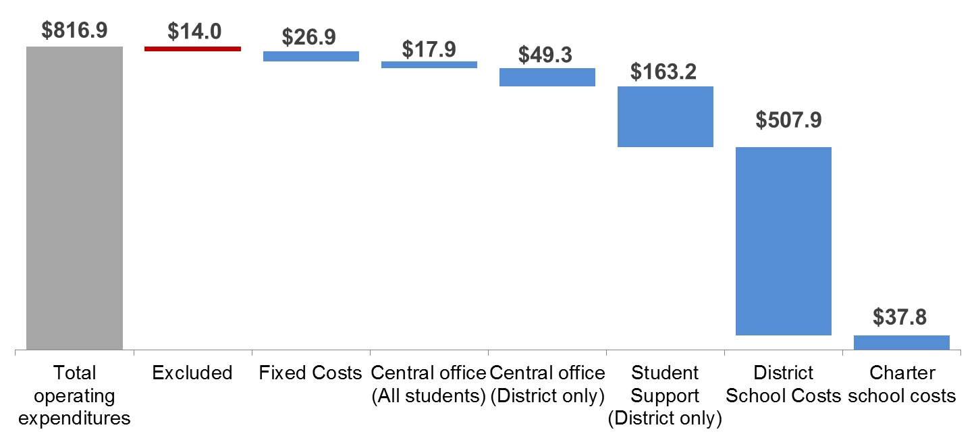
District X should adjust its services and cost structure over the long term to match the needs of its projected mix of school operators
A. Fixed Costs
B. Semi-Variable (All)
C. Semi-Variable (District) - $720.4MM
D. Variable
Will not vary based on enrollment
Varies based on total enrollment
Varies based on District-run enrollment
Varies based on Charter enrollment
Notes:
Figures shown are in millions ($MM)
“Operating” refers to general purpose fund and federal, state, and local grants fund expenditures
Fixed costs = all costs that do not vary based on enrollment over the long term, assuming MNPS continues to manage and operate at least one school, and continues to function as an LEA.

Slide 33
Challenges to Site Level Reporting

Slide 34
Often Many Expenses Coded to Central
District 1
District 2
In millions
In millions
Central Expenses Include: Substitute teachers, sped clinical services, classroom supplies and materials, rentals, athletic expenses, facilities maintenance, capex, contracted psychologists
Central Expenses Include: Sped tuition, IT, facilities maintenance, insurance, headstart, support services, elementary school furniture, middle school textbooks, food services, transportation
Source: District documents.

Slide 35
Other Challenges to School Site Level Reporting
Accounting Capacity
Not all Districts fully utilize accounting strings
Central Expenses
Limited visibility to which schools benefit from various central and shared services
  Intensive work with District finance team required
Position Control
Some districts struggle to appropriately report positions by location
Budget does not capture FTEs or detailed position types
Marrying position file with budget gives “best-possible” view: FTE counts and detailed position types with actual spending
Teacher Salary
Average teacher salary varies between campuses
Affects equity analysis – some district’s point of view about equity in this regard differs

Slide 36
CHALLENGES & OPPORTUNITIES
Insert picture of activity here

