Slide 1

Financial transparency displays:
a) for what? b) for whom? c) how will it work?
September 19, 2018
©2018 Edunomics Lab, Georgetown University

Slide 2

Happy
(almost) Pumpkin Spice Season
Fall!
©2018 Edunomics Lab, Georgetown University
Notes:
Love this!

Slide 3
Agenda
State question
Visualization Goals & Audiences
Sample Visualizations
©2018 Edunomics Lab, Georgetown University

Slide 4
State question
Illinois is planning to report some accountability data for schools inside the juvenile justice system in new state report cards, but is unsure about how/whether to report spending.
Are other states reporting school level spending data for juvenile justice schools?
©2018 Edunomics Lab, Georgetown University

Slide 5
The problem with most financial displays…
they. don’t. get. used.
Have you ever used one? For what?
©2018 Edunomics Lab, Georgetown University

Slide 6
Critical questions for visualization designs
WHAT do you hope they’ll do with it?
WHO do you hope will use the info?
HOW will that happen?
(no really: How exactly?)
Parents
Advocacy
Principals
District Leaders
Seek improved equity across district schools.
Seek improved outcomes for the dollar (relative to meaningful peers).
Improve participation in allocation
Other?
Agnostic?
©2018 Edunomics Lab, Georgetown University

Slide 7
Critical questions for visualization designs
WHAT do you hope they’ll do with it?
WHO (primarily) do you hope will use the info?
HOW will that happen?
(How exactly?)
Parents
Advocacy
Principals
District Leaders
Seek improved equity across district schools.
Seek improved outcomes for the dollar (relative to meaningful peers).
Improve participation in allocation
Other?
Agnostic?
Parents look up how much is spent at their school, then compare to other schools (taking stock of demographics), then lobby district for change.
©2018 Edunomics Lab, Georgetown University

Slide 8
Critical questions for visualization designs
WHAT do you hope they’ll do with it?
WHO (primarily) do you hope will use the info?
HOW will that happen?
(How exactly?)
Parents
Advocacy
Principals
District Leaders
Seek improved equity across district schools.
Seek improved outcomes for the dollar (relative to meaningful peers).
Improve participation in allocation
Other?
Agnostic?
Advocacy compares spending across all schools in the district (taking stock of demographics), then presses district for change.
©2018 Edunomics Lab, Georgetown University

Slide 9
Critical questions for visualization designs
WHAT do you hope they’ll do with it?
WHO (primarily) do you hope will use the info?
HOW will that happen?
(How exactly?)
Parents
Advocacy
Principals
District Leaders
Seek improved equity across district schools.
Seek improved outcomes for the dollar (relative to meaningful peers).
Improve participation in allocation
Other?
Agnostic?
Principals benchmark their own school’s spending and outcomes, in comparison to meaningful peers, and then: a) manages school differently to improve results, b) seeks new ideas/innovations from peers, c) presses districts for changes in allocation that can help.
Principals benchmark their own school’s spending and outcomes, in comparison to meaningful peers, and then: a) manages school differently to improve results, b) seeks new ideas/innovations from peers, c) presses districts for changes in allocation that can help.
©2018 Edunomics Lab, Georgetown University

Slide 10
Critical questions for visualization designs
WHAT do you hope they’ll do with it?
WHO (primarily) do you hope will use the info?
HOW will that happen?
(How exactly?)
Parents
Advocacy
Principals
District Leaders
Seek improved equity across district schools.
Seek improved outcomes for the dollar (relative to meaningful peers).
Improve participation in allocation
Other?
Agnostic?
Users examine their own spending (and maybe demographics and outcomes) and are invited to weigh in on proposed spending going forward (requires display of budgets too).
©2018 Edunomics Lab, Georgetown University

Slide 11
Critical questions for visualization designs
WHAT do you hope they’ll do with it?
WHO (primarily) do you hope will use the info?
HOW will that happen?
(How exactly?)
Parents
Advocacy
Principals
District Leaders
Seek improved equity across district schools.
Seek improved outcomes for the dollar (relative to meaningful peers).
Improve participation in allocation
Other?
Agnostic?
Which other data are needed for this to happen?
©2018 Edunomics Lab, Georgetown University

Slide 12
Relevant information depending on the WHAT, WHO and HOW:
1. How much does the school spend per pupil?
2. Is that more or less per-pupil than other schools in the same district?
3. Is that more or less per-pupil than other schools with similar student demographics?
4. Is that more or less per-pupil than other schools within the state?
5. Does is appear that the district divvies up funds equitably?
6. What is driving spending differences across schools?
7. What funds/expenditures (if any) were excluded from the PPE calculation?
8. How does the school's spending on services (e.g. benefits, transportation, food) compare to that of other schools? (Is the school able to get similar services for less or more?)
9. How does the schools' costs for different inputs (e.g. teaching, leadership) compare to those of others?
10. Is there a school (or schools) that the school can learn from? Specifically, is there one that has a similar level of funds (and similar demographics) but that is able to achieve much higher outcomes for their students?
11. Compared to peers, how well is the school able to leverage funds to achieve outcomes for students?
©2018 Edunomics Lab, Georgetown University

Slide 13
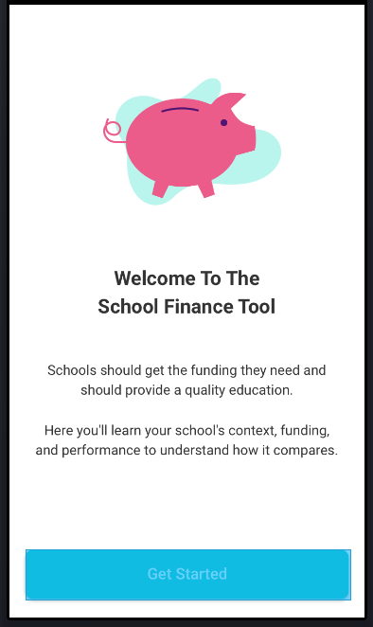
CCSSO template: Parents as primary audience
What: Other/Agnostic (inform, meet requirement)
Who: Parents
How:
Mobile design only (for now)
©2018 Edunomics Lab, Georgetown University

Slide 14
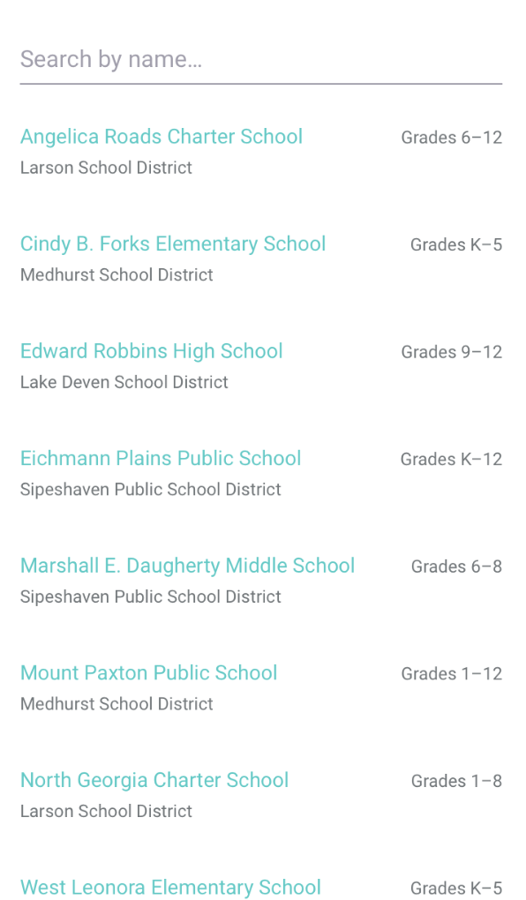
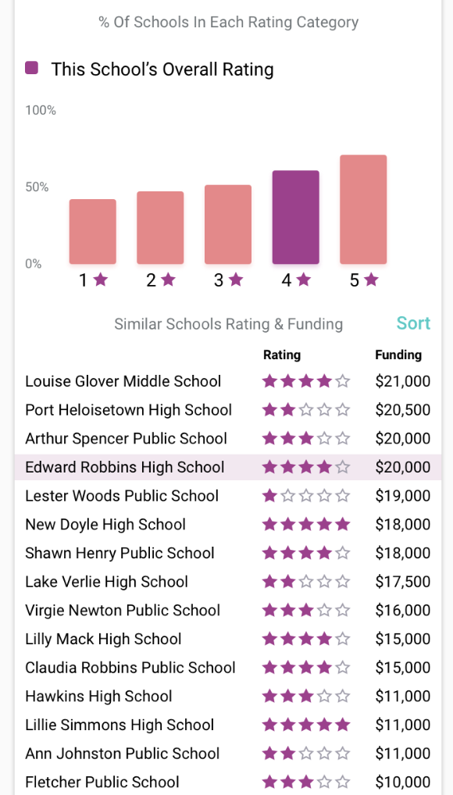
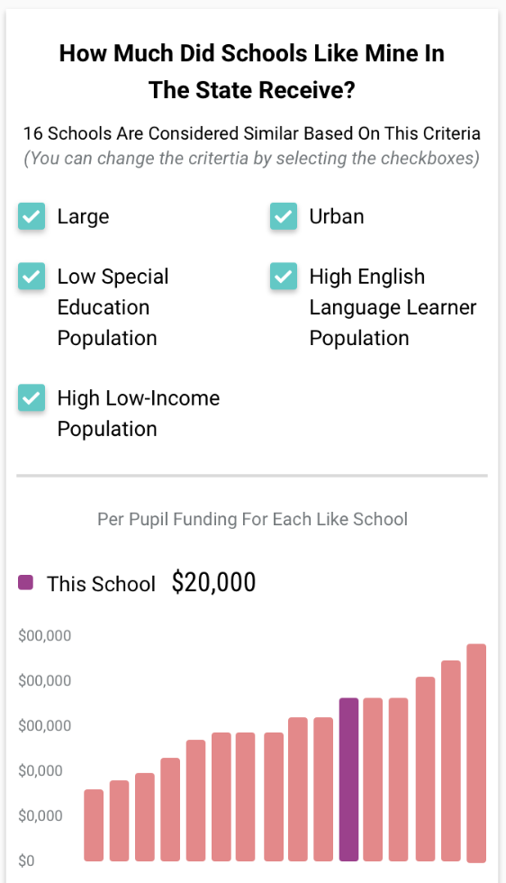
Matches performance with spending (auto-selects comparison schools)
Does not allow for within district comparisons. Limited data available on any one screen.
Starts by user selecting one school at a time

Slide 15
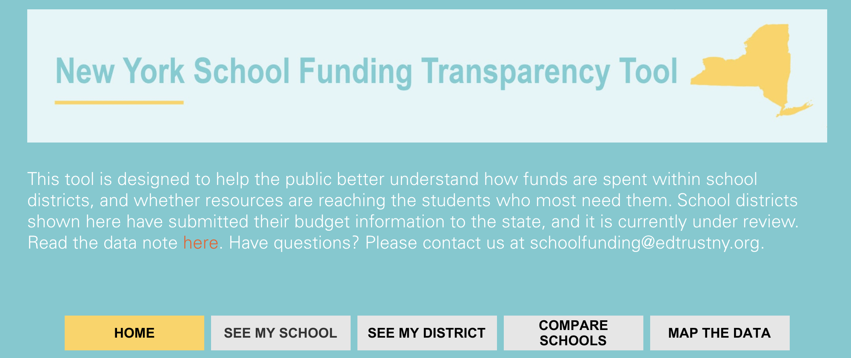
EdTrust New York: Advocacy tool
What: Equity
Who: Multiple
How: Compare spending across schools in district to advocate for equitable distribution
Some info on outcomes but user has to navigate numerous screens
©2018 Edunomics Lab, Georgetown University

Slide 16
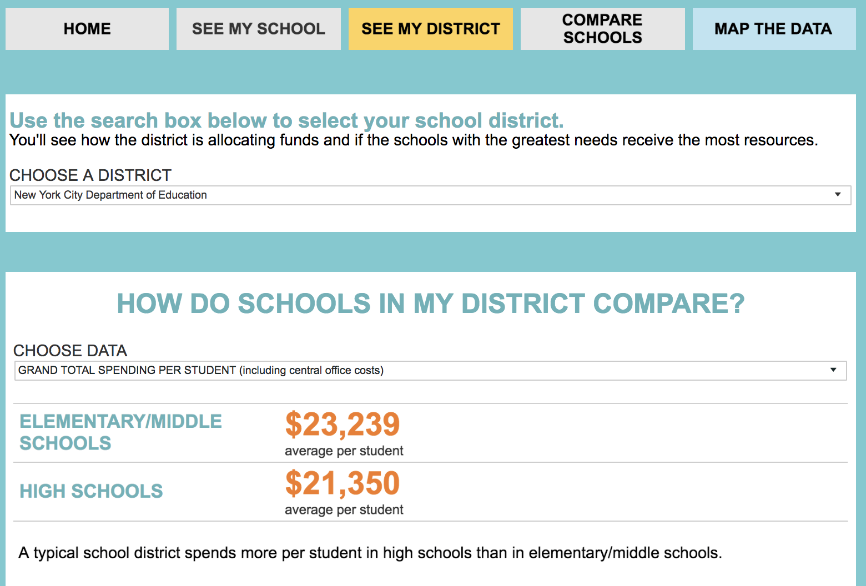
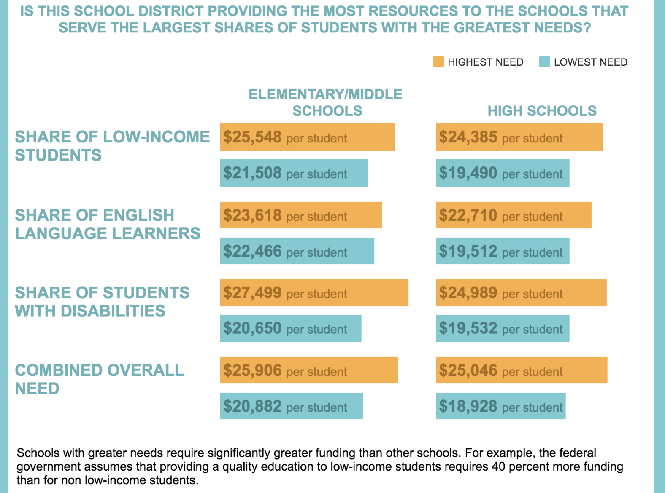
District user: Allows quick comparison of spending in high need to low need schools.
On average, does this district spend more on highest need schools?

Slide 17
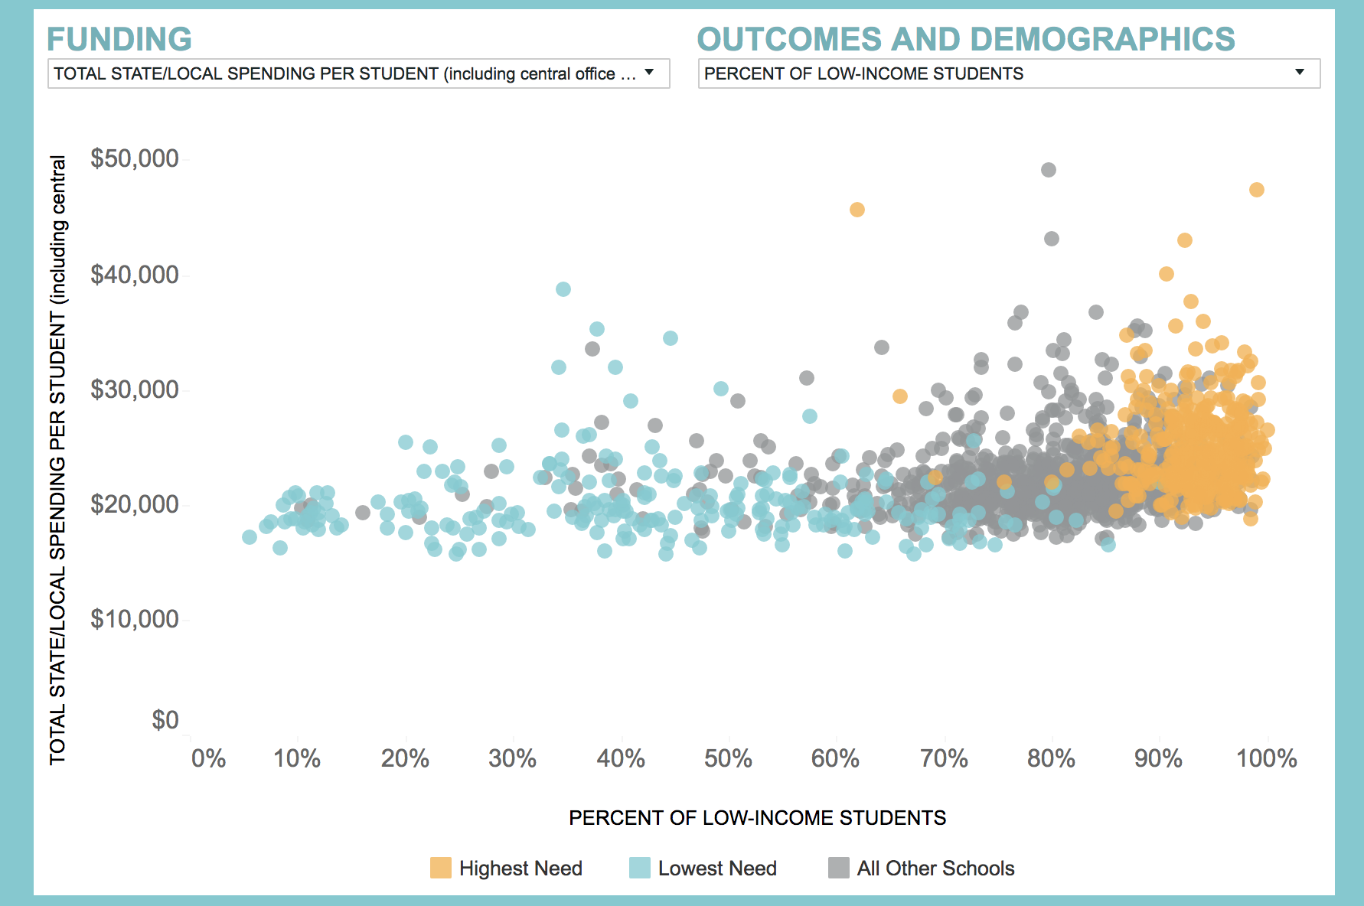
District user: quick view of spending and poverty across all schools – for equity

Slide 18
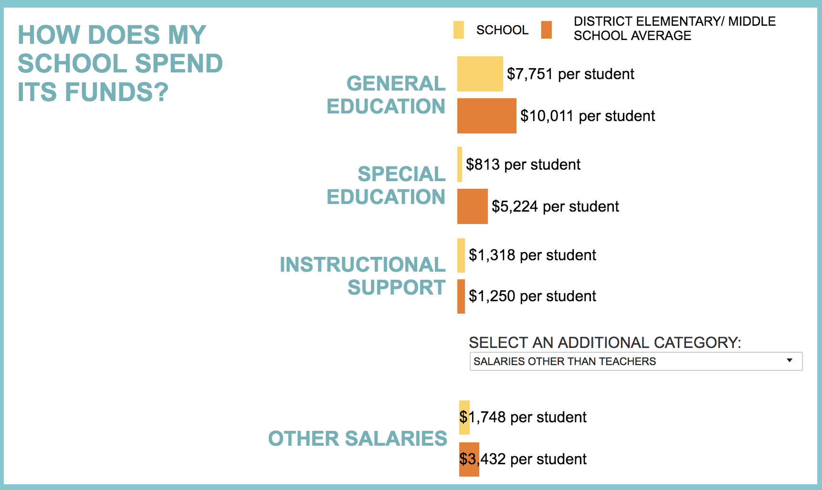
Principal/parent user–does my school spend more/less than district average?

Slide 19
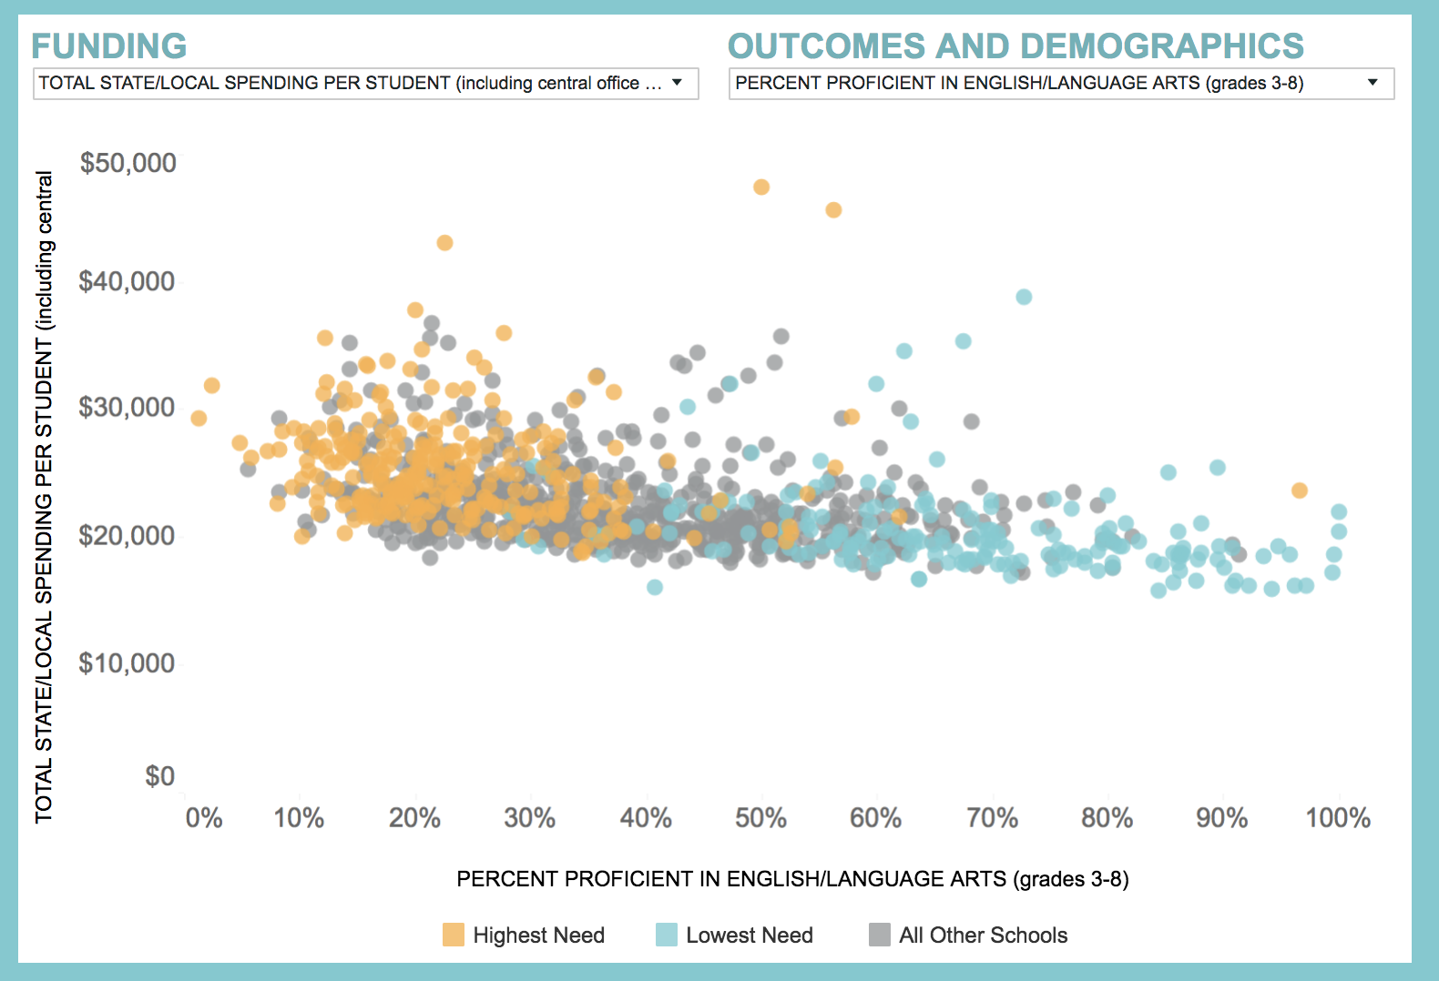
District user: comprehensive view of spending and outcomes

Slide 20


FiTWiG Supporters
Next virtual FiTWiG meeting: October 9, 2018, 1-2pm ET
Potential future topics:
Resource allocation reviews
What to do when advocacy groups get the data?
State legislation impacting FT reporting
Other?
Other upcoming FT webinars:
BSCP Center Visualization Webinar (same content as today)
September 27, 1-2pm ET
Invite vendors & advocates
U.S. Department of Education-sponsored Peer-to-Peer with Mike Wiltfong from Oregon
Date & time TBD
©2018 Edunomics Lab, Georgetown University

