Slide 1

Tracking State Progress
November 19, 2018
©2018 Edunomics Lab, Georgetown University

Slide 2

Still waiting on that rumored guidance…
©2018 Edunomics Lab, Georgetown University

Slide 3

But the Department did release a parent guide, and it mentions school level spending
https://www2.ed.gov/policy/elsec/leg/essa/parent-guide-state-local-report-cards.pdf
©2018 Edunomics Lab, Georgetown University

Slide 4
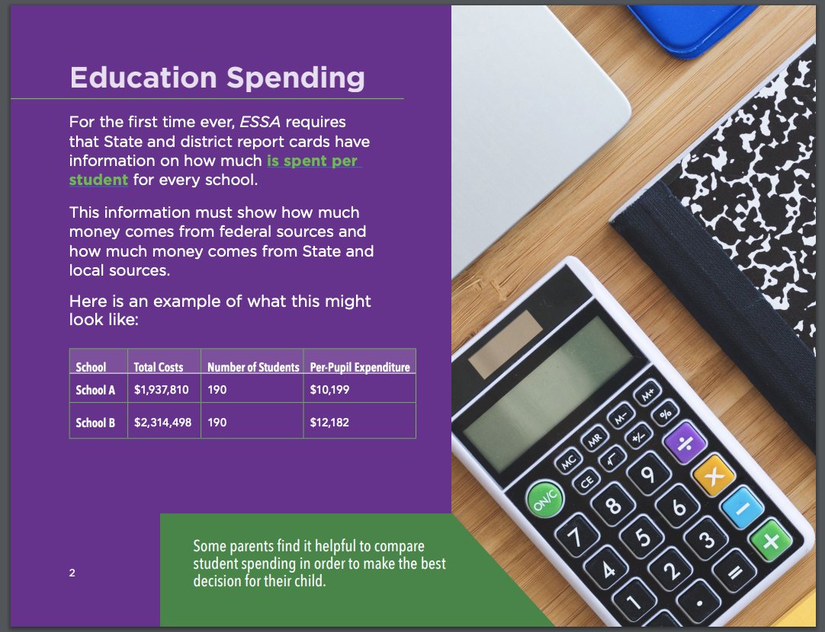
Dept alerting groups that school by school PPE is coming.
Simplistic guide provides no new information.

Slide 5
Main conclusion from the U.S. DoE Report Card Challenge…
Developing a school by school PPE display is HARD!
Tension between including all financial data that a state can access, as opposed to thinking about how data would be used
Groups tended to forget about including contextual data (performance, subgroup enrollment)
©2018 Edunomics Lab, Georgetown University
Notes:
Mention only 2 teams of 12 attempted

Slide 6
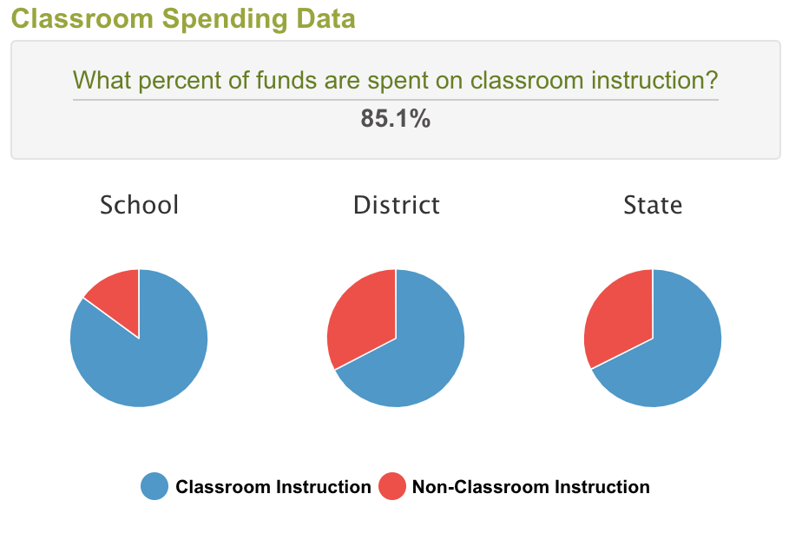
Age old question
Is the goal of the report to show:
HOW MUCH money was spent on each school
On WHAT was the money was spent (inst. vs admin, salaries, etc.)
OR
$12,811 pp Ash Elem
$11,029 pp Oak Elem
Required by law
Can connect to performance
Not required by law
For your reports, which will be the focus? (A, B, or both?)

Slide 7
Increasingly hearing parents are less interested in finance data
WHAT do you hope they’ll do with it?
WHO do you hope will use the info?
HOW will that happen?
(no really: How exactly?)
Parents
Advocacy
Principals
District Leaders
Seek improved equity across district schools.
Seek improved outcomes for the dollar (relative to meaningful peers).
Improve participation in allocation
Other?
Agnostic?
©2018 Edunomics Lab, Georgetown University

Slide 8
Tracking state efforts
Live tracker available at link below:
https://docs.google.com/spreadsheets/d/1NmDTHq3cFcj3rC51_bD4Vv7knahTzNPzxcC77BtrBD8/edit?usp=sharing
©2018 Edunomics Lab, Georgetown University

Slide 9
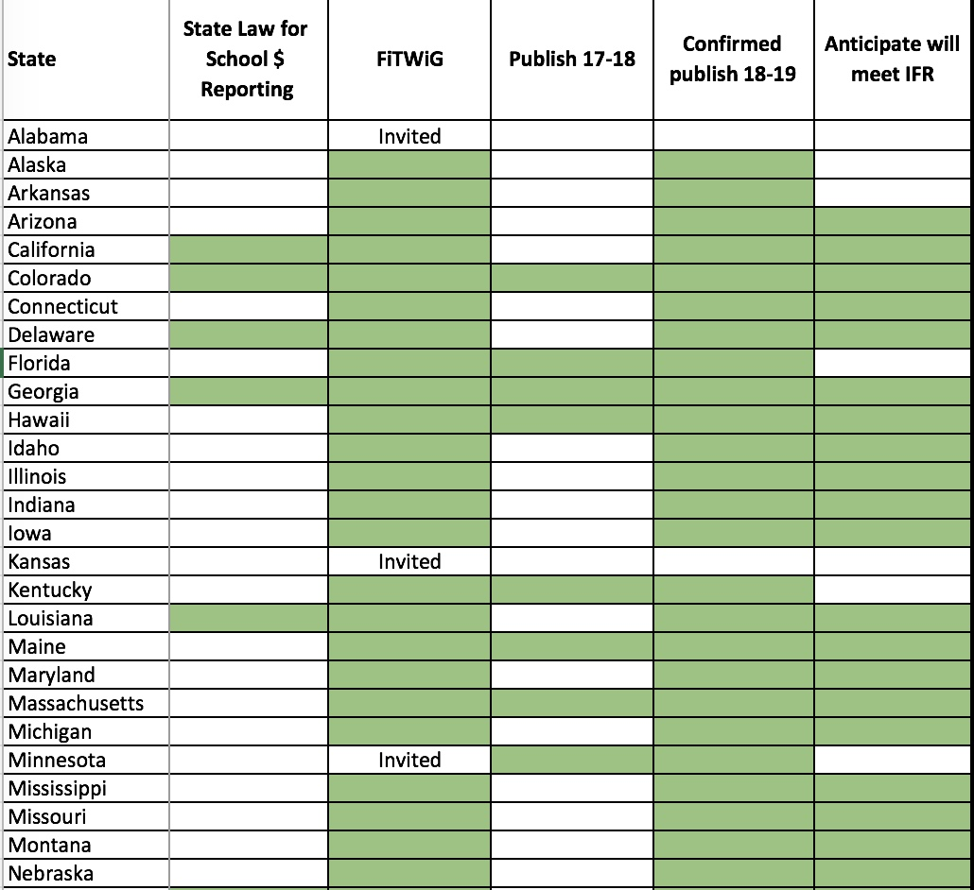
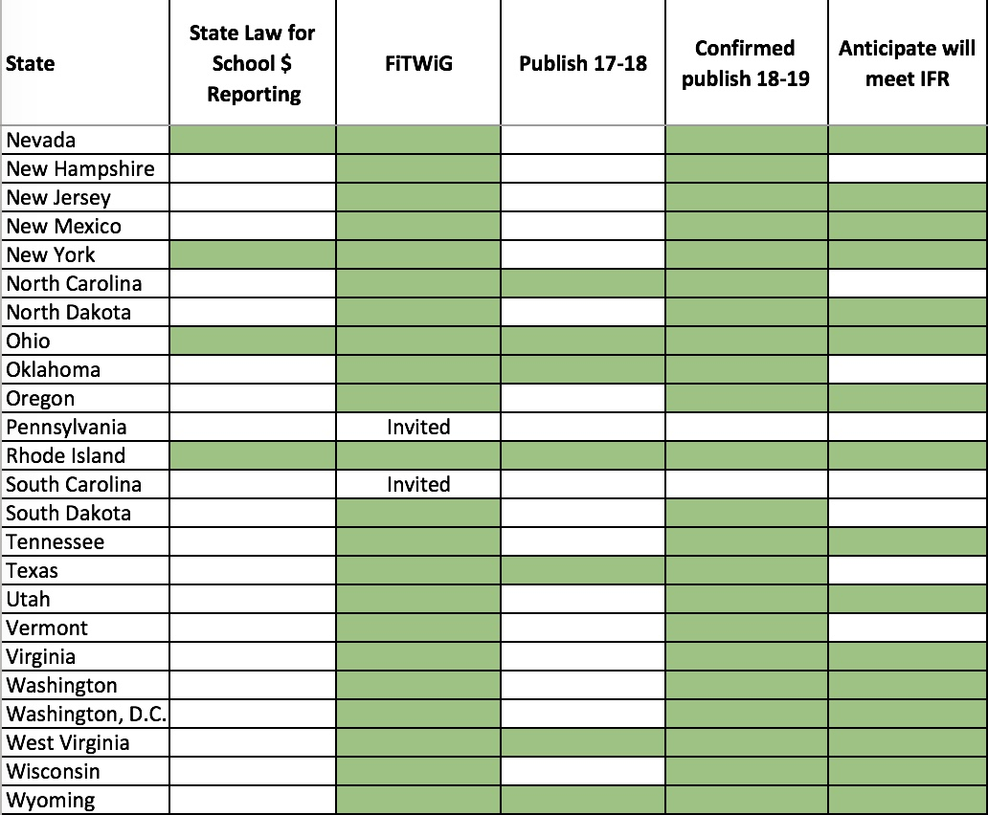
Use chat box to share any updates.

Slide 10
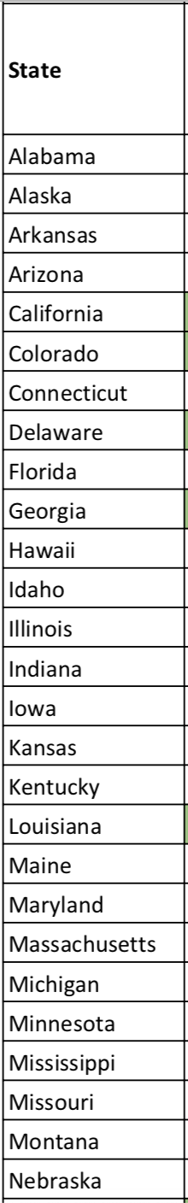
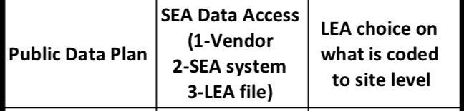
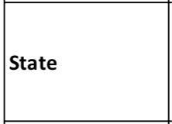
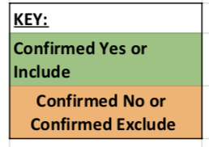
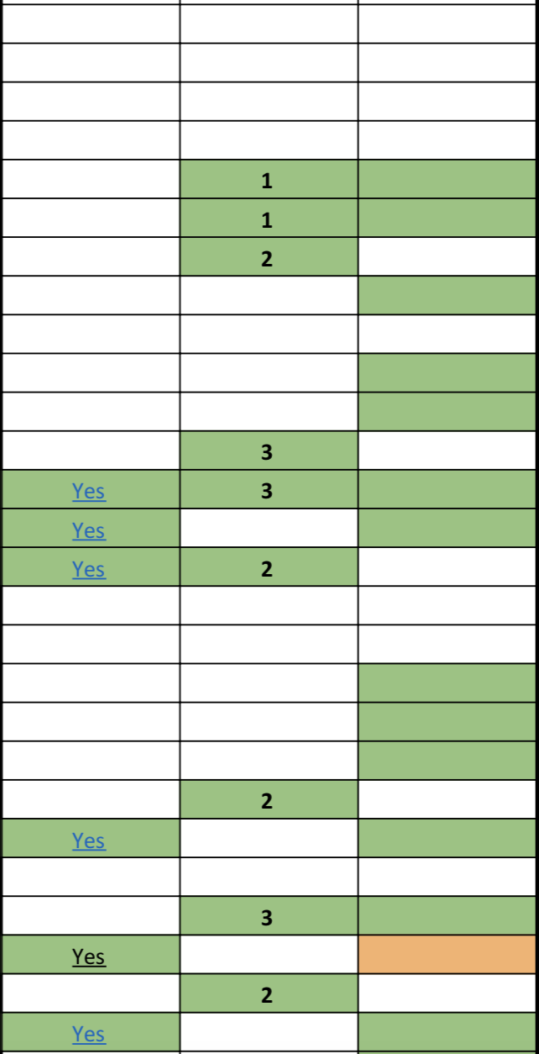
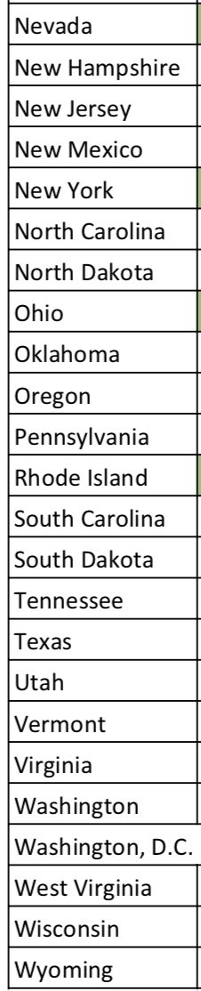
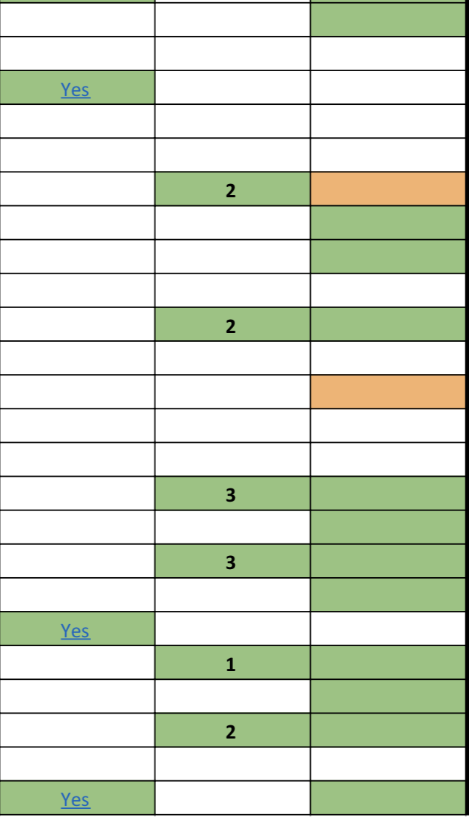
Use chat box to share any updates.

Slide 11
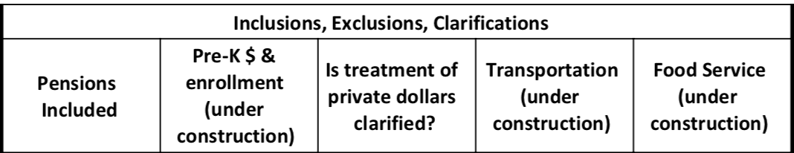
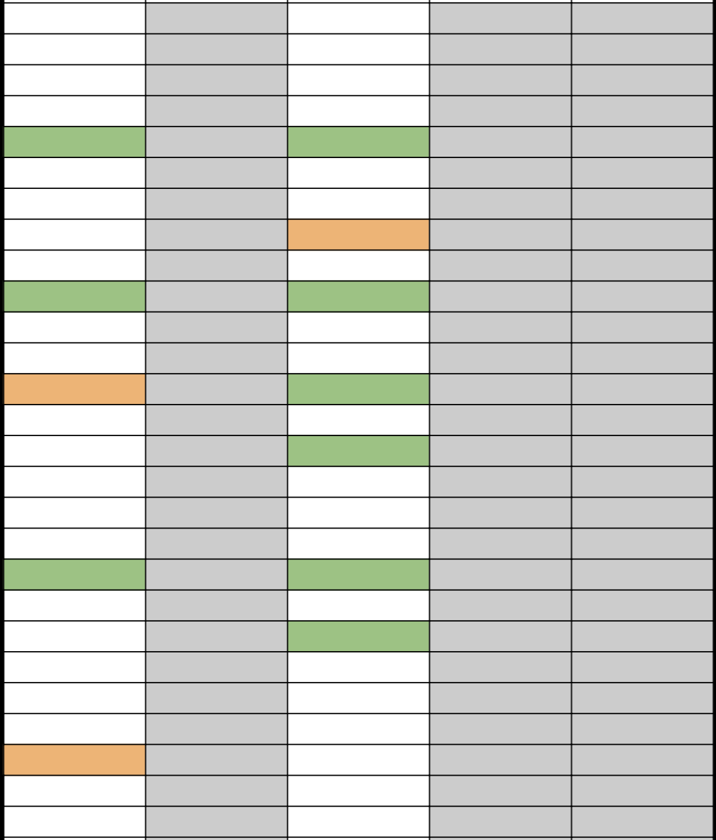
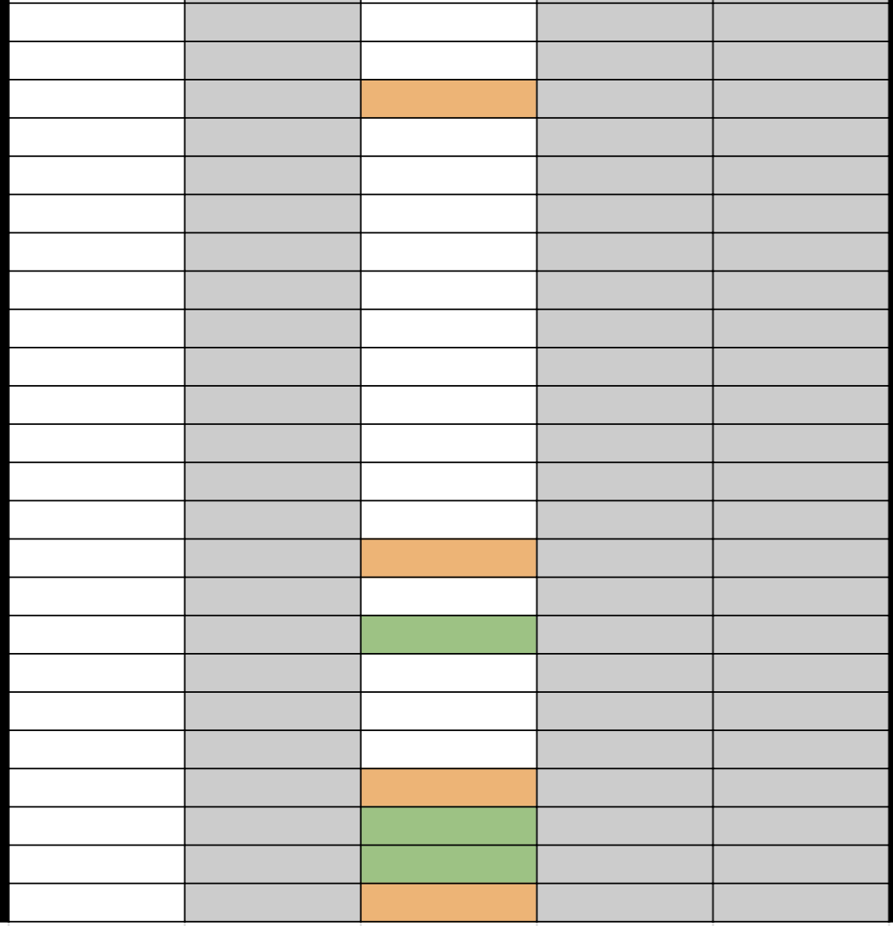
We did not start tracking pre-k, transportation or food service yet. Use chat box to share an update.
Include pre-K money and students or exclude both

Slide 12
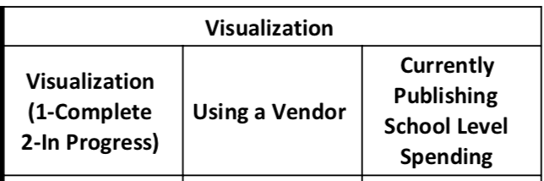
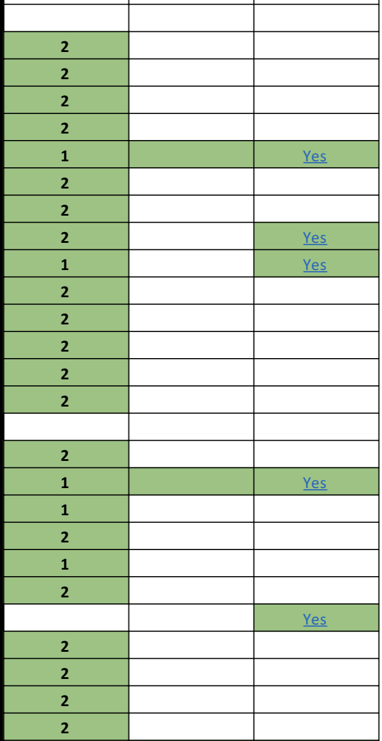
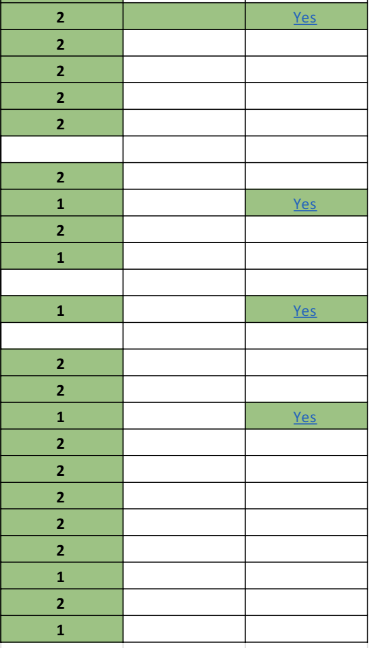
Use chat box to share any updates.

Slide 13
Tracking state efforts
Live tracker available at link below:
https://docs.google.com/spreadsheets/d/1NmDTHq3cFcj3rC51_bD4Vv7knahTzNPzxcC77BtrBD8/edit?usp=sharing
What else would you like tracked?
©2018 Edunomics Lab, Georgetown University

Slide 14
State Chiefs want an update – here are some tips we’ve shared before:
ESSA requires school-level financials (something we’ve never reported before) starting 2018-19.
LEA leaders have received X (data plans, FAQs, etc.).
Data will emerge late 2019/early 2020.
Many LEAs are anxious. (SEA confirms these data are not for accountability purposes).
Data can be used for system improvement when combined in a visualization with outcomes (a good thing… we’re working on this).
Advocacy groups are watching for equity.
Districts can/should embrace local dialogue about their numbers.
Might be a good time to check what finance training our state requires for school boards, administrators, and principals.
©2018 Edunomics Lab, Georgetown University

Slide 15
Any questions from NCES SLFS webinar last week (Thursday)?
©2018 Edunomics Lab, Georgetown University

Slide 16
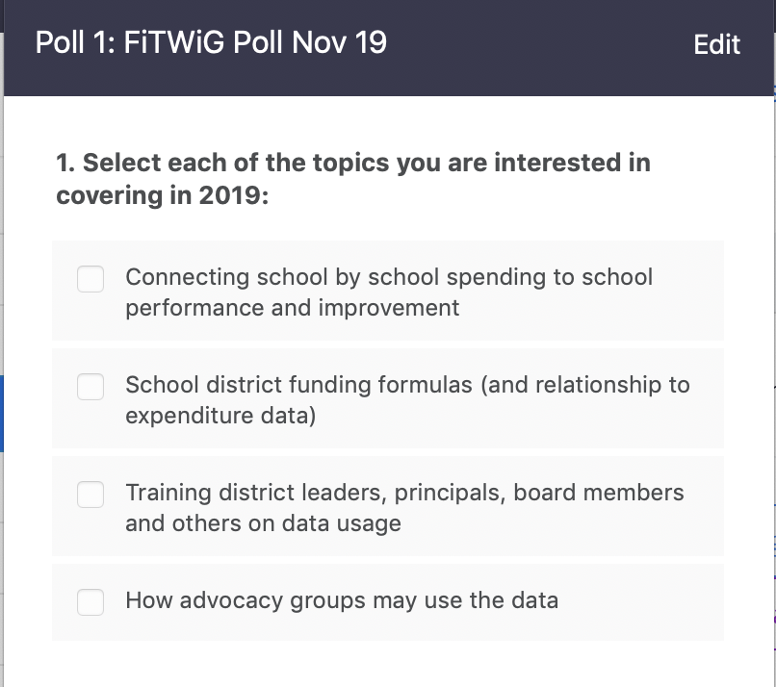
Looking Ahead Poll: FiTWiG in 2019
Use chat box to suggest other topics you’d like covered.
©2018 Edunomics Lab, Georgetown University
Notes:
Topics voiced in Feb 2018 not yet covered:
Connecting school level finance data to other efforts:
School improvement (student performance, productivity)
District funding formulas
Training district leaders, school leaders, board members on data usage, how to react once data are public, etc.
How advocacy groups may use the data (and how to prepare)

Slide 17


FiTWiG Supporters
Next virtual FiTWiG meeting: December 12, 2018 from 1-2pm ET
Reminder: Georgetown Certificate of Ed Finance cohorts:
- Boston Nov. 28-29
- Austin Jan 31-Feb 1.
©2018 Edunomics Lab, Georgetown University

