Slide 1
The Smart Money: Designing a School Budget to Get the Most for Your School Dollar
Dr. Marguerite Roza
Georgetown University

Slide 2
What’s spent per pupil on the students in your school?
What is the current average expenditure per student in US public education?
Is it more or less than what this country spends on defense?
Do traditional salary schedules favor teachers in certain subjects?
Would teachers prefer smaller classes or higher salaries?

Slide 3
What do you prefer? (survey of teachers by Goldhaber & DeArmond)
$5K bonus or 2 fewer students in
each class you teach
83%
$5K bonus or 1/5 of an aide
88%
$5K bonus or 3.5 hours more prep
time per week
69%

Slide 4
What’s spent per pupil on the students in your school?
What is the current average expenditure per student in US public education?
Is it more or less than what this country spends on defense?
Do traditional salary schedules favor teachers in certain subjects?
Would teachers prefer smaller classes or higher salaries?
At what size do schools maximize economies of scale?
If a school purchases Spanish software at $100 per student, what happens to the cost of Spanish per pupil at that school?
T or F: School budgets are mostly fixed costs.
Who earns more per week: teacher or accountant?

Slide 5
Shorter work year drives up teacher benefit costs per week
Per year

Slide 6
Shorter work year drives up teacher benefit costs per week
Per year
Per week

Slide 7
Pay well for good people and keep costs in check
  Strategy 1: Keep an eye on total staff counts.
  Strategy 2: Offer extra work to existing staff as a way to raise pay. (Think Stipends!)
  Strategy 3: Consider per-head costs of benefits and let staff choose between benefits and cash.
  Strategy 4: Cover substitutes internally and share savings with staff.
  Strategy 5: Rethink salary schedules.

Slide 8
Fundamental Tradeoff:
Total Comp
# Adults

Slide 9
Pay well for good people and keep costs in check
  Strategy 1: Keep an eye on total staff counts.
  Strategy 2: Offer extra work to existing staff as a way to raise pay. (Think Stipends!)
  Strategy 3: Consider per-head costs of benefits and let staff choose between benefits and cash.
  Strategy 4: Cover substitutes internally and share savings with staff.
  Strategy 5: Rethink salary schedules.

Slide 10
Leverage limited programming funds to do the most for students
  Strategy 1: Offset small classes with larger ones.
  Strategy 2: Rethink frequency – parents value small sizes, but don’t question the
  Strategy 3: Consider non-traditional providers or partnerships.
  Strategy 4: Leverage learning labs (or other lower-cost offsets).
  Strategy 5: Customize by allowing students to opt out of redundant requirements.

Slide 11
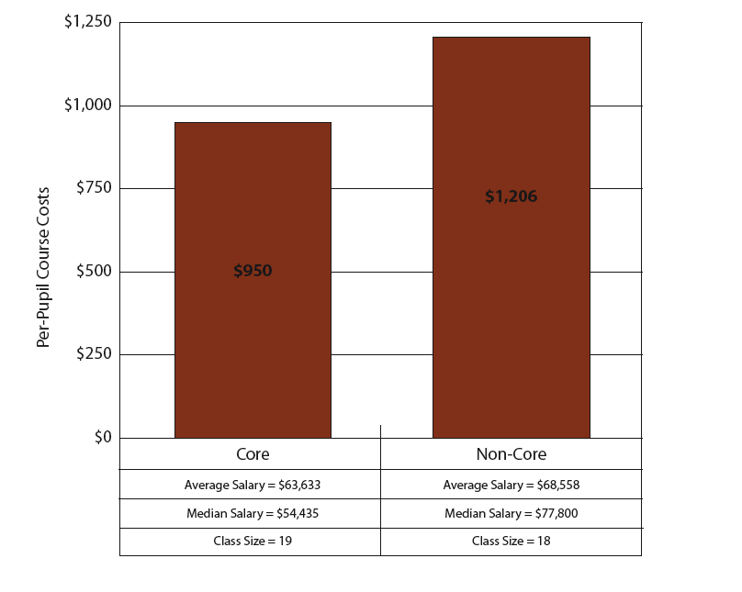
Per-Pupil Costs by Course Type

Slide 12
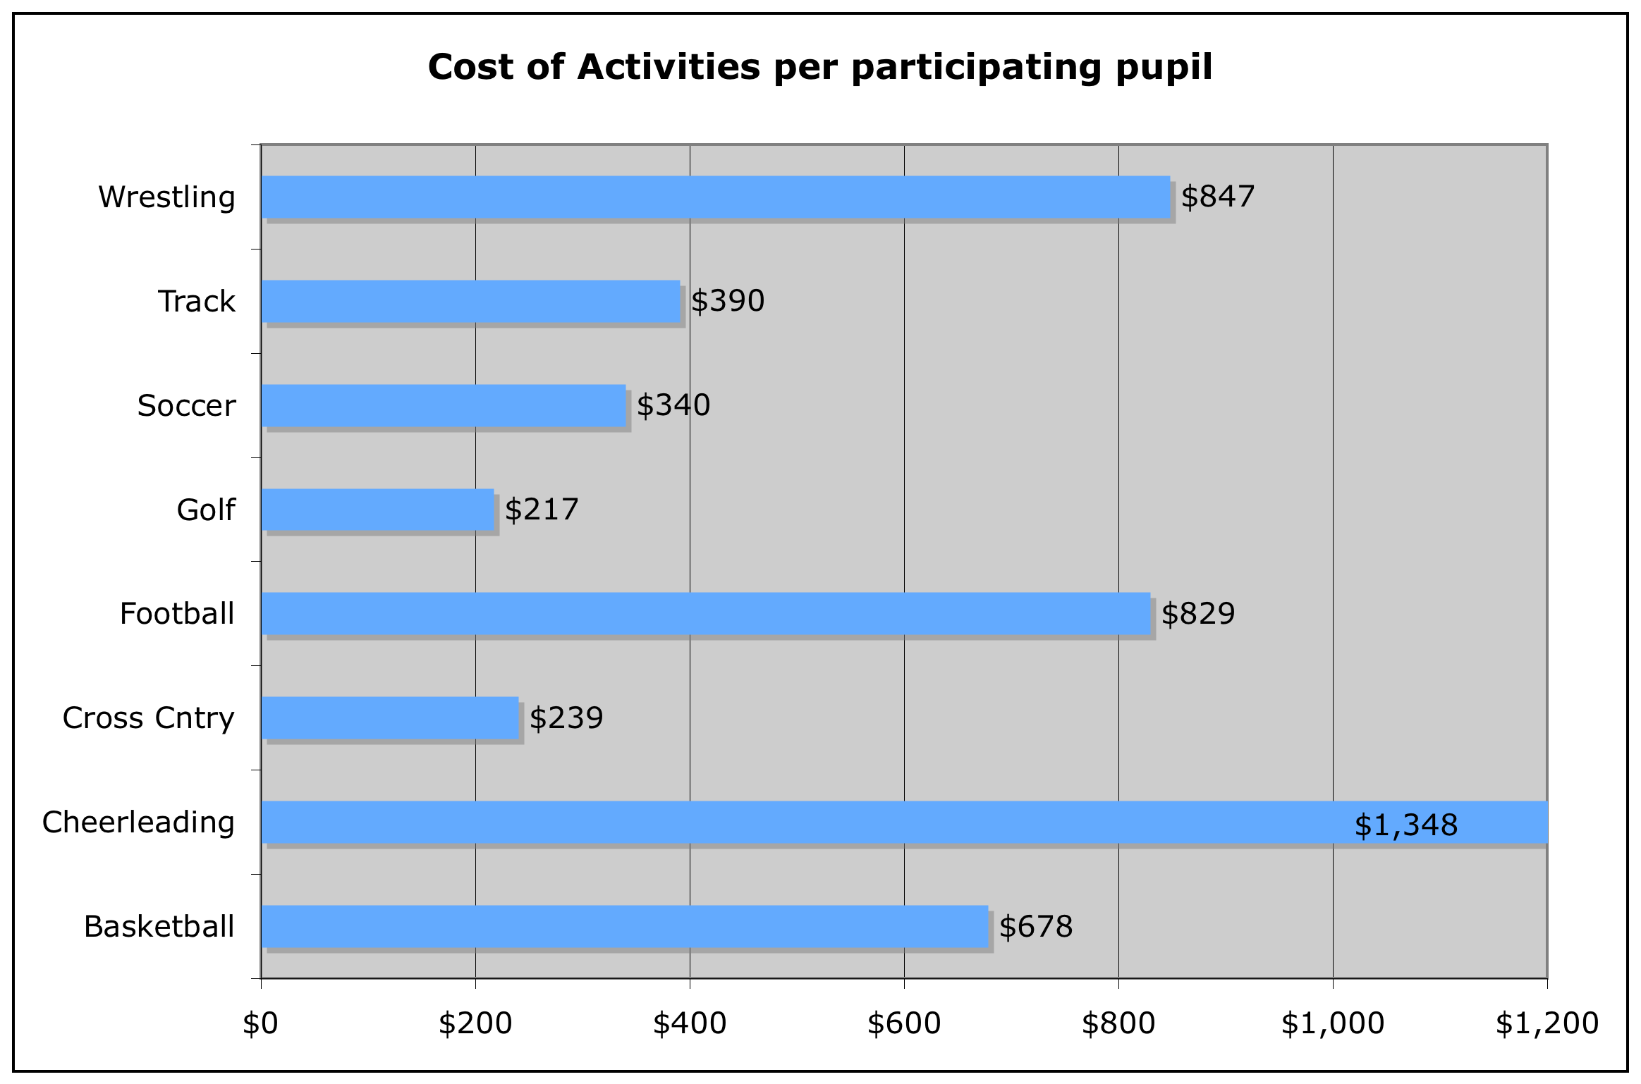

Slide 13
3 Teachers teach 4 Classes, with Learning Lab

Slide 14
Toward better messaging:
All financial communication should reference students (and what XX will do to improve student outcomes).
Parents/communities respond better to info from their principals. Email works best. Prefer short bullet points to communicate finance concepts.
Teachers want to hear directly from their principals in a format that allows for them to weigh in.
Rather than reference “consultant” expertise, better to refer to guidance from “experts” or “academics”. Even then, learnings much acknowledge local context to be trusted.
Parents and teachers will accept cuts (or reallocations) if they understand the tradeoff: “By raising class sizes, we are able to pay for xx”.
Based off opinion research conducted by Winston Group

Slide 15
Don’t say:
Reallocation
Efficiency
Do more with less
Describe a cut without explaining what else is done to support students.
“We were told we had to…”
Do say:
Leveraging dollars to do more for students.
Link discussion to STUDENTS at every turn.
What the tradeoff is: “we could have done XX or YY and we chose YY because it helps us do ZZ for students.
Spending smarter
Communicate with $ amounts
We have the flexibility to make tradeoffs that meet the needs of our students.
Do any of you do training for principals in communicating re finance?
Based off opinion research conducted by Winston Group

Slide 16
For more information, contact
Marguerite Roza
at mr1170@georgetown.edu

