Slide 1

7 Equity Analyses Districts Can Do Now
(to prepare for school-level financial transparency)
June 19, 2018
©2018 Edunomics Lab, Georgetown University

Slide 2
Agenda
CCSSO Handbook update
Equity analysis districts can do now.
©2018 Edunomics Lab, Georgetown University

Slide 3
CCSSO Handbook
Distributed to CIOs, CAOs, and communication officers
P. 91-92 = inaccurate template for per-pupil spending
CCSSO redacted and re-issued the handbook with correction
Available via internal communication channels (not public online), but we can share it if you would like it
©2018 Edunomics Lab, Georgetown University

Slide 4
7 Equity Analyses
Districts Can Do Now
©2018 Edunomics Lab, Georgetown University

Slide 5
Why might districts run equity analyses now?
Identify patterns and share with leaders, school board, etc.
Understand factors driving inequities
Media/Advocacy groups likely to run these analyses once data is available
=> Some districts may opt to reallocate in 19-20 budget (possibly remedying some inequities)
©2018 Edunomics Lab, Georgetown University

Slide 6
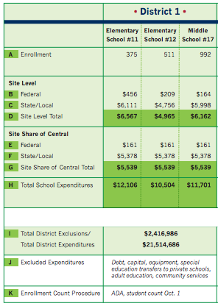
Start with basic info, including what is needed for IFR.
Organize by student demographics, salaries
Compare PPE across schools and groups of schools
©2018 Edunomics Lab, Georgetown University

Slide 7
Seven equity analyses:
Basic premise: If the district allocates more to one school, there is less money for others.
Which schools are outliers? Array schools from lowest to highest state/local PPE. On which school does the district spend the most per pupil (in state/local funds)? Least per pupil? Why? (E.g. what is driving the difference?). Does PPE at any school stand out as unexpected?
How does school level matter? Group schools by level. Does the district spend more on elementary, middle, or high schools? Why?
Do poor/minority students get their share? Group schools by percent poverty and/or percent minority. Among elementary schools, does the district allocate the less/same/or more of its state/local dollars to its schools with more students in poverty? More students of color? Why? How about across middle and high schools? Note that federal funds are intended to be layered on top of an equitable allocation of state/local funds.
Does the district spend fairly across regions or school types? If the district has any obvious regions or school types, is spending fair across regions?
Are uneven teacher salaries a concerning factor? Do teacher salary differences drive any of the patterns identified in #3?
How much is managed centrally? What percentage of an average school’s resources is attributed to the site’s share of central? Does that seem high?
Does size matter? Does the district spend more/less on smaller schools? Why?
©2018 Edunomics Lab, Georgetown University

Slide 8
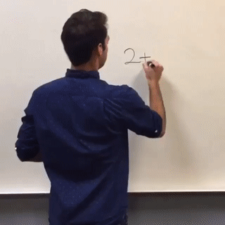
They start out fairly simple…

Slide 9
Note: The following are real examples documented in various districts over the years. They do not represent national averages. In practice, the patterns in each district will vary and in many cases, analysis will not reveal inequities at all.
©2018 Edunomics Lab, Georgetown University

Slide 10
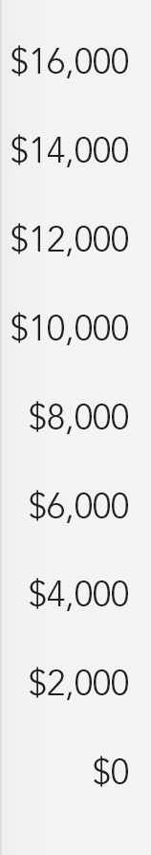
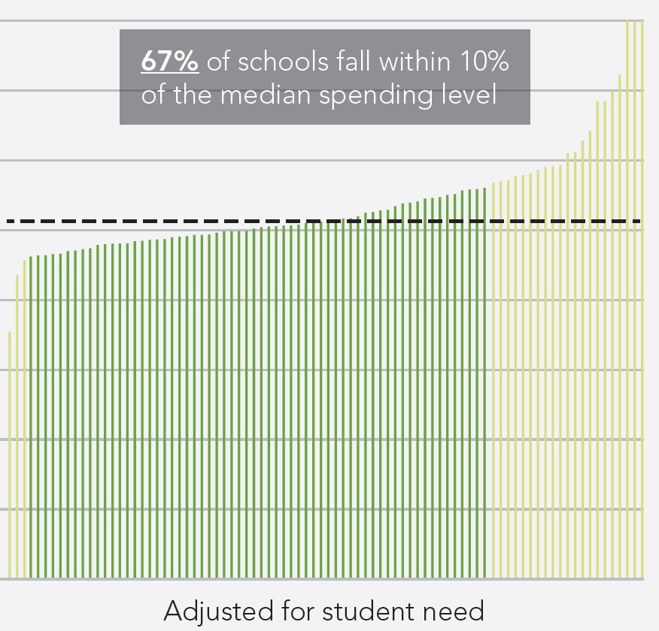
1. Which schools are outliers? Array schools from lowest to highest state/local PPE. On which school does the district spend the most per pupil (in state/local funds)? Least per pupil? Why? (E.g. what is driving the difference?). Does PPE at any school stand out as unexpected?
Example from: Informing Equity: Student Need, Spending, and Resource Use in Oakland Public Schools, Education Resource Strategies and Oakland Achieves, 2017.
©2018 Edunomics Lab, Georgetown University

Slide 11
2. Does school level matter?
Group schools by level. Does the district spend more on elementary, middle, or high schools? Why?
Example from a Mississippi district, computations by Edunomics Lab.
HS = $9,740
Elem. Schools Avg = $7,509
MS = $6,939
©2018 Edunomics Lab, Georgetown University

Slide 12
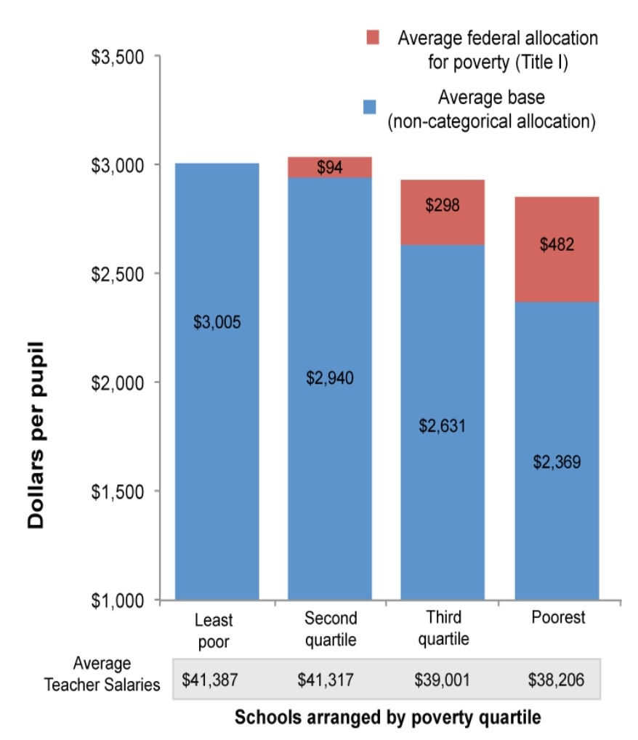
3. Do poor/minority students get their share? Group schools by percent poverty and/or percent minority. Among elementary schools, does the district allocate the less/same/or more of its state/local dollars to its schools with more students in poverty? More students of color? Why? How about across middle and high schools? Note that federal funds are intended to be layered on top of an equitable allocation of state/local funds.
Example from Beyond teacher Reassignments. Better Ways Teachers Can Remedy Salary Inequities Across Schools, Roza and Yatsko, 2010.
Comparison of school level funds in Austin ISD, 2004, arrayed by poverty quartile.
©2018 Edunomics Lab, Georgetown University

Slide 13
3. (cont.) Do poor/minority students get their share?
Example from a California district, computations by Edunomics Lab.
%FRL = 10%
Avg = $9,884
%FRL = 86%
Avg = $10,240
©2018 Edunomics Lab, Georgetown University

Slide 14
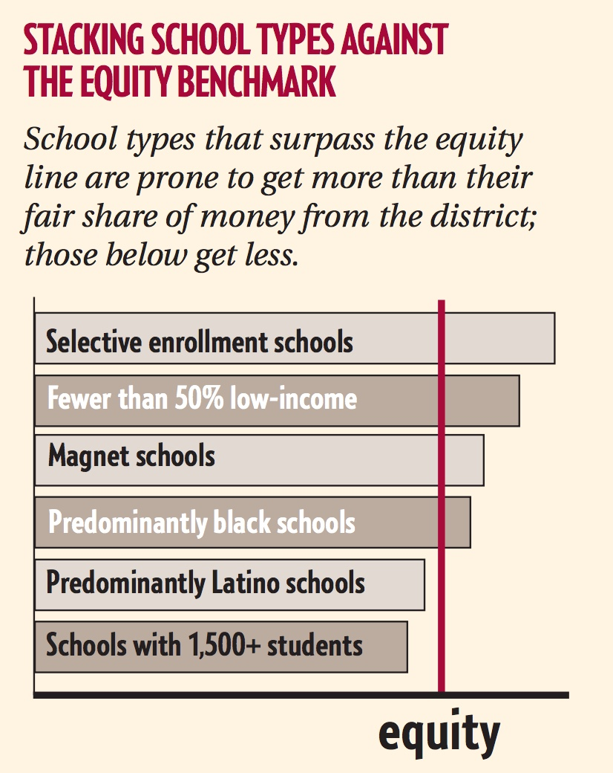
4. Does the district spend fairly across regions or school types? If the district has any obvious regions or school types, is spending fair across groups?
Example from Catalyst Chicago: How much is this child worth? Feb. 2005.
Lakefront schools
©2018 Edunomics Lab, Georgetown University

Slide 15
5. Are uneven teacher salaries a concerning factor? Do teacher salary differences drive any of the patterns identified in #3?
Example from Beyond teacher Reassignments. Better Ways Teachers Can Remedy Salary Inequities Across Schools, Roza and Yatsko, 2010.
Comparison of school level funds in Austin ISD, 2004.
©2018 Edunomics Lab, Georgetown University

Slide 16
6. How much is managed centrally? What percentage of an average school’s resources is attributed to the site’s share of central? Does that seem high?
Examples from a MS district and a CA district, computations by Edunomics Lab.
Central Avg = 53%
Central avg = 23%
©2018 Edunomics Lab, Georgetown University

Slide 17
This district spends about $800 pp more on smaller elementary schools.
7. Does size matter?
Why?
Example from a California district, computations by Edunomics Lab.
< 400 students Avg = $10,707
> 700 students
Avg = $9,848

Slide 18



FiTWiG Supporters
Next virtual meeting: July 16, 2018
Topic: TBD, but possibly office hours
We spaced out the FiTWiG meetings for the next month to allow for the capacity to support more one-on-ones, so please do take advantage of that and reach out to us as needed!
See you at STATS DC July 25-27!
©2018 Edunomics Lab, Georgetown University

