Slide 1

Resource Allocation Reviews: Part 2!
(See April 17, 2018 meeting for Part 1)
October 30, 2018
©2018 Edunomics Lab, Georgetown University

Slide 2

Need costume ideas?
©2018 Edunomics Lab, Georgetown University

Slide 3
Agenda
Rumor!
State question
Resource allocation reviews
©2018 Edunomics Lab, Georgetown University

Slide 4
Rumor has it…
Department of Education guidance on state report cards is coming... next week!
©2018 Edunomics Lab, Georgetown University

Slide 5
Equipment in school spending reporting
Are states including or excluding (or a mix) equipment in the per-pupil spending calculations? (Donna in Maryland)
If including, which equipment purchases are you including?
©2018 Edunomics Lab, Georgetown University

Slide 6
Checking in on resource allocation reviews
Does your state have a plan for resource allocation reviews?
  Yes
  No
  It’s in progress
  Not technically my job
  What’s a resource allocation review?
©2018 Edunomics Lab, Georgetown University

Slide 7
ESSA Language: Resource Allocation Reviews
In 2017-18, identify schools in need of improvement
Repeat at least every 3 years.
“(c)(4)(D)(i): establish a State-determined methodology to identify, beginning with school year 2017–2018, and at least once every three school years thereafter, one statewide category of schools for comprehensive support and improvement”
Select some schools for resource review from identified LEAs
SEA reviews “resource allocation” to support improvement
“periodically review resource allocation to support school improvement in each local educational agency in the State serving— (I) a significant number of schools identified for comprehensive support and improvement under subsection (c)(4)(D)(i); and (II) a significant number of schools implementing targeted support and improvement plans under paragraph (2)”
©2018 Edunomics Lab, Georgetown University

Slide 8
True/False
T/ F The law specifies equity as a goal of resource allocation reviews.
T/F The law specifies that some reallocation has to occur.
T/F The law says the goal is school improvement.
T/F The law specifies that resource allocation reviews must be done annually.
©2018 Edunomics Lab, Georgetown University

Slide 9
Connecting school spending to school improvement
Federal/Title I Directors
SEA finance offices & fiscal coordinators:
Ensuring school by school spending data is collected and reported
School Improvement and Turnaround offices: improving performance at high need and low performing schools
Who’s job is it to connect these efforts?
©2018 Edunomics Lab, Georgetown University

Slide 10
We read all your ESSA plans detailing the resource review process in your state, and….
States were asked:
Resource Allocation Review. Describe how the State will periodically review resource allocation to support school improvement in each LEA in the State serving a significant number or percentage of schools identified for comprehensive or targeted support and improvement.
Most said: SEA will look at data.
Then gave list of data.
©2018 Edunomics Lab, Georgetown University

Slide 11

Research shows: the act of looking at data for 2 hours causes students’ reading comprehension to go up by 20 percentile points.
?
©2018 Edunomics Lab, Georgetown University

Slide 12
Most existing ESSA plans:
List data (“resources”) that are to be reviewed
Most of those resources are inputs (what was bought, vs. “how much money spent on the school”)
Don’t explain what state will do once resource data are reviewed, but assume some sort of communication made to LEAs (Send in the suits?)
Assume: LEAs make some sort of change in “resource allocation”
Assume: schools will improve.
©2018 Edunomics Lab, Georgetown University

Slide 13
Potential SEA & LEA roles in RA reviews
Scenario 1: SEA assembles and views data, makes judgment (compares spending to peers, looks for inequity), advises/requires LEAs/schools to make specific changes.
Scenario 2: SEA assembles data for LEA/school, identifies issues, and requires that LEAs (and schools) address issues surfaced in a plan.
  Scenario 3: SEA assembles data, facilitates discussion with school and LEA to brainstorm solutions/barriers to better leveraging dollars. LEA/school develop a plan.
Others? Which do you imagine your SEA might do?
©2018 Edunomics Lab, Georgetown University

Slide 14
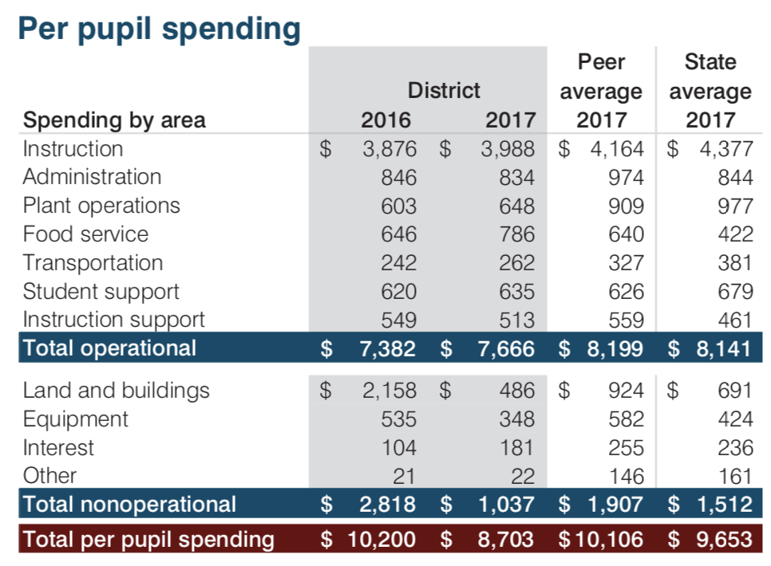
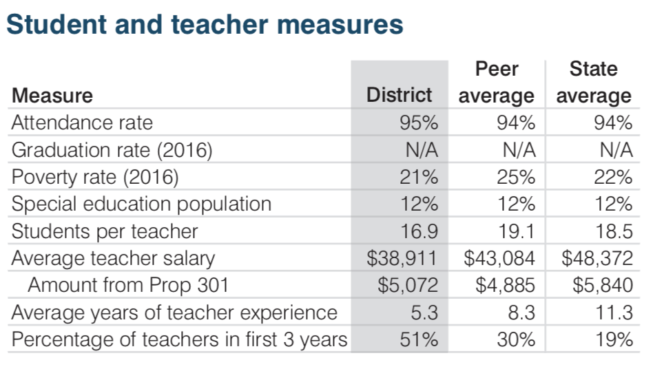
SEA views data & advises/requires changes
School
School
What issues would you surface?
©2018 Edunomics Lab, Georgetown University

Slide 15
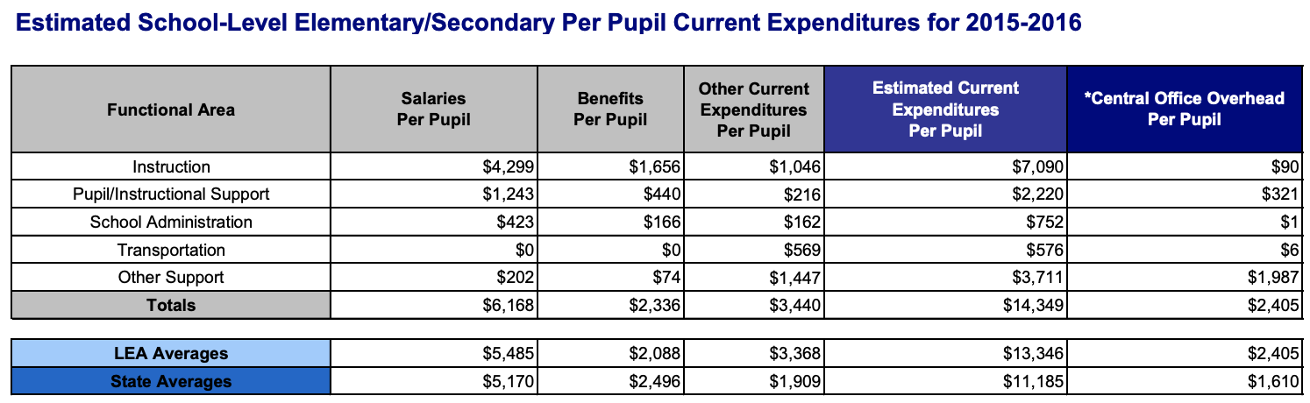
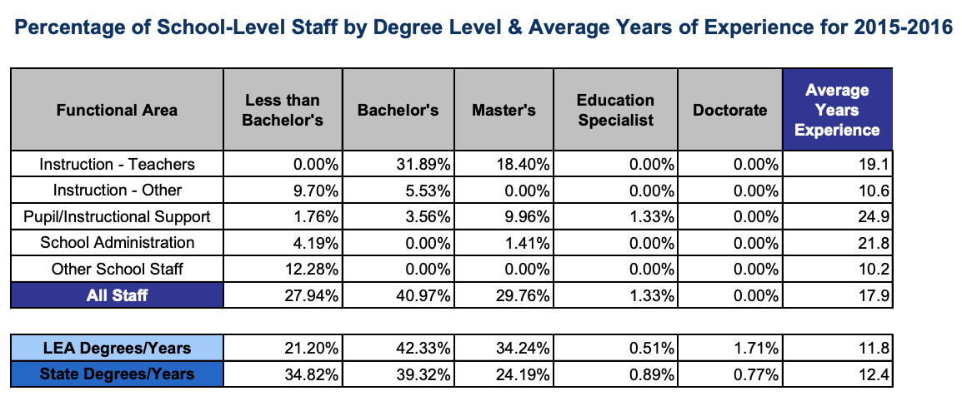
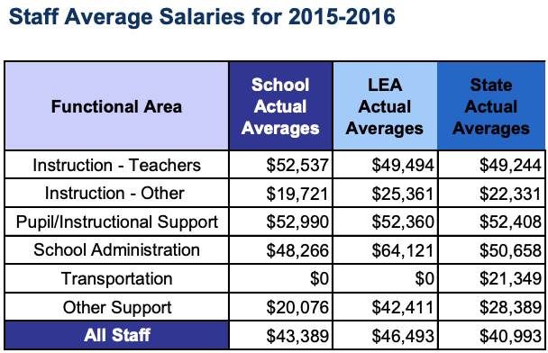
SEA assembles data, and requires LEAs address items in their plan.
What should be addressed?

Slide 16
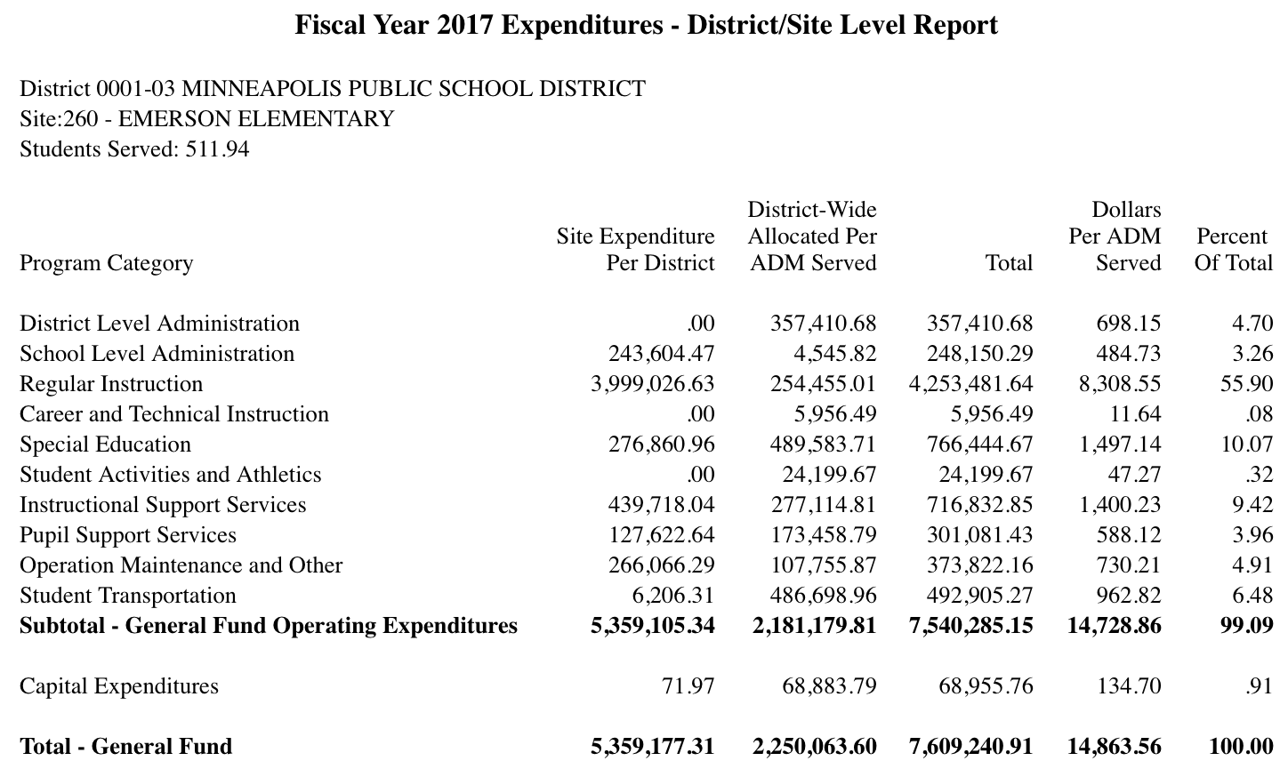
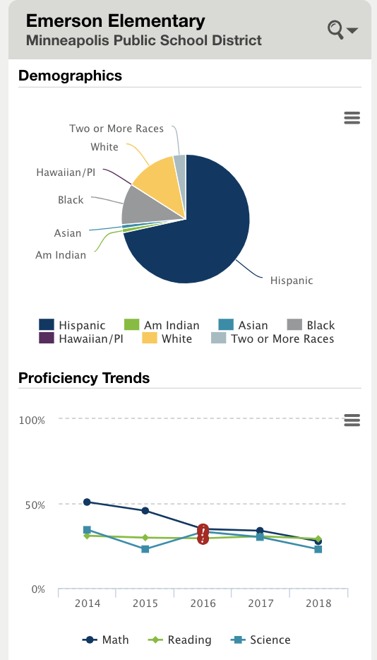
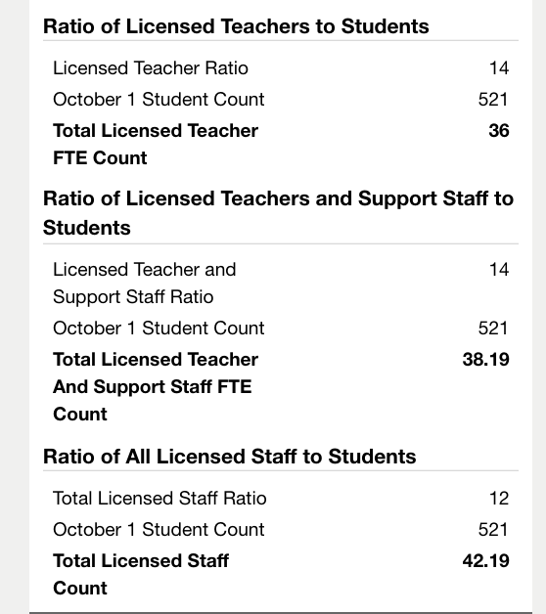
SEA facilitates discussion
What do you think they will talk about?
©2018 Edunomics Lab, Georgetown University

Slide 17
Resource Allocation Review Community of Practice
4-5 ‘Learning Cycles’
Requires ~2-3 hour commitment/month for meetings, plus independent work as state develops plans
Should include 2-3 people from each SEA
Ideal for 5-10 states wanting to dive deep into this effort and develop high quality plans
Let Katie know if you are interested
©2018 Edunomics Lab, Georgetown University

Slide 18


FiTWiG Supporters
Next virtual FiTWiG meeting: Nov 19th (MONDAY)
Potential future topics:
What to do when advocacy groups get the data?
State legislation impacting FT reporting
Key lessons for working with vendors
Other?
©2018 Edunomics Lab, Georgetown University

Slide 19
Older slides

Slide 20
What’s the goal?
2. What’s doable? (what’s your capacity to execute & enforce?)
3. Do you believe the plan will improve outcomes in the identified low-performing schools?
©2018 Edunomics Lab, Georgetown University

Slide 21
1. What is the goal?
Are we looking at inputs to see if a school spent its money on the “right” things? (And … gulp… do we think we know the “right” way to spend money to achieve desired outcome?)
Are we looking at school-level PPE to see if the district gave the school a fair share of its money? (If so, school-level financial data can help)
Are we engaging with the school/district to trigger their thinking about what needs to change and owning those outcomes? (Should there be a protocol that does this?)
Are you planning on dictating changes? Or letting
©2018 Edunomics Lab, Georgetown University

Slide 22
2. Is the plan doable (for the SEA)?
What capacity do you have?
Are you overcomplicating?
3. Do you truly believe your effort will improve outcomes in those schools?
©2018 Edunomics Lab, Georgetown University

Slide 23
What could a process look like that does some of each?
©2018 Edunomics Lab, Georgetown University

Slide 24
Question 1: Is the identified school making progress?
Data source: student performance over time
Yes!
Celebrate that school and the district.
Ask for their thoughts on what triggered the improvement so they can share with other schools.
No/Stagnant
Move on to question 2.
©2018 Edunomics Lab, Georgetown University

Slide 25
Question 2: Does the district give the school its share of funds for the students served?
Data source: school-level PPE relative to that for other schools in the district.
Yes!
Great. Share that finding with the district and school.
No – District is not giving school its share of funds.
Make district and school aware of finding.
©2018 Edunomics Lab, Georgetown University

Slide 26
Question 3: How do the spending choices of the identified school compare to similar schools with better performance?
Data source(s): spending by object/function, school demographics, school performance
Nothing looks out of whack
Spending appears out-of-whack
Prompts discussion, but does not prescribe solutions
Discuss: Use training protocol to engage the school leaders in spending/outcomes data and ask whether they believe the current mix of resources are working for their students or if they believe reallocation is needed.
©2018 Edunomics Lab, Georgetown University

Slide 27
Tips for developing plans:
NEW SLIDE
Involve LEAs early and often
Do a data inventory at SEA to determine the need for additional data collection (and to sort out the nice to haves from the need to haves)
You put a lot of work into this financial transparency data – use it if you can! (in combination with other data)
Trust local context & school leaders -- enable them to drive the change
Collaborate within your SEA (Office of School Improvement/Turnaround, teams working with low-performing districts)
Consider who will be involved at LEA level (which communities will have a voice)
(something here about being okay if the ‘step’ districts & schools take when a resource allocation review uncovers a flag is a tough conversation)
©2018 Edunomics Lab, Georgetown University

