Slide 1

Combined FiTWiG and SBA Network Meeting!
Interview with DoEd.
Burying Data?
Central Expenses.
March 3, 2020
Marguerite Roza, Liz Ross, Laura Anderson
©2019 Edunomics Lab, Georgetown University

Slide 2

Today’s episode is broadcast from the US epicenter of Covid-19…
Live from Seattle and we’re still smiling ☺

Slide 3

Agenda
Update on state release and interview with USED
Burying the data?
Fostering transparency, analysis and action
Resources

Slide 4
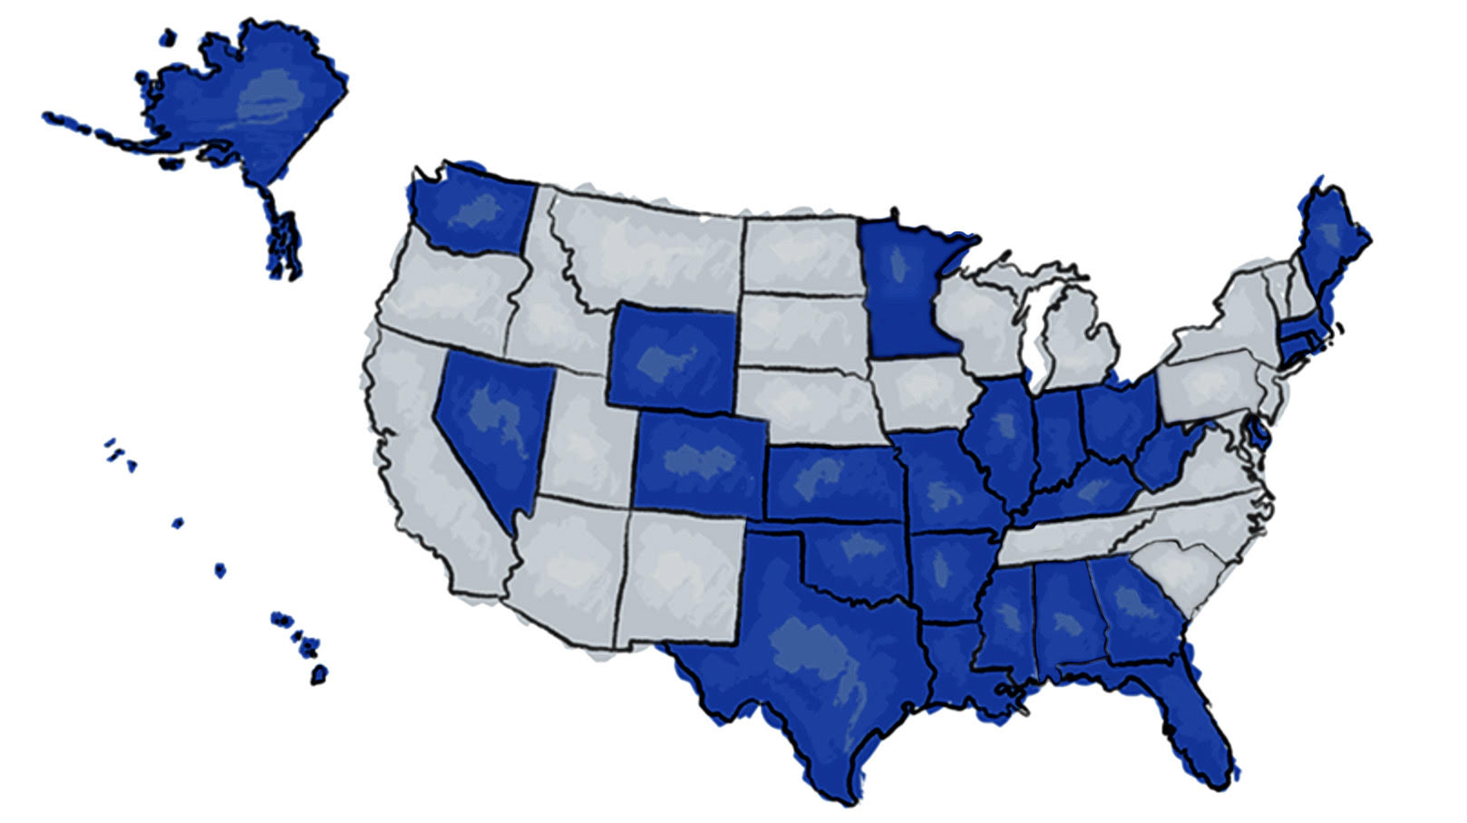
As of today 27 states released school-by-school spending data
Links to states’ school spending data
Resources for district leaders, principals and journalists
Developing a data archive of all state data
www.edunomicslab.org
SCHOOL SPENDING DATA HUB
©2019 Edunomics Lab, Georgetown University

Slide 5

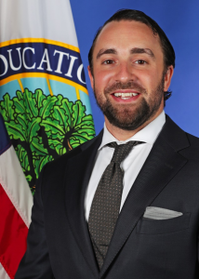
U.S. Department of Education
Jim Blew
Assistant Secretary for Planning, Evaluation, and Policy Development
Chris Rinkus
Deputy Assistant Secretary for Policy and Use of Evidence
Notes:
I would interview you and our goal for the meeting would be to:
a) emphasize how important these data are for districts (from a management perspective), acknowledge it is difficult, and thank them for their hard work
b) remind folks how high profile these data will be over time (Congress is asking about the numbers, and no, the DoEd hasn’t forgot about this ESSA requirement)
c) remind folks that DoEd monitoring will begin after the June 2020 deadline (we are worried a few will miss the deadline, having not heard much from DoEd on this).
d) ask what kinds of supports states need to ensure their systems and communities can access and use the data (might remind them that DoEd funded the national center and RCCs and their agencies can ask those groups for federally funded support in this work).

Slide 6

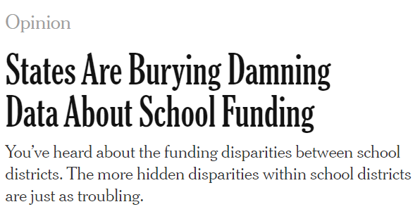
Burying the data?
“SEAs aren’t presenting these troubling patterns in a legible way.”
“…buried several clicks inside a state’s website.”

Slide 7
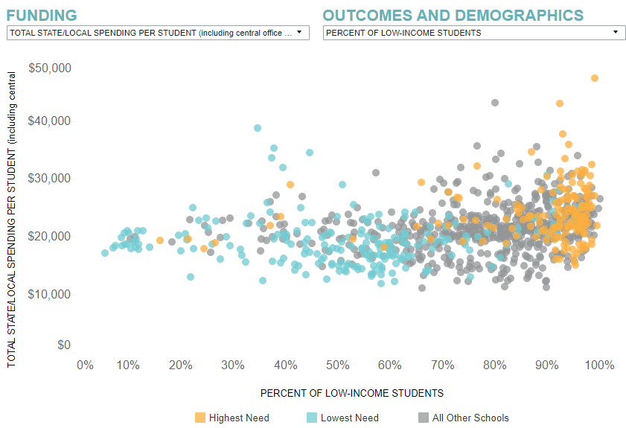
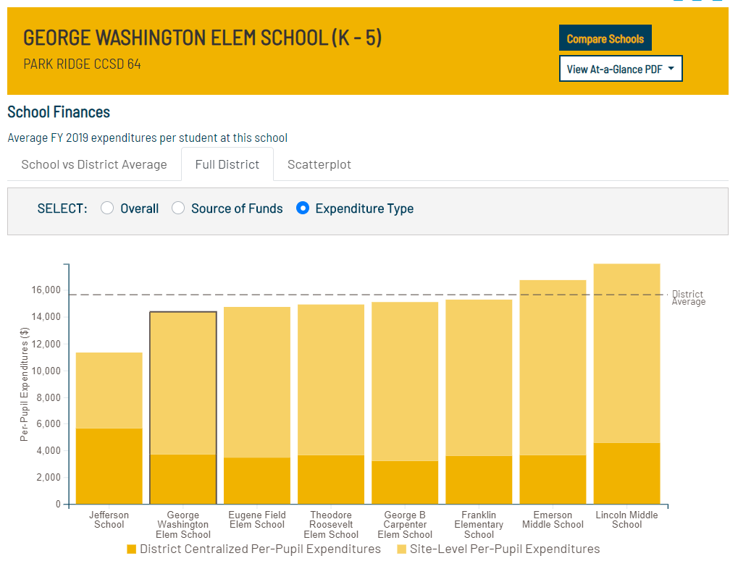
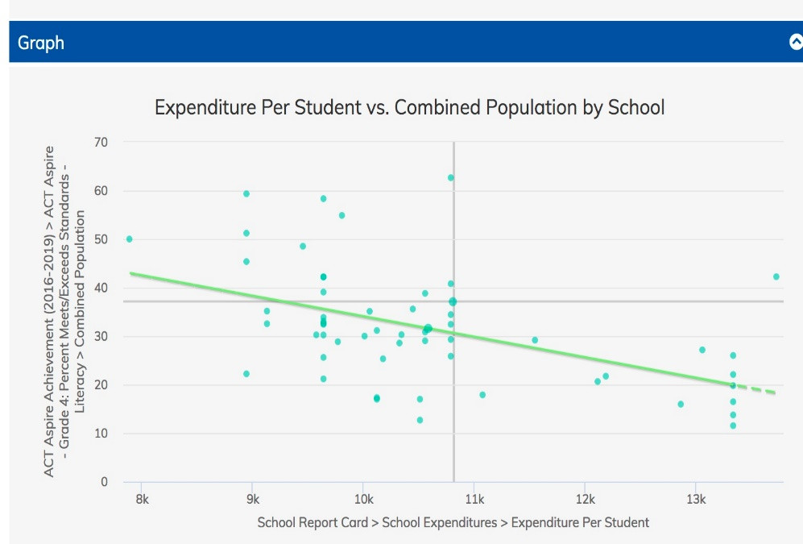
What kind of analysis prompts LEA discussion?
Array spending across schools within a district
Array spending with outcomes
Array spending with demographics

Slide 8
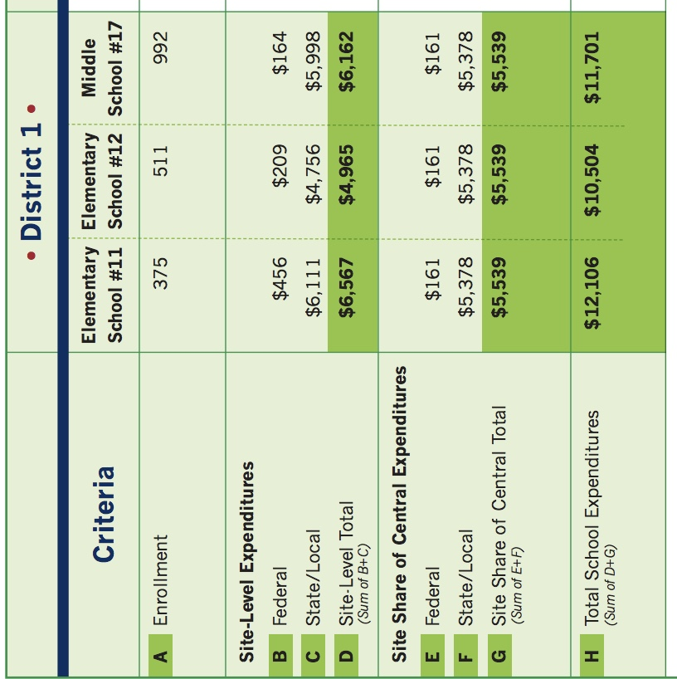
Let’s talk about central/shared expenses…
IFR calls for listing each school’s share of central/shared expenses separately (rows E, F, G)
(ESSA is silent on this).

Slide 9
States are handling central expenses differently
Did we get it right?
A: Separately lists central expenses --
Assigns costs on fixed per pupil basis to all schools:
AR, AK, CT, GA, IN,
MA, ME, MI, MN,
MO, MS, NE, WI,
WV, WY
B: Separately list central expenses --
Assigns costs via another method:
OH (# students at level relevant to cost, e.g. elem)
AL (% of site costs)
FL, IL, KS (mixed methods)
C: Does not separate central expenses from site expenses --
Assigns costs via:
CO, KY, TX, RI (per pupil)
KS (# students at each level)
WA (% of site costs)
DE (# units/FTEs ?)
HI, LA, NV, NH, OK (not clarified)
Reminder: Check if your SEA’s methodology is posted and accessible

Slide 10
LEAs… what say you?
Any thoughts?
What are you hearing about PPE expenditure reporting by school?
How might district leaders use the data?

Slide 11
Next FiTWiG Meeting is April 6th, 1 pm ET
Next SBA Meeting is April 7th, 1 pm ET
Got questions? We’re here!
Marguerite Roza Liz Ross Laura Anderson
mr1170@Georgetown.edu Elizabeth.Ross@Georgetown.edu Laura.Anderson@Georgetown.edu
Resources:
Accessing, Validating and Communicating about your Data: https://statesupportnetwork.ed.gov/system/files/financial_transparency_community_of_practice_cop_key_slides.pdf
Advancing System Productivity Series: https://edunomicslab.org/2016/02/22/1596-2/
Data Hub: https://edunomicslab.org/our-research/financial-transparency/#schoolSpending
Resource Allocation Reviews: https://edunomicslab.org/2019/09/25/appendix-a-sample-data-report/

