Slide 1
Financial Impacts of a Pandemic
October 30, 2020
Marguerite Roza
Hannah Jarmolowski
1

Slide 2
Agenda
Impact of enrollment declines on LEA finances
K-shaped learning recovery
Updates on teacher attrition
Examples of recent finance decisions

Slide 3
With enrollment drops, LEAs are worried they will lose revenue
State dollars for LEAs are typically tied to enrollment (or attendance)
District enrollment decline of 2-7% is typical
Most in PK-1st
More among higher-needs students
Charter enrollment is up
Private school enrollment is mixed
Even enrollment drops of 0.75% can be financially destabilizing

Slide 4
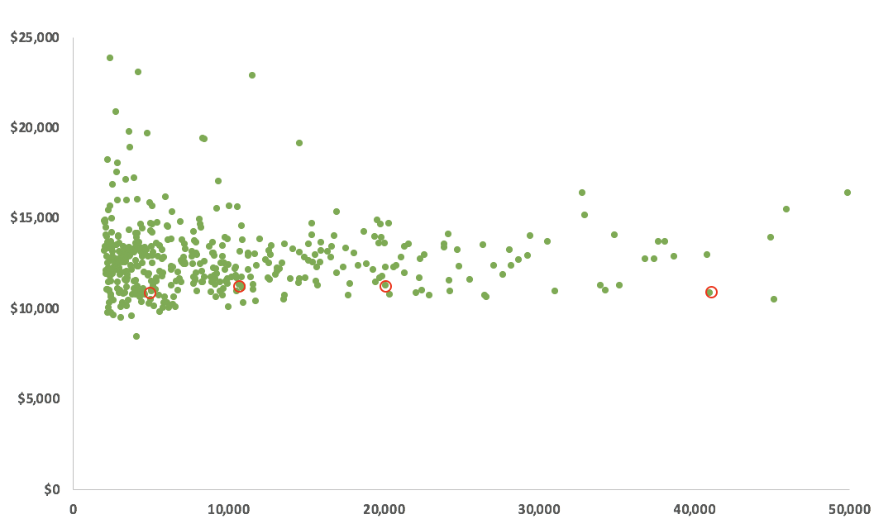
LEAs of all sizes do operate on the same per pupil funding
Different sized districts can and operate with the same per pupil amounts
But it is the shrinking that is a challenge
CA traditional public school districts with ADA of 2000+

Slide 5
POLL: What do you think states should do about the financial impact of enrollment decline?
During the pandemic, do you think states should maintain each LEA’s funding levels so that no district loses $ with enrollment drops?
Yes, but only for this school year
Yes, and next year too
No

Slide 6
State funding policies regarding enrollment are getting a lot of attention and are in flux
Holding Districts Harmless
Declining Enrollment Provisions
NC
100% Hold Harmless
CA
Multi-year enrollment averaging/smoothing
CO
MT
WI
Hold Harmless ½ year only and
contingent on in-person school
and others
TX
FL
Changed to: 75% last year; 25% this year’s attendance
Choose this year’s or last year’s enrollment
MI
OR
KS
$$≠$$

Slide 7
Some considerations:
Decisions might depend on when leaders anticipate students will be in school at capacity
Costly for the state (some students double counted)
Could reduce per pupil allocation for all districts
More $ to one district often means less for another
Will districts feel less pressure to reach students?
Financial effect delayed to following year (if costs permitted to continue to drift up this year?)

Slide 8
Enrollment is down but attendance may be even worse
Ed week reports absences have increased from 6% last year to 10% - 12%
Enrollment $≠$attendance
1 to 3 million US students missing from school¹
Boston estimates as many as 1 in 5 may be “virtual dropouts”²
IES launches: Operation Reverse the Loss. Effort intended to uncover interventions interventions that can reverse ongoing and catastrophic learning losses⁴
CHAT: NEA predicts all students will return. Do you agree?⁵
In Baltimore, just 65% of students are regularly logging on³
https://bellwethereducation.org/publication/missing-margins-estimating-scale-covid-19-attendance-crisis
https://www.bostonglobe.com/2020/05/23/metro/more-than-one-five-boston-public-school-children-may-be-virtual-dropouts/
https://www.propublica.org/article/the-students-left-behind-by-remote-learning
https://ies.ed.gov/director/remarks/10-26-2020.asp?utm_source=newsletter&utm_medium=email&utm_campaign=cb_bureau_national
https://www.propublica.org/article/the-students-left-behind-by-remote-learning

Slide 9
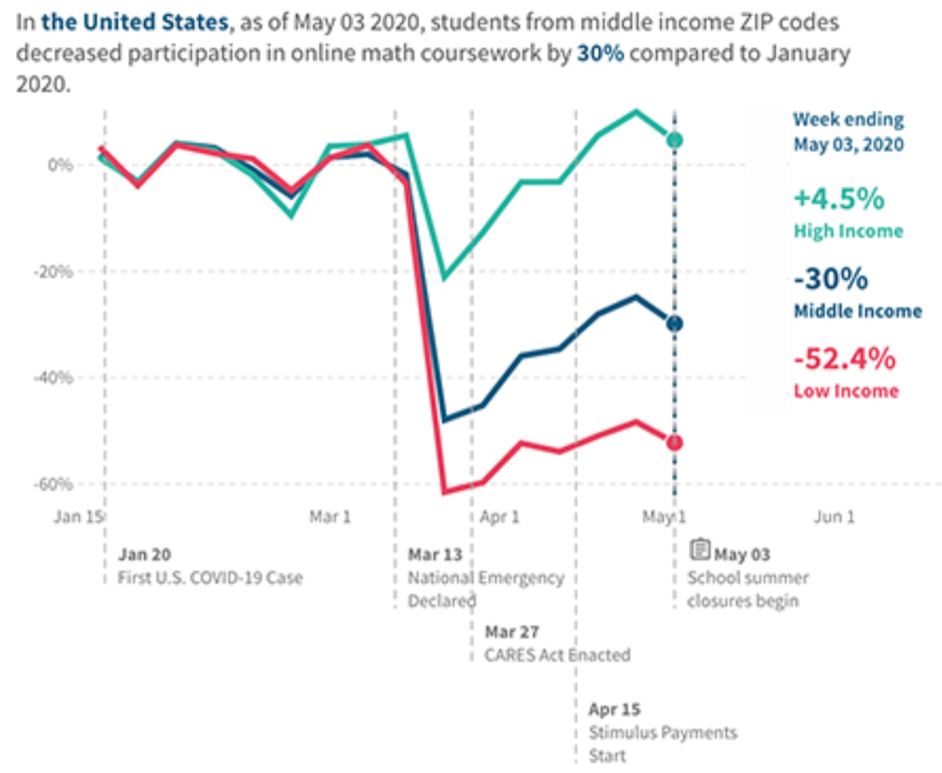
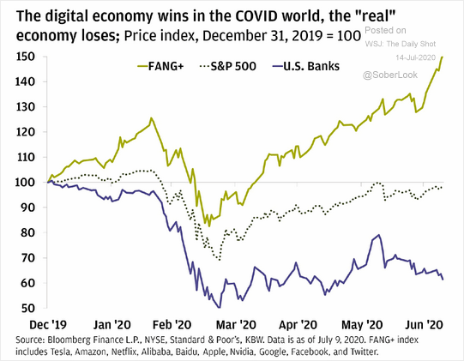
K-Shaped Recovery?
Economist Peter Atwater’s K-shaped economic recovery illustrates two diverging trends. Those with means experience a quicker bounceback. Others face a slower, more difficult recovery … jobs that skew female and minority—are being hit the hardest.
K-shape also describes impact on students:
High-income students recover faster academically
Lower-income students fall further behind
Source: Whiteboard Advisors
Thoughts/comments?
Are states thinking ahead about how their funding formulas will meet this moment?

Slide 10
How might we adjust funding to focus on student needs?
Could start by figuring out how many students are:
a) Missing in action (likely not being served at all or barely at all)
b) Temporarily homeschooling/ redshirting but plan to return when school reopens
c) Being served elsewhere (and unlikely to return)
Then tailor financial adjustments for each group accordingly:
(a) Increase allocations with an imperative to better serve this group
(b) Provide bridge funds to ensure services are available upon return
(c) Eliminate funds
Do your state(s) and districts know which students are which?

Slide 11
Teacher shortages? Broad warnings of mass teacher exits have not materialized
What we were warned about:
What we’re seeing: Anecdotally, SEAs and LEAs are reporting reduced teacher turnover
Retirements mostly down
Attrition drop
Down:
Large decrease in TN
Modest decrease in MA and MS
No change in Detroit
Up:
Modest increases in MI and NY
Down:
Decrease in Denver
Decrease in Hillsborough (FL)
Large decrease in Houston; small decrease nearby districts
Fort Worth
Up:
Increase in AZ
Financial Implications: When teachers don’t leave, costs go up
For sources, contact Hannah Jarmolowski at hj254@georgetown.edu

Slide 12
POLLS: Your thoughts on hurried ed finance decisions:
1. Facing revenue gaps for its 2-year budget, Washington state chose to continue with
existing 2020-2021 spending and absorb gaps all in Year 2 (2021-2022)
Reasonable? or I’m less comfortable with this
2. California’s June 2020 budget revision assumes $6B will come via federal relief, and
prohibits districts from laying off teachers, bus drivers, custodians and nutrition
workers for the next year (but does not protect classroom aides)
Reasonable? or I’m less comfortable with this

Slide 13
POLLS: Your thoughts on hurried ed finance decisions:
3. Hawaii’s Governor proposed temporarily cutting employee pay (including teachers)
by 20% to cope with sharp drop in state revenue and avert large-scale layoffs
Reasonable? or I’m less comfortable with this
4. Idaho families can now apply to the state for up to $1,500 per child with a maximum of
$3,500 per family to be used to purchase educational materials, devices and services
Reasonable? or I’m less comfortable with this
5. Charleston Co. teachers and administrators will receive a one-time $500 bonus and
classified staff a $250 bonus after calls for teacher hazard pay
Reasonable? or I’m less comfortable with this

Slide 14
POLLS: Your thoughts on hurried ed finance decisions:
6. Philadelphia Public Schools is offering parents up to $1,500 this school year for opting out of their school bus ride, to reduce density on buses
Reasonable? or I’m less comfortable with this
7. New Haven Public Schools put off pay increases in exchange for 3 years of protection from layoffs or rising medical costs
Reasonable? or I’m less comfortable with this

Slide 15
Next FiDWiG Meeting:
Need costume ideas?
December 8 at 1pm ET
Topics on the horizon:
What the election outcomes mean for SEAs and education finance
State funding formulas (and how they can meet the moment)
ESSA data tracker and update
Anything else you’d like to talk about? Let us know!
Got questions? We’re here!
Marguerite Roza
mr1170@Georgetown.edu
Hannah Jarmolowski
hj254@Georgetown.edu
Liz Ross
Elizabeth.Ross@Georgetown.edu

Slide 16
This presentation is in the public domain. While permission to reprint is not necessary, publication should be cited. The presentation is prepared by the National Comprehensive Center under Award #S283B190028 for the Office of Program and Grantee Support Services (PGSS) within the Office of Elementary and Secondary Education (OESE) of the U.S. Department of Education and is administered by Westat. The content of the presentation does not necessarily reflect the views or policies of the PGSS or OESE or the U.S. Department of Education nor does mention of trade names, commercial products, or organizations imply endorsement by the U.S. Government. © 2019 Westat.

