Slide 1
Financial Decision-Making: Exploring Resource Allocation Across Schools
September 25, 2020
Marguerite Roza
Hannah Jarmolowski

Slide 2


Moving from Transparency to Decision-making
Thank you, Liz Ross!
Welcome, Hannah Jarmolowski!
Hannah at hj254@Georgetown.edu

Slide 3
Agenda
Financial Stimulus Update
US ED Per-Pupil Expenditure Transparency Site
Spending by School: Visualization and Decisions
SEA and RC role
SEA Questions / Future Topics

Slide 4
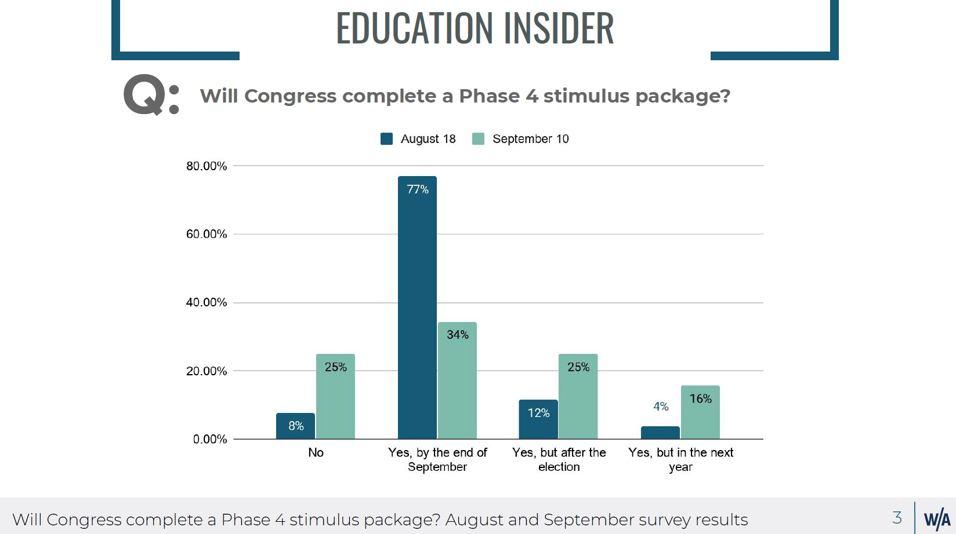
Stimulus Update
Whiteboard Advisors: Insiders’ view of likelihood of a Phase 4 stimulus:
“One would think the politics would pressure all to a deal. But the D politics against an apparent Trump win seems to be trumping ordinary politics. Whether there’s a stimulus package after the election depends on the outcome of the election. The uncertainty of the election makes it too difficult to predict a deal even then. If the Ds win it all, the deal will be HUGE, and unparalleled in history. If the Rs win or it’s shared, getting a deal will depend on how much the economy necessitates one.”

Slide 5
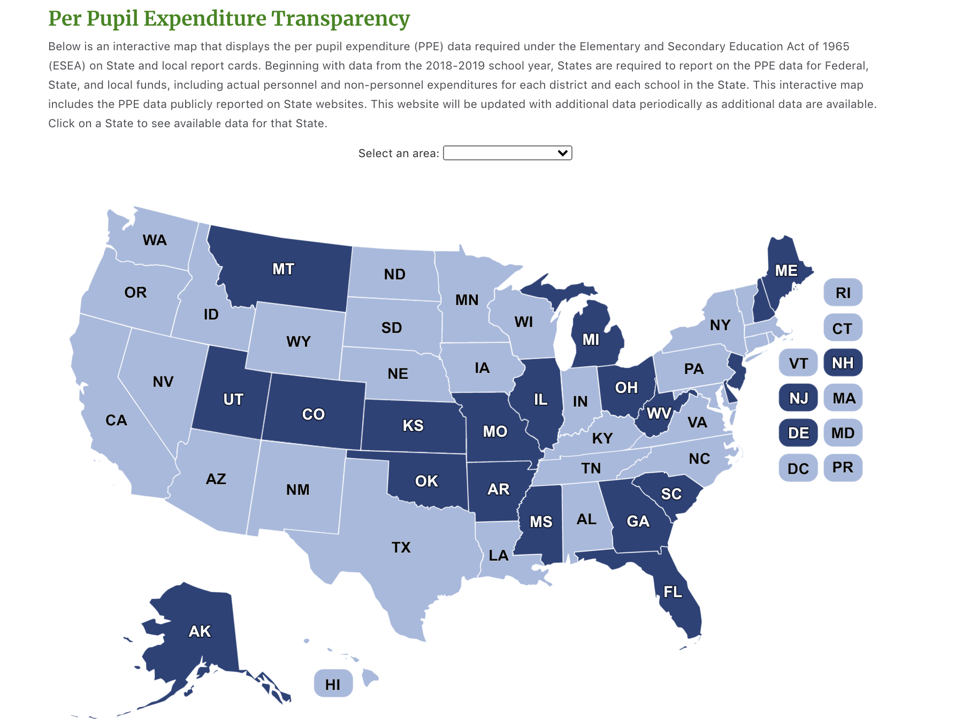
ED Launches One Stop Shop With School-by-School PPE!
Why?
Where’d they get the data?
Why isn’t my state included?
Are the PPE comparable across states?
Does it include student mix?
Are there errors?
StudentSpending.ed.gov
Some SEAs offer richer data displays. Direct link to each SEA’s display is available at: https://edunomicslab.org/our-research/data-hub/

Slide 6
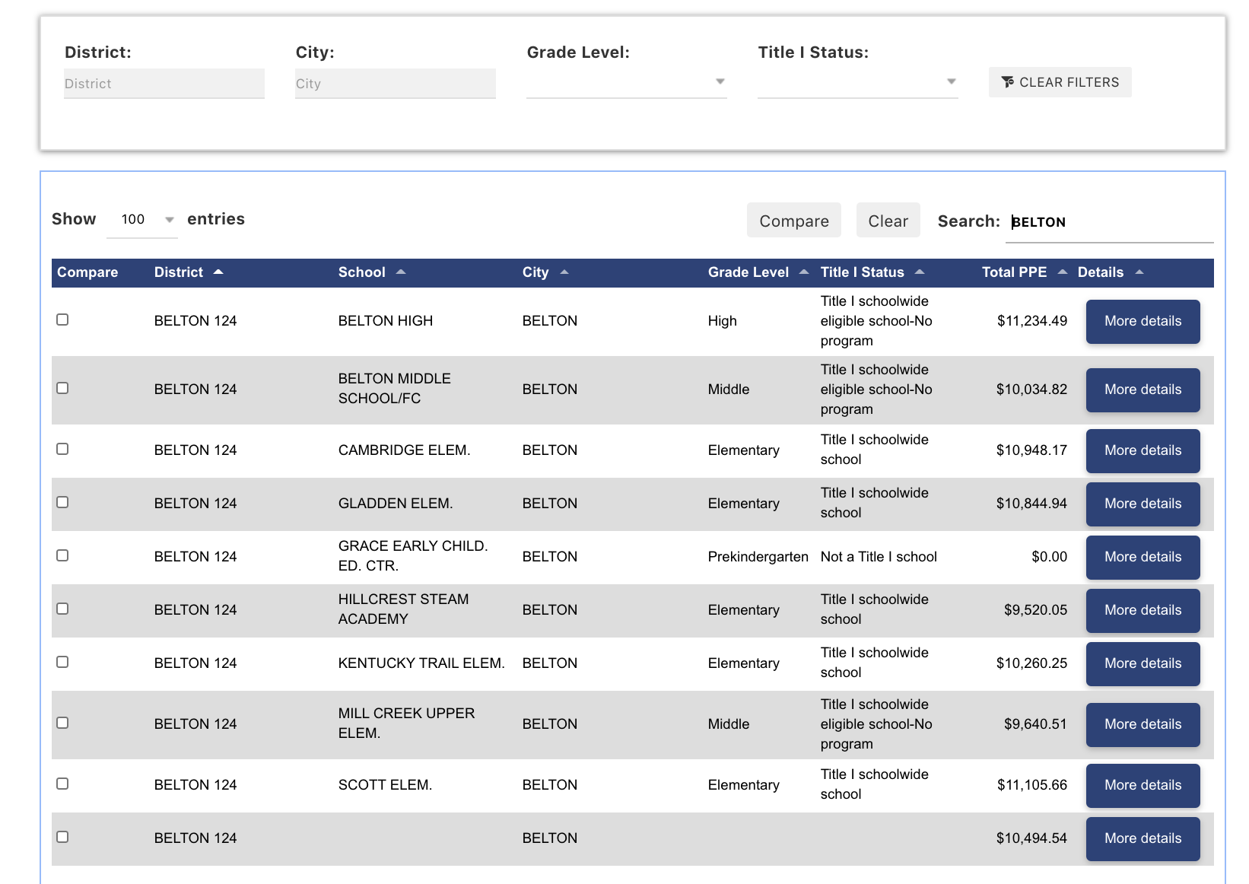
Why is it important to see PPE for all schools in a district?
ED Site Allows Comparison of PPE Across All Schools in a District

Slide 7
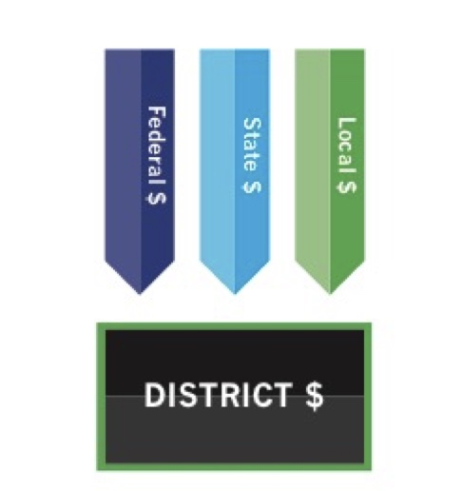
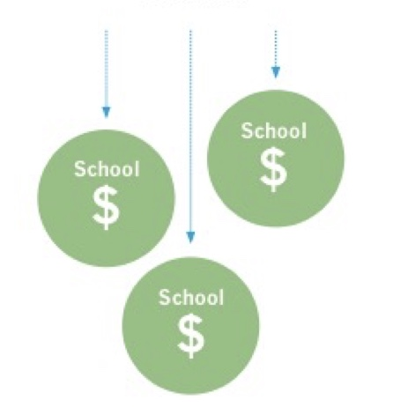
A. Up ’til now, ed finance has focused mostly on how much $ came to the district
Districts decide how to spend $700 billion in public funds
Anoka-Hennepin (MN) $568 million
Cypress-Fairbanks ISD (TX) $1.2 billion
Douglas County (CO) $689 million
Hillsborough County (FL) $2.7 billion
Fresno Unified (CA) $1.4 billion
B. But that ignores major decisions happening at districts on how to spend that $
This money gets spent via gobs of choices:
Staffing Decisions
Pay for Senior Teachers
Extracurricular Enhancements
LIFO, CBAs
©2019 Edunomics Lab, Georgetown University

Slide 8
Poll: If uneven spending is caused by uneven salaries, should districts care? Y/N
Federal $
State and Local $
38%
97 %
Chat any reactions!
What stands out?
33%
97 %
96 %
38%
East Baton Rouge Elementary Schools (FY 19)
Higher-Poverty (%FRL)
Lower-Poverty (%FRL)

Slide 9
Lawrence Public Schools Elementary Schools (FY 19)
Highest poverty school
Second highest poverty school
Poll: Assuming a district needs to make a 5% cut, do you think the district should
Make uniform cuts to affect all staff/schools equally
Tailor cuts to current spending levels and poverty levels
Other - Specify in the chat

Slide 10
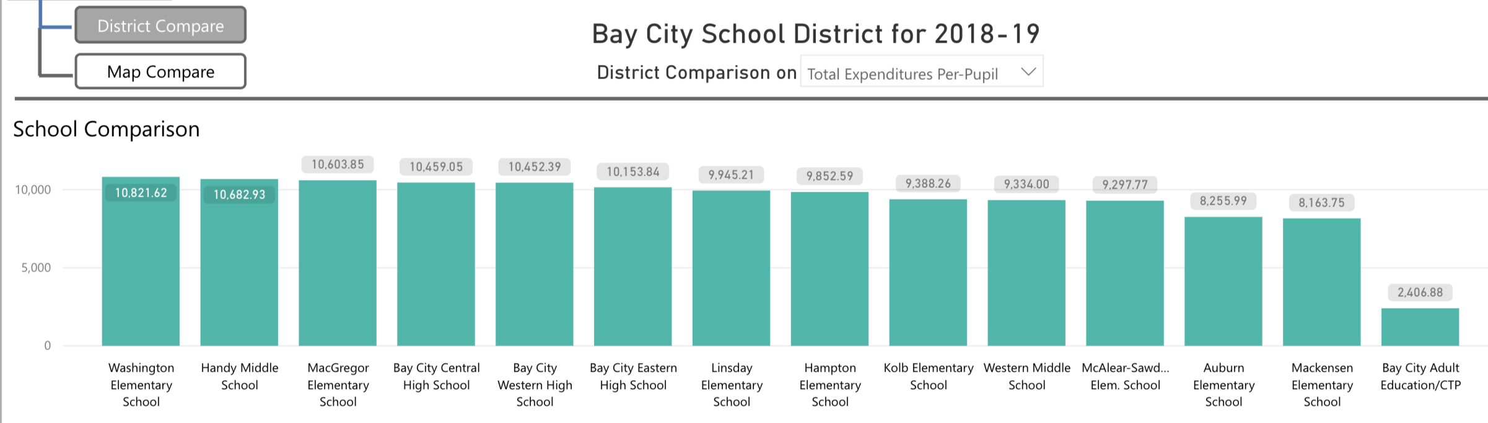
State Spotlight: Michigan Array the Data
12 SEAs allow comparison of spending across all schools in a district
But all SEAs/RCs could still make these displays for their districts
Bay City Central HS
Bay City Western HS
Bay City Eastern HS
Washington ES
MacGregor ES
Kolb ES
McAlear - Sawden ES
Handy MS
Lindsay ES
Hampton ES
Western MS
Auburn ES
Mackensen ES

Slide 11
Poll: Do districts in your area(s) examine school-by- school spending data?
A. Yes
B. No
C. Not sure
Our sense is that most districts leaders aren’t taking stock of their role in resource allocation. What districts see as “costs” are actually “spending choices”

Slide 12
Poll: Do you believe there is an SEA role to play in getting districts to use school-by-school data in financial decisions?
What can SEAs and RCs do?
Build “array the data” displays for large districts or districts of concern to allow comparison across the whole district
Nudge districts to factor in spending by school when making future financial decisions (via announcement, webinar, etc.)
A. Yes - via training, SEA data displays, etc
B. No - this is not the SEA’s role
C. Don’t know

Slide 13
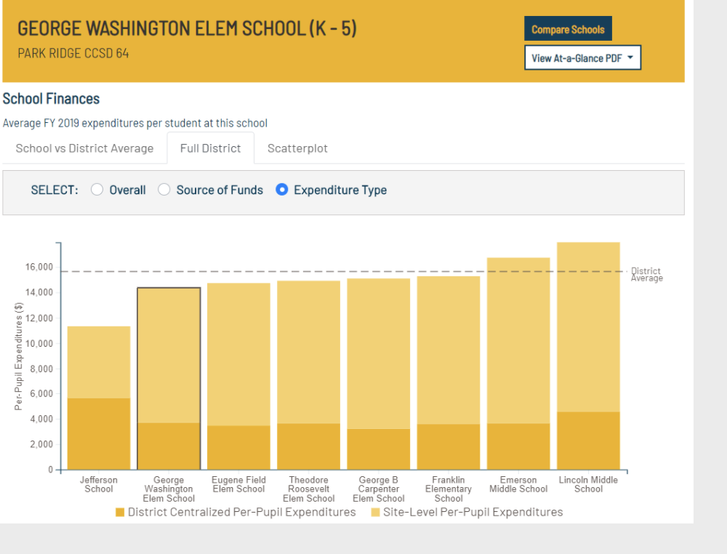
Want an array?
Happy to share arrays we’ve done:
AZ: Osborn Elementary SD, Roosevelt Elementary SD
CA: Corona-Norco, Fullerton, Long-Beach, Los Angeles, Oakland, Orange, Oxnard, Sacramento, San Diego, San Francisco, San Juan, Santa Ana
DC: DCPS*
FL: Hillsborough County, Miami Dade
IL: Chicago
LA: East Baton Rouge
MA: Lawrence
NJ: Dover
NV: Clark Co.*
NY: Rochester
TX: San Antonio, Houston*
VA: Arlington, Chesterfield, Culpeper
SEAs that display array graphs:
DE, IL, ME, MI, WY (OK*, RI*)
SEAs that display data in tables:
AZ, CT, MS, NE, NV, TX, WV
The Data Hub has direct links:
https://edunomicslab.org/our-research/data-hub/

Slide 14
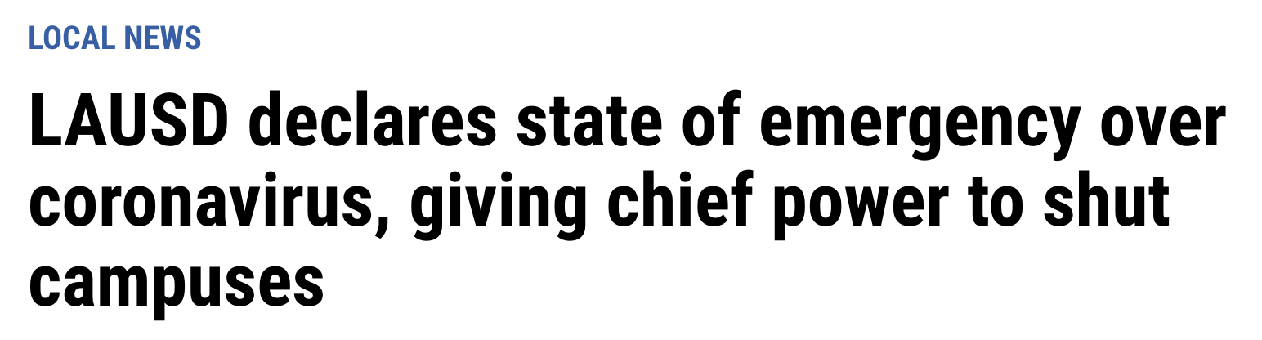
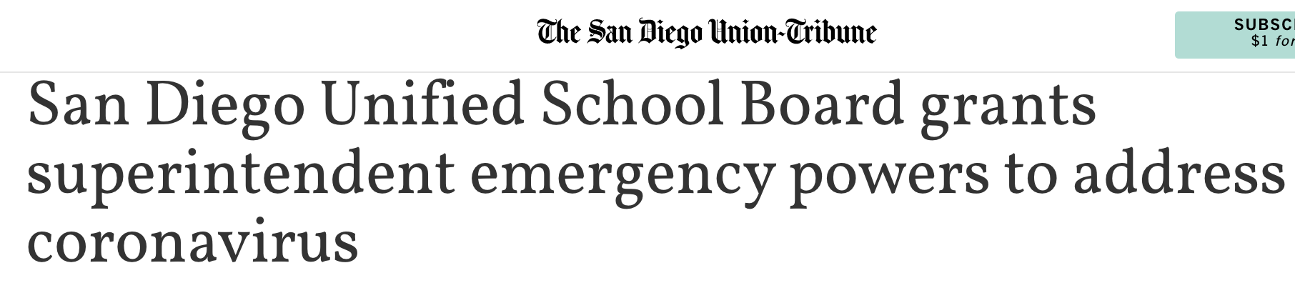
In the current moment, boards are granting superintendents emergency financial powers - providing flexibility but also risk and less transparency

Slide 15
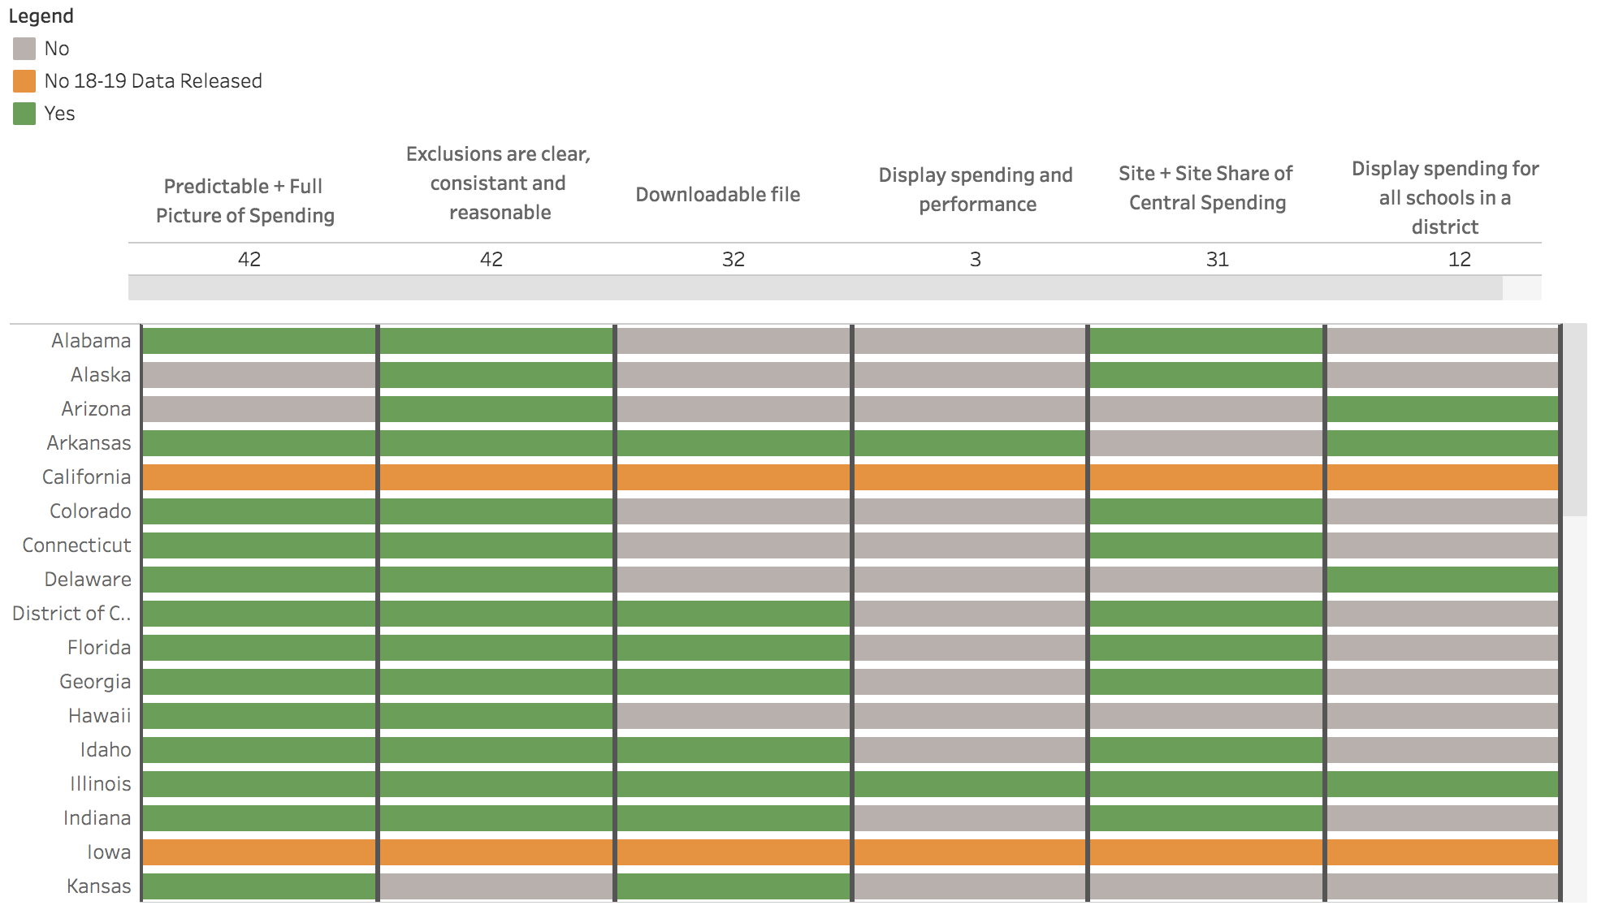

ESSA spending data and display tracker

Slide 16
SEA questions
Future topics?
CHAT THOUGHTS:
Measuring district fiscal solvency
Incorporating spending data in school evaluations
Building district capacity to make budget cuts (or even add money) in thoughtful ways
Controlling costs of private SpEd placements
Other (chat)
1. What are SEA requirements on content and format for annual district budgets? (Illinois)
2. What mechanisms and criteria do SEAs use to evaluate the fiscal solvency of districts? (Illinois)

Slide 17



Next FiDWiG Meeting!
Got questions? We’re here!
Oct, 29: 1:00 pm ET
Oct. 21-22, 2020
Virtual Delivery
Marguerite Roza
mr1170@Georgetown.edu
Hannah Jarmolowski
hj254@Georgetown.edu
Resources for Financial Decision-making During the Pandemic
https://compcenternetwork.org/national-center/our-work/

Slide 18
This presentation is in the public domain. While permission to reprint is not necessary, publication should be cited. The presentation is prepared by the National Comprehensive Center under Award #S283B190028 for the Office of Program and Grantee Support Services (PGSS) within the Office of Elementary and Secondary Education (OESE) of the U.S. Department of Education and is administered by Westat. The content of the presentation does not necessarily reflect the views or policies of the PGSS or OESE or the U.S. Department of Education nor does mention of trade names, commercial products, or organizations imply endorsement by the U.S. Government. © 2019 Westat.

