Slide 1
State of the states: ESSA data tracker
December 8, 2020
Marguerite Roza
Hannah Jarmolowski

Slide 2
Agenda
1. Looking ahead: Federal stimulus and state outlook
2. ESSA tracker - taking stock of where states stand
3. Announcements
We hope you had a great Thanksgiving.
We’re thankful for you all!

Slide 3
Congressional outlook, looking ahead ...
Senate bailout
Biden outlook
Roughly doubling the federal dollars for a typical district
Before end of year: Talk of smaller stimulus is still in flux ($58-70B in K12).
January:
If senate stays R… less than proposed.
If senate goes D … bigger funding
$70B =
$1400 per pupil
IDEA. “fully fund” the Individuals with Disabilities Education Act, the nation’s special education law, within 10 years.
ESSA. Triple Title I funding from $16 billion to more than $45 billion.
Early Care. Obama-era preschool for All (2013-2016). A 10-year, $75 billion mandatory investment in the Preschool for All program.
FEMA funding?
Available, but considered a hassle.
Meanwhile, more talk about how long term outlook shifts $ away from K12 to senior citizens

Slide 4
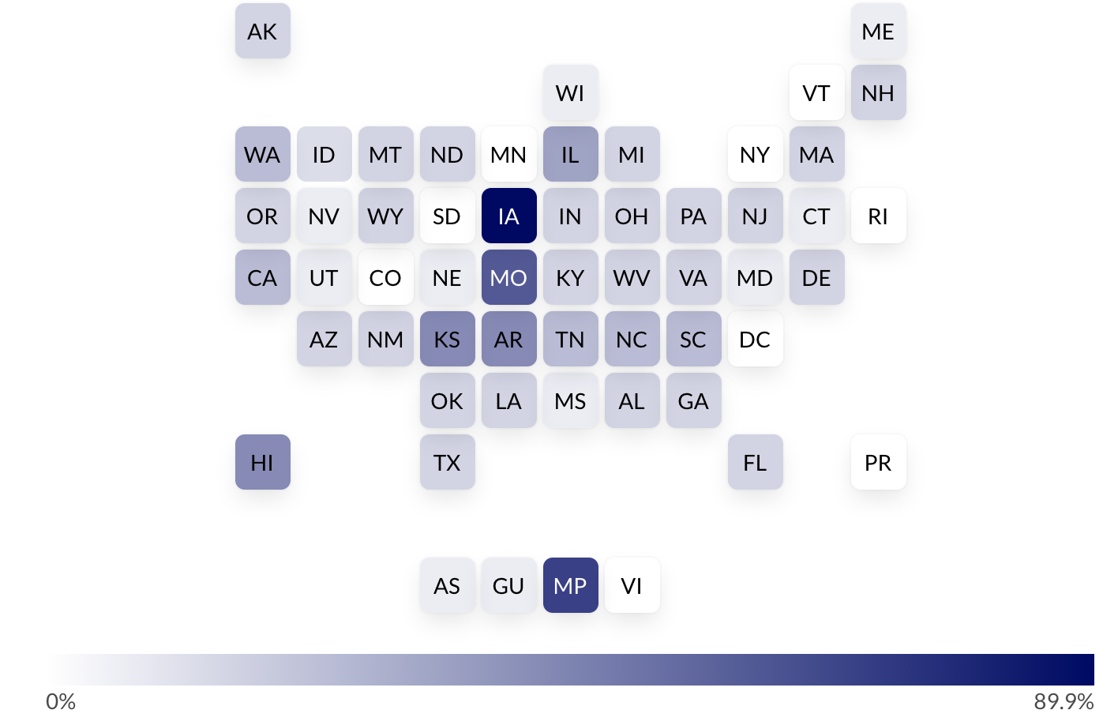
Attention is on how states spend the first batch federal relief money (and would be for any new money as well)
% of each state’s ESSER funds that have been spent by Sept 2020.
Anticipate continued attention on how current / future federal bailout funds are spent.
https://covid-relief-data.ed.gov/

Slide 5
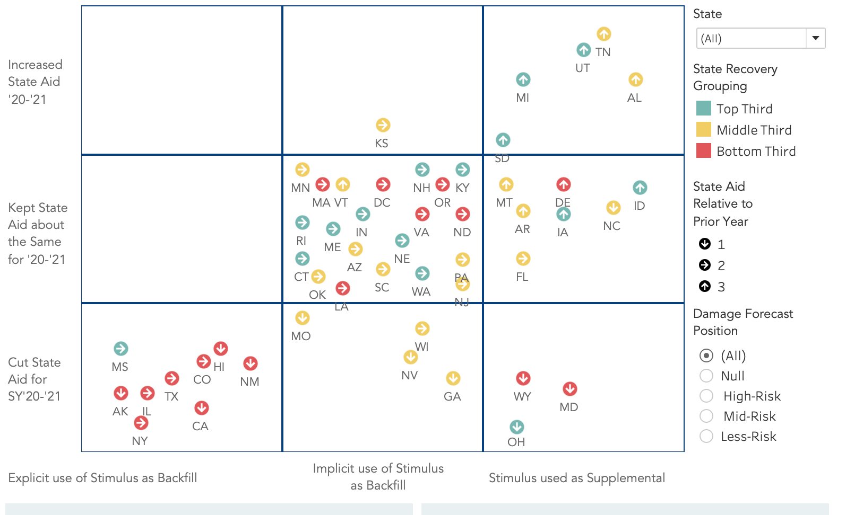
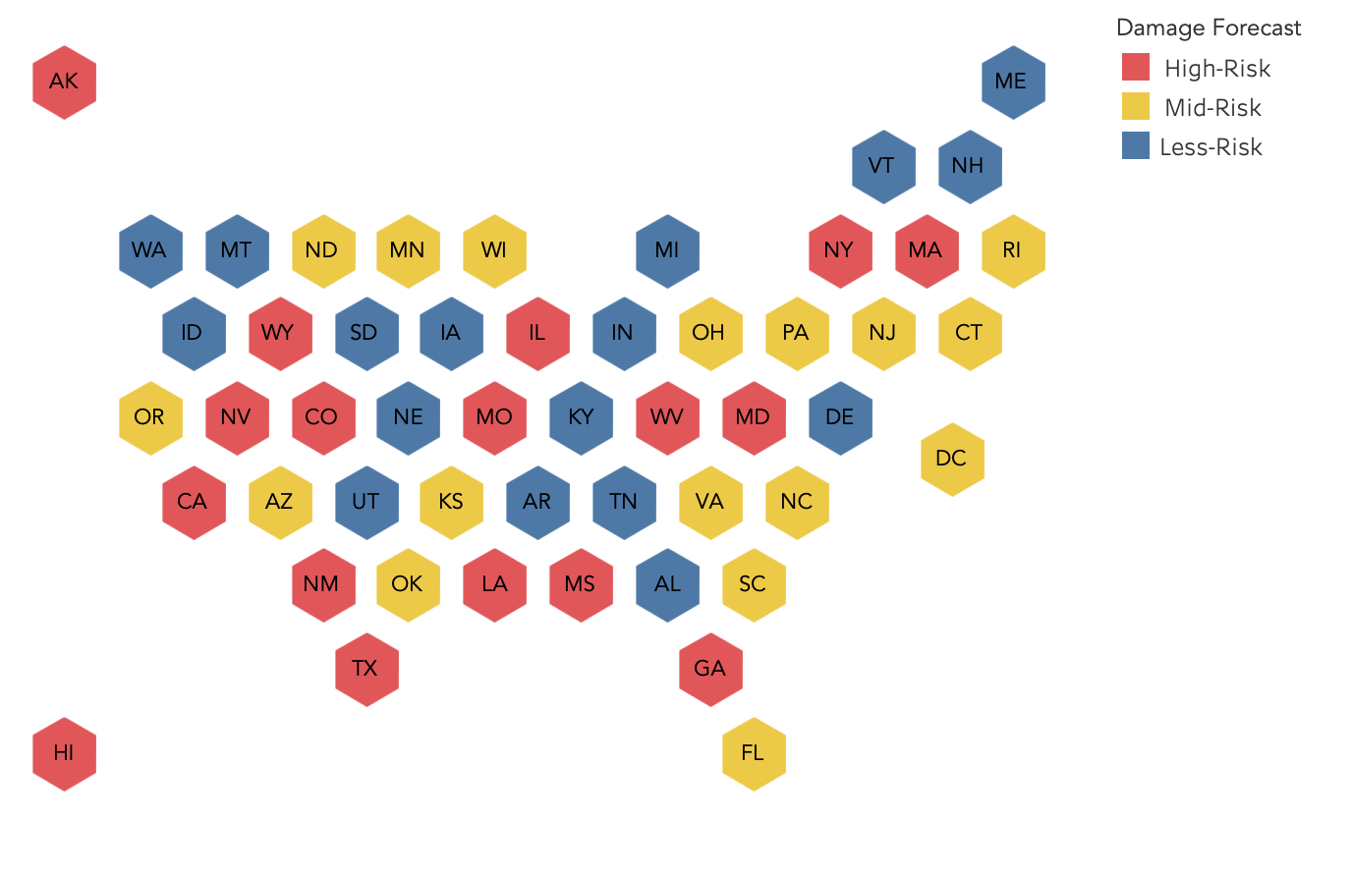
Conditions of each state vary
We’re hearing anecdotally: some states may be okay due to reserves, but
some may be overly optimistic

Slide 6
Also matters: How the state applies a cut to state ed funds.
5% cut = $329 pp
5% cut = $748 pp

Slide 7
Finance issues to watch!
Funding for remediation
Imagine that your state now (right now) has remediation funding (equivalent to 5% of the total k-12 budget). How do you think the state should distribute the funds?
Allocate to districts based on:
Student enrollment
Poverty (or part on enrollment and part on poverty)
Some measure of student failure
Other (tell us in chat!)
POLL

Slide 8
POLL
What provisions, if any, should accompany the funds?
Funding should
Only be used for some sort of supplemental services
Be used to lengthen the school year
Contain no restrictions whatsoever
Other (tell us in chat!)

Slide 9
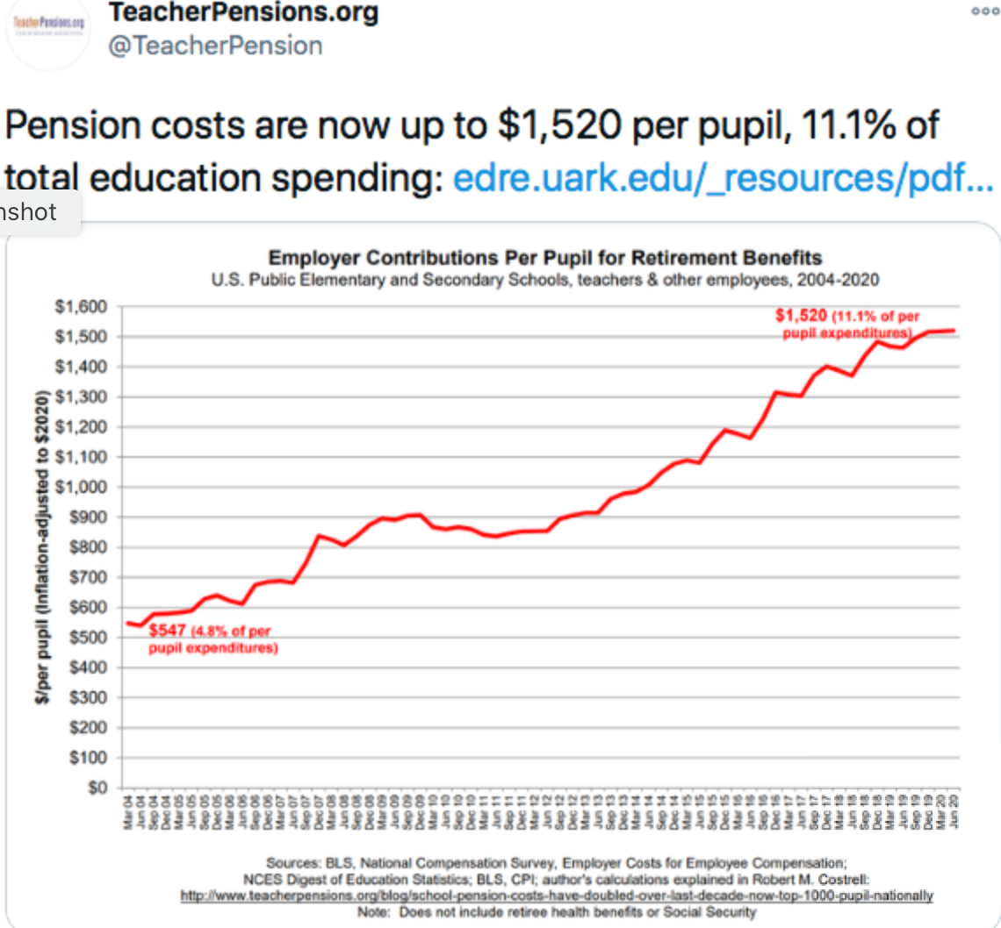
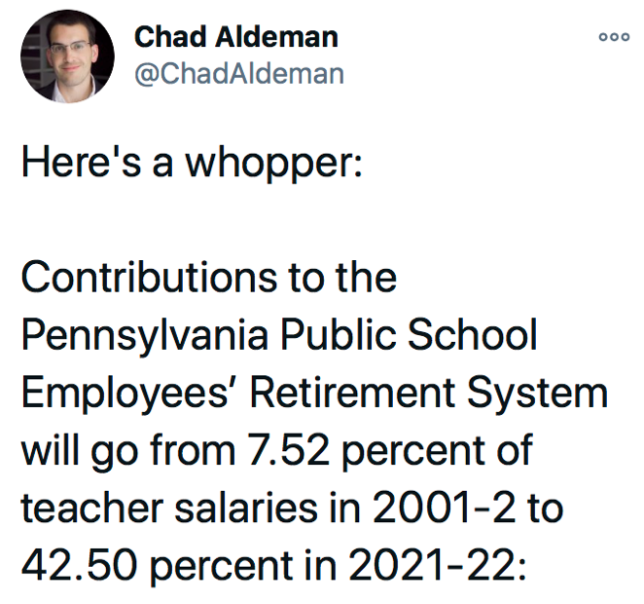
Recessions tend to drive up pension/retiree health debt
POLL
1. Do you think that any more federal stimulus for K12 should come with a condition that states remedy these pension gaps?
Yes/No

Slide 10
POLL
LAUSD pays $18K per retiree for health care.
SDUSD makes the retiree pay (and it is only $9K).
Do you think CA should:
Let districts handle their own health benefits negotiations --they’ll negotiate what works in their region?
Have the state regulate or take over all plans/rates?
Other (tell us in the chat).

Slide 11
Finance issues to watch
Enrollment shifts and hold harmless provisions
May be costly if some students double-funded (shrinking LEAs use last year’s enrollment, growing LEAs use this year’s)
What happens next year? The year after?
Find our October FiDWiG meeting at
https://edunomicslab.org/financial-transparency-working-group/

Slide 12
On the 5th anniversary of ESSA, presenting…
Our ESSA financial data tracker!

Slide 13
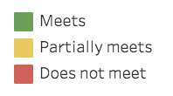
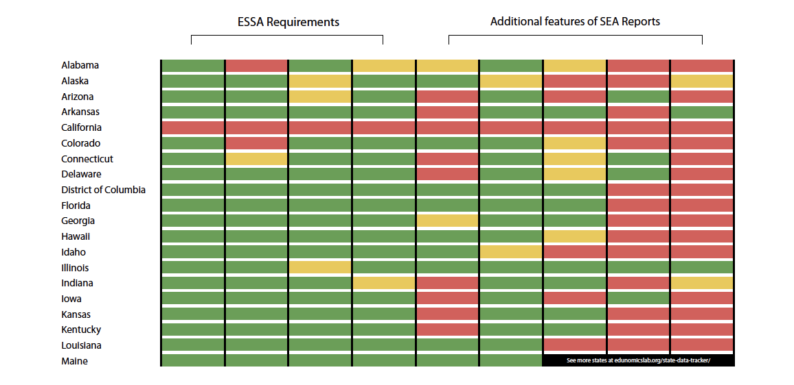
Tracking the Utility and Usefulness of ESSA PPE Data
See more states at edunomicslab.org/state-data-tracker/

Slide 14
SEAs and RCs can use this tool to:
See how they match up to peers in the completeness and utility of their data
Find which states have already implemented features that your SEA would like to add
Track the progress of their state (and others) as data improvement are made

Slide 15
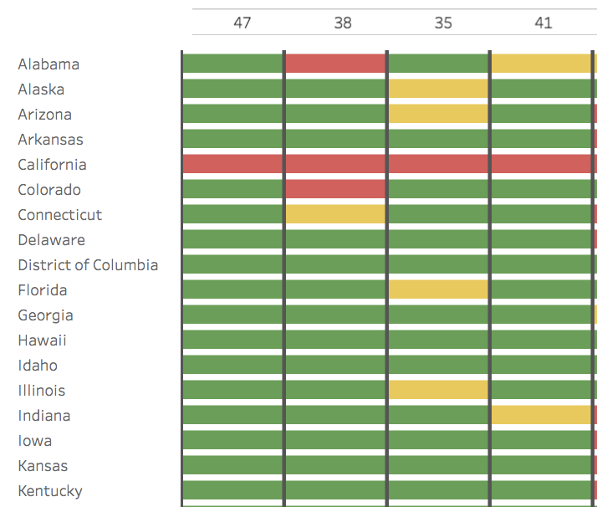
24 states meet all ESSA financial transparency requirements
47 states have FY 19 data posted publicly
Data appear complete, accurate, and are in per-pupil terms
Data are located on the report card
SEA separates federal $ vs state/local $ and uses real salaries
FY 18-19 data
Quick fixes to meet ESSA requirements in 2020:
Display data on report card
AL, CO, MI, MN, OR, SD, TN, WI, (MA and CT have FY 18 data on report card)
Do the math - list federal $ and state/local $ in per-pupil terms (vs totals)
IN, MN, NH, NM
CA, PA, RI, SD have yet to publish
Other trends:
Missing or erroneous data on some LEAs
Data file doesn’t match figures on report card
https://edunomicslab.org/state-data-tracker/

Slide 16
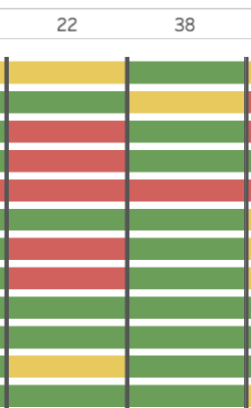
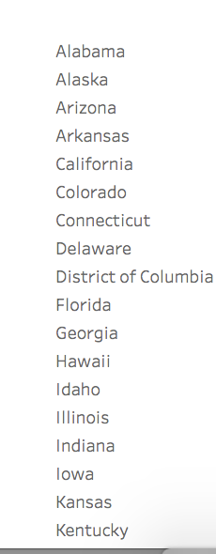
Additional features add clarity
Exclusions are clear, reasonable, consistent, and quantifiable
Separates site and site-share of central $
22 states separate site vs site-share of central
38 states list spending exclusions
https://edunomicslab.org/state-data-tracker/

Slide 17
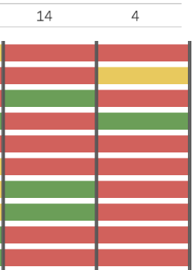
A few states took extra steps to ensure data are usable
Enables comparison of $ for all schools in a district
Enables comparison of spending and performance
14 states allow online comparisons of school-by-school spending for all schools
4 states enable comparisons of spending and performance for ALL schools (AR, IL, NH, OK, TX*)
3 more enable this comparison for a small number of schools
*TX comparison is for state-required (not ESSA) PPE data
https://edunomicslab.org/state-data-tracker/

Slide 18
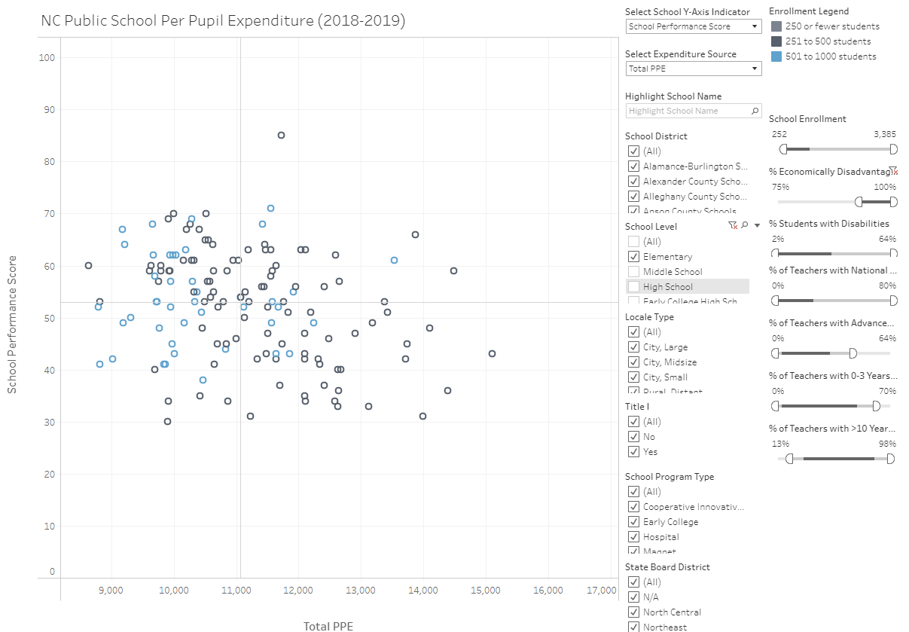
If states don’t create meaningful visualizations, others will
These organizations have made data visualizations using school-by-school financials:
Best NC
Massachusetts Business Alliance for Education
Ed Trust NY
Hechinger Report
All NC elementary schools with >75% poverty

Slide 19
Coming up next FiDWiG…Fiscal Insolvency
What oversight role exists regarding district insolvency?
If you have info handy on your state, chat response to each:
A. What oversight body is involved? (County, SEA?)
B. What requirements are in place and what evaluations are done? (Minimum reserves?)
C. What interventions are made? (Financial expertise, takeover, loans, etc.)
4 out of 10 New York school districts could claim insolvency if mid-year state aid cuts are made

Slide 20
Nominate LEAs for analysis/training in using school-by-school financial data
The National Center and Edunomics Lab have DoEd funding to guide and support LEAs in their efforts to improve the usefulness of school-by-school finance data
Benefits to participating LEAs
Data visualizations using school-by-school spending, outcomes, and demographic data
Protocols and training for LEA conversations with stakeholder groups
Nominate an LEA:
Email Hannah at Hj254@georgetown.edu
Look out for an email on the specifics later this week

Slide 21
Next FiDWiG Meeting:
February 4 at 1pm ET
Anything else you’d like to talk about? Let us know!
Got questions? We’re here!
Marguerite Roza
mr1170@Georgetown.edu
Hannah Jarmolowski
hj254@Georgetown.edu

Slide 22
This presentation is in the public domain. While permission to reprint is not necessary, publication should be cited. The presentation is prepared by the National Comprehensive Center under Award #S283B190028 for the Office of Program and Grantee Support Services (PGSS) within the Office of Elementary and Secondary Education (OESE) of the U.S. Department of Education and is administered by Westat. The content of the presentation does not necessarily reflect the views or policies of the PGSS or OESE or the U.S. Department of Education nor does mention of trade names, commercial products, or organizations imply endorsement by the U.S. Government. © 2019 Westat.

