Slide 1
Federal ESSER dollars in the context of school-by-school spending
May 27, 2021
Marguerite Roza
Hannah Jarmolowski

Slide 2
Agenda
SEA ESSER3 timeline, plans, public engagement
Q: re reimbursement
LEA ESSER3 Spending plans
Q: SEA influence
School-by-school spending data for 19-20
SEA questions

Slide 3
American Rescue Plan Act of 2021
ESSER III ($122.8B)
Other Ed (~$55B)
90% allocated to districts via Title I formula.
$109.8B ~= $2,200 /student
Districts not eligible for Title I get no $.
Quirks in Title I formula mean that some get as much as $16,000/student.
Districts must use >20% for learning recovery.
Maintenance of Equity (SEA and district) for FY22 and FY23 prevents disproportionate cuts to high-need districts and schools.
Districts must submit a reopening plan 30 days after receiving $.
States can add additional restrictions.
10% SEA reserve:
>5% learning recovery
>1% summer enrichment
>1% afterschool
2.5% SEA discretion
<½% admin
$39B for Child Care Stabilization and Child Care and Development Block Grants
$1B for Head Start
~$7.2B for E-Rate
~$3B in new IDEA funds (~$2.6B for K12)
$2.75B for private schools
$ 850M to outlying areas
$ 850M Bureau of Indian Education
$800M for homeless youth for wraparound services and to enable school participation
$ 190M for Amer. Indian, HI, & AK Native ed

Slide 4
For SEAs, the clock is ticking…
Today
3/11 ARP passes
DoEd issues draft regs 4/22
2021-22
Mar Apr May Jun Jul Aug Sep Oct
2020-21
States must make 2/3 ESSER3 funding available to districts May 24
DoEd releases 2/3 ESSER3 ($81B) to states 3/24

Slide 5
At least one SEA has asked for an extension
For SEAs, the clock is ticking…
SEAs must submit plans for use of 10% set-aside to DoED by June 7 to receive final 1/3 ESSER3
SEA plans must include:
Current educational needs
Plans for ESSER set-aside
Plans to support districts in ESSER3 planning/use
Today
3/11 ARP passes
DoEd issues draft regs 4/22
SEAs must publish plans June 21st
2021-22
Mar Apr May Jun Jul Aug Sep Oct
2020-21
States must make 2/3 ESSER3 funding available to districts May 24
DoEd releases 2/3 ESSER3 ($81B) to states 3/24

Slide 6
At least one SEA has asked for an extension
For SEAs, the clock is ticking…
SEAs must submit plans for use of 10% set-aside to DoED by June 7 to receive final 1/3 ESSER3
SEA plans must include:
Current educational needs
Plans for ESSER set-aside
Plans to support districts in ESSER3 planning/use
Today
3/11 ARP passes
DoEd issues draft regs 4/22
SEAs must publish plans June 21st
2021-22
Mar Apr May Jun Jul Aug Sep Oct
2020-21
States must make 2/3 ESSER3 funding available to districts May 24
DoEd releases 2/3 ESSER3 ($81B) to states 3/24
Tribes
Civil rights orgs
Disability rights orgs
Stakeholders representing students types including:
Disabilities
English learners,
Experiencing homelessness,
Foster care,
Migratory,
Incarcerated,
Other underserved
SEA ESSER3 planning must involve “meaningful consultation”
Students
Families
School admins
District admins
Spec. Ed admins
Teachers
Principals
Other educators,
School staff,
Employee unions

Slide 7
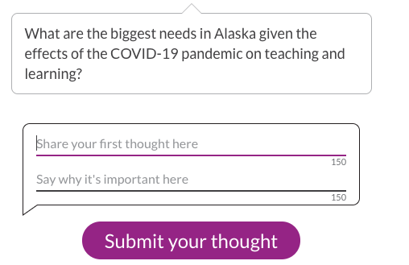
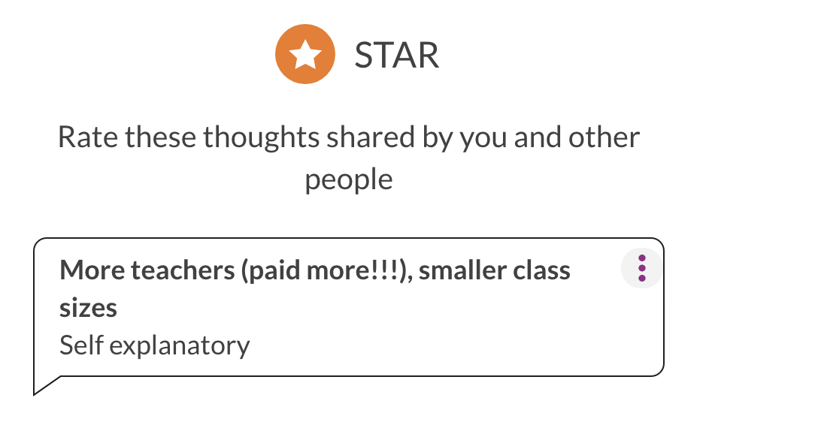
Federal regulation calls on SEAs to get input on spending plans
POLL: How has your SEA solicited input from your community so far?
Public testimony/public town hall
Open response survey
Survey with concrete options
Email outreach
Briefed community leaders, ask them to engage their communities and report back
Other – tell us in the chat
Alaska SEA provides multiple ways for the public to provide input
An SEA issued an open-ended survey to stakeholder groups asking how they’d like to see the funds spent. One SpEd parent asked: “what are the options?”
OMB estimate = $12,000:
80 SEA staff hours for stakeholder groups
40 staff hours for public input
7
*https://www.federalregister.gov/documents/2021/04/22/2021-08359/american-rescue-plan-act-elementary-and-secondary-school-emergency-relief-fund

Slide 8
On delivering funds to districts via “reimbursement”:
POLL: When and how are you distributing the 90% of ESSER3 that goes to districts?
Transferring funds to districts
Send funds on via reimbursement
Other - chat us!
District: We don’t have the working capital to float expenses of this magnitude while we wait for the state to reimburse us.
SEA: Based on past experience, we’re concerned small districts with less capacity will make expenditures that will turn out to be unallowable. Reimbursement is slow but less risky.
District: The reimbursement process is slow due to understaffing at the SEA. And it means we can’t earn interest on the funds.
SEA: Reimbursement is how we always manage federal funds - Districts are used to this.
District: I’m hesitant to spend the money. What if the SEA says no to reimbursing us?

Slide 9
Turning to the district share of ESSER3…
ESSER III ($122.8B)
Other Ed (~$55B)
90% allocated to districts via Title I formula.
$109.8B ~= $2,200 /student
Districts not eligible for Title I get no $.
Quirks in Title I formula mean that some get as much as $16,000/student.
Districts must use >20% for learning recovery.
Maintenance of Equity (SEA and district) for FY22 and FY23 prevents disproportionate cuts to high-need districts and schools.
Districts must submit a reopening plan 30 days after receiving $.
States can add additional restrictions.
10% SEA reserve:
>5% learning recovery
>1% summer enrichment
>1% afterschool
2.5% SEA discretion
<½% admin
$39B for Child Care Stabilization and Child Care and Development Block Grants
$1B for Head Start
~$7.2B for E-Rate
~$3B in new IDEA funds (~$2.6B for K12)
$2.75B for private schools
$ 850M to outlying areas
$ 850M Bureau of Indian Education
$800M for homeless youth for wraparound services and to enable school participation
$ 190M for Amer. Indian, HI, & AK Native ed

Slide 10
It’s still very early, but in our tracking of districts so far:
We’re seeing lots of this:
Thank you payments to staff
Filling budget gaps
Plans to hire counselors, nurses, specialists
Class size reduction (hiring more teachers)
Facilities projects
Tech/Curric updates
Planning time for staff
and not much of this:
Tutoring
Added weeks to school year
Pass through allocations to schools (for flexible use)
Customized options where families select what works for their kids
New delivery models
New content/course options
POLL: Seeing these early choices, what’s your reaction?
A. Seems reasonable B. I’m less comfortable with this C. A bit of both

Slide 11
What leverage do SEAs have over district ESSER spending choices?
Technically none.
SEAs can point to requirement re district plans:
DoEd FAQs:
Q: “May an SEA or a State legislature limit an LEA’s use of ESSER formula funds?”
A: “No.”
Draft regs require districts specify:
“How the LEA will use the funds it reserves under section 2001(e)(1) of the ARP Act to address the academic impact of lost instructional time through the implementation of evidence-based interventions, such as summer learning or summer enrichment, extended day, comprehensive afterschool programs, or extended school year”
”So much is riding on each district’s decisions about how to spend its relief funds.”
~ Edunomics Lab

Slide 12
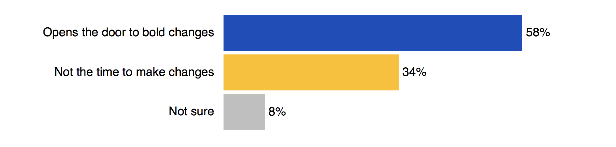
Polling* indicates parents want to see bold changes with these federal dollars
POLL: Which level in the education system is better positioned to invest funding toward innovation?
A. SEAs B. LEAs C. Both D. Neither
https://www.waltonfamilyfoundation.org/learning/national-poll-reveals-parents-priorities-for-k-12-education

Slide 13
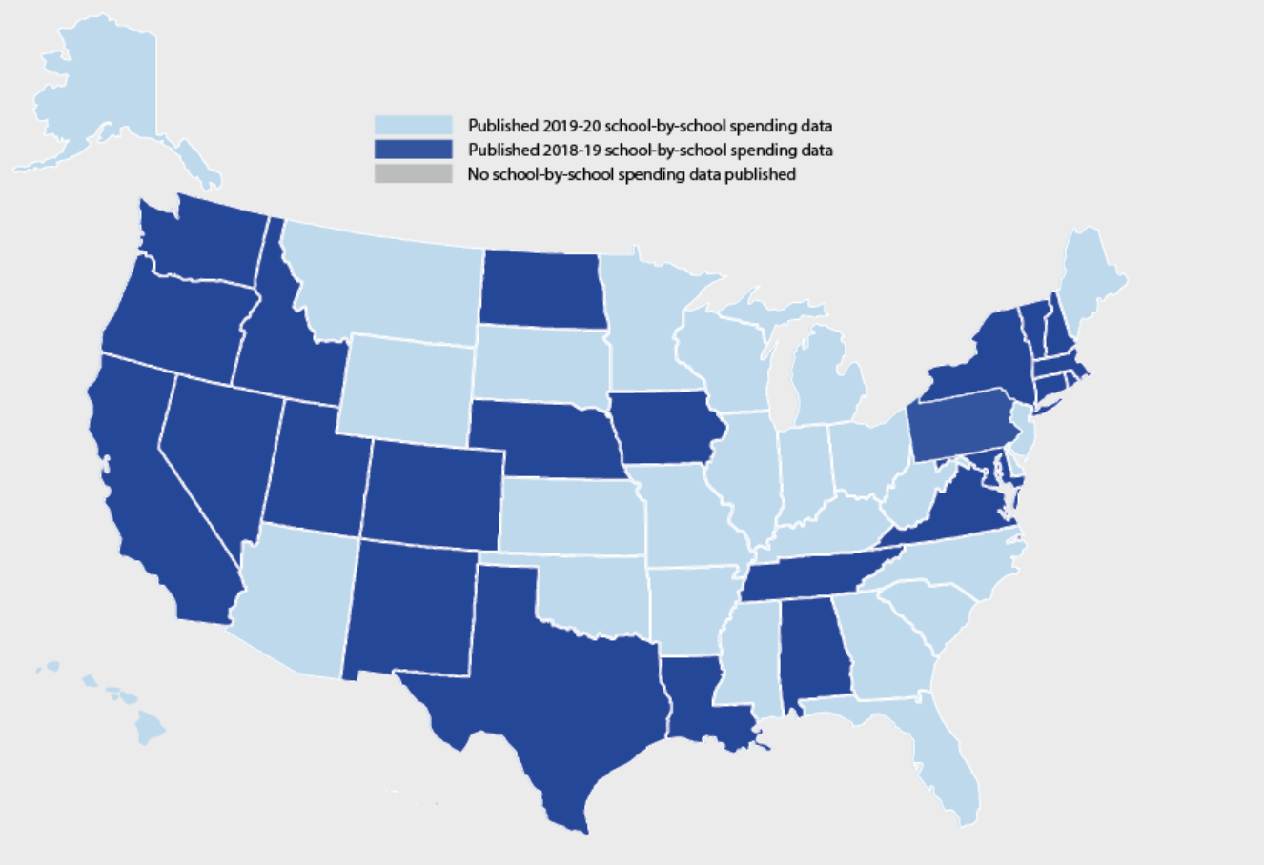
26 states have released FY 20 data!
BUT we’ve seen:
Missing LEAs/charters
Improbable $ amounts (millions per pupil; hundreds per pupil)
Reporting differs greatly from federal F33
Central $ > Site $
More on this in June’s FiDWiG!
The “Maintenance of Equity” provision will depend on these data
CHAT: For darker shaded states, when do you estimate 19-20 data will be released?

Slide 14
We’ll be tracking improvements in reporting SEA school-by-school spending data
Accessible on the
report card
Enables comparison of spending and performance
SEA separates federal $ vs state/local $ and uses real salaries
Exclusions are clear, consistent, and quantifiable
Enables comparison of $ for all schools in a district
FY 18-19 data
Data appear complete
Statewide downloadable file available
Separates site and site-share of central $

Slide 15
SEA questions
Illinois:
In FY21, the district used an ESSER grant to reimburse itself for FY20 expenditures. How should those “reimbursing dollars” be reported in FY21 school spending per pupil data?
Tennessee:
How are other states treating system-wide expenses in LEAs with within-district charters when the charter does not use most central services?

Slide 16
Next Meeting:
June 15 1pm ET
Got questions? We’re here!
Marguerite Roza
mr1170@Georgetown.edu
@MargueriteRoza
Hannah Jarmolowski
HJ254@Georgetown.edu

Slide 17
This presentation is in the public domain. While permission to reprint is not necessary, publication should be cited. The presentation is prepared by the National Comprehensive Center under Award #S283B190028 for the Office of Program and Grantee Support Services (PGSS) within the Office of Elementary and Secondary Education (OESE) of the U.S. Department of Education and is administered by Westat. The content of the presentation does not necessarily reflect the views or policies of the PGSS or OESE or the U.S. Department of Education nor does mention of trade names, commercial products, or organizations imply endorsement by the U.S. Government. © 2019 Westat.

