Slide 1
Six mistakes we’re seeing with ESSER funds.
What’s the role of the SEA?
December 10, 2021
Marguerite Roza
Hannah Jarmolowski

Slide 2
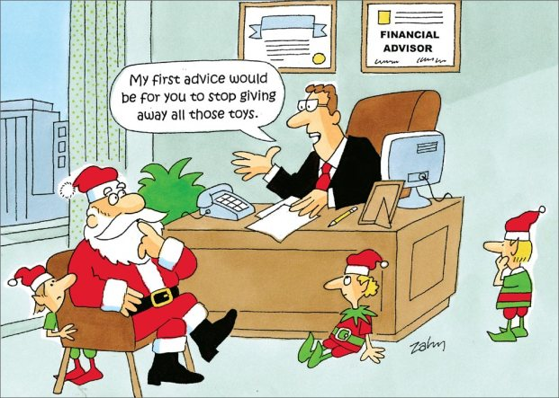
Agenda
I. Six mistakes with ESSER funds
II. Role of the SEA?
III. Data transparency

Slide 3
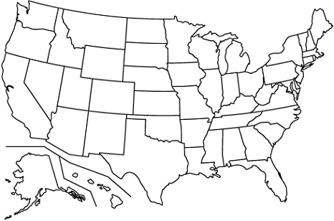
How much did your state (SEA and districts) get from ESSER3?
$1.9B
VT: $285M
$305M
NH: $351M
$411M
$382M
$1.3B
MA: $1.8B
$1.1B
RI: $415M
$440M
$382M
$1.5B
$9.0B
CT: $1.1B
$304M
$3.7B
$546M
$775M
$5.0B
NJ: $2.8B
$5.1B
$4.5B
$1.1B
$2.0B
DE: $411M
$616M
$1.2B
$726M
$2.1B
MD: $2.0B
$831M
DC: $386M
$15.1B
$2.0B
$2.0B
$2.5B
$3.6B
$1.5B
$2.6B
$1.3B
$2.1B
$980M
$1.6B
$2.0B
$4.3B
$12.4B
$2.6B
$359M
$7.0B
$413M
https://oese.ed.gov/files/2021/06/Revised-ARP-ESSER-Grant-Award-Allocation_6.25.21_FINAL.pdf

Slide 4
POLL: Now think of a district you know well. How much per pupil did it receive from ESSER III?
<$1,000 per student
$1,000 - $2,000 per student
$2,000 - $3,000 per student
$3,000 - $4,000 per student
>$4,000 per student
Leaders ought to locate this figure and say it often!

Slide 5
money
It’s 2023. Where did the time go?
ESSER was a grand experiment: What happens when feds give large sums to districts with few strings attached?

Slide 6
BREAKING: Millions in federal ESSER relief dollars spent on_____ !
POLL: Who do you think should deserve the blame if there’s little to show for ESSER?
Feds
SEAs
Districts
Other – tell us in the chat
BREAKING: Reports show ESSER investments didn’t benefit students.

Slide 7
Six potential mistakes districts might be making with federal relief funds
Spending in a way that creates a disruptive fiscal cliff
Offsetting lost funds due to permanent enrollment declines
Issuing problematic contracts that come back to haunt leaders
Deploying funds inequitably across schools
Failing to make sure community sees/values investments
Investing without demonstrating real results for students

Slide 8
Making of a cliff:
Funding cliffs are typical when federal relief aid stops
Beware of adding recurring labor costs!
Instead of recurring labor costs:
New hires (nurses, counselors, VPs)
Base pay raises: % raises, COLAs
Increased benefits
2020
2021
2022
2023
2024
Consider one-time strategies:
Furloughs/layoffs, stagnant pay
Stipends
One-time bonuses
Contractors (e.g., nurses, tutors)
COVID HITS!

Slide 9
Six potential mistakes districts might be making with federal relief funds
Spending in a way that creates a disruptive fiscal cliff
Offsetting lost funds due to permanent enrollment declines
Issuing problematic contracts that come back to haunt leaders
Deploying funds inequitably across schools
Failing to make sure community sees/values investments
Investing without demonstrating real results for students

Slide 10
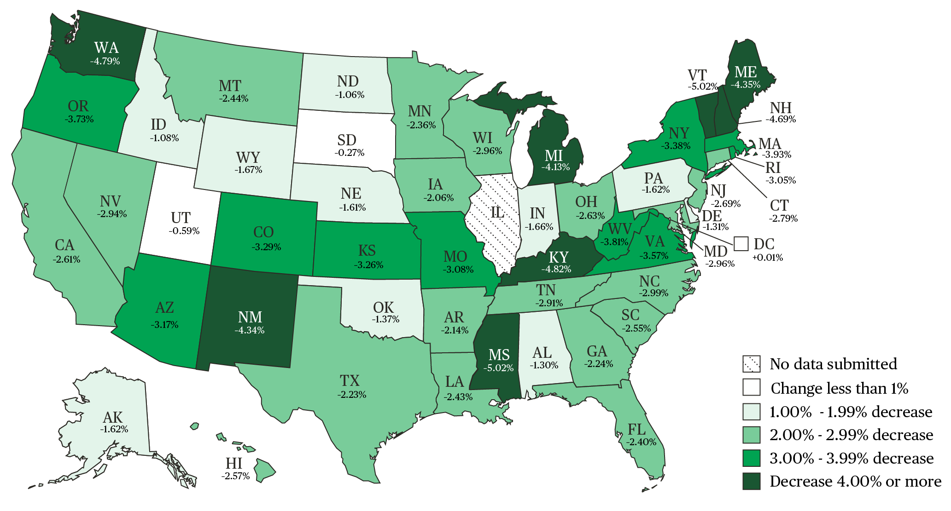
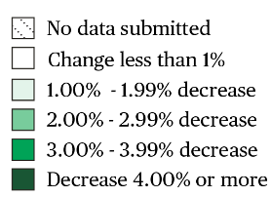
School districts have a hard time downsizing. Public school
enrollments fell 3% last year.¹ Will all students come back?
A “COVID baby-bust³” suggests enrollment declines may continue
School district revenues are tied to the number of students they enroll
Half of Minneapolis relief dollars used to avoid layoffs triggered by pre-pandemic enrollment drops.
Source: NCES
¹ https://nces.ed.gov/blogs/nces/post/new-data-reveal-public-school-enrollment-decreased-3-percent-in-2020-21-school-year
² https://nces.ed.gov/programs/digest/d20/tables/dt20_203.10.asp
³ https://www.brookings.edu/blog/up-front/2021/05/05/the-coming-covid-19-baby-bust-is-here/
*In 2017, Roza examined spending data from districts >20,000 with and without enrollment declines. A PPT covering the analysis and findings is available upon request.
¹.

Slide 11
Six potential mistakes districts might be making with federal relief funds
“It’s Procurement-palooza!”
Spending in a way that creates a disruptive fiscal cliff
Offsetting lost funds due to permanent enrollment declines
Issuing problematic contracts that come back to haunt leaders
Deploying funds inequitably across schools
Failing to make sure community sees/values investments
Investing without demonstrating real results for students
Montgomery Co Schools wrote a $169M contract (over 16 years) to a one-year old company to lease electric school buses
Slide was updated 12/13/21 to reflect correct Montgomery Co. figure as reported:
https://www.greentechmedia.com/articles/read/on-heels-of-253m-raise-highland-electric-lands-biggest-electric-school-bus-contract-in-the-u.s

Slide 12
Six potential mistakes districts might be making with federal relief funds
Spending in a way that creates a disruptive fiscal cliff
Offsetting lost funds due to permanent enrollment declines
Issuing problematic contracts that come back to haunt leaders
Deploying funds inequitably across schools
Failing to make sure community sees/values investments
Investing without demonstrating real results for students

Slide 13
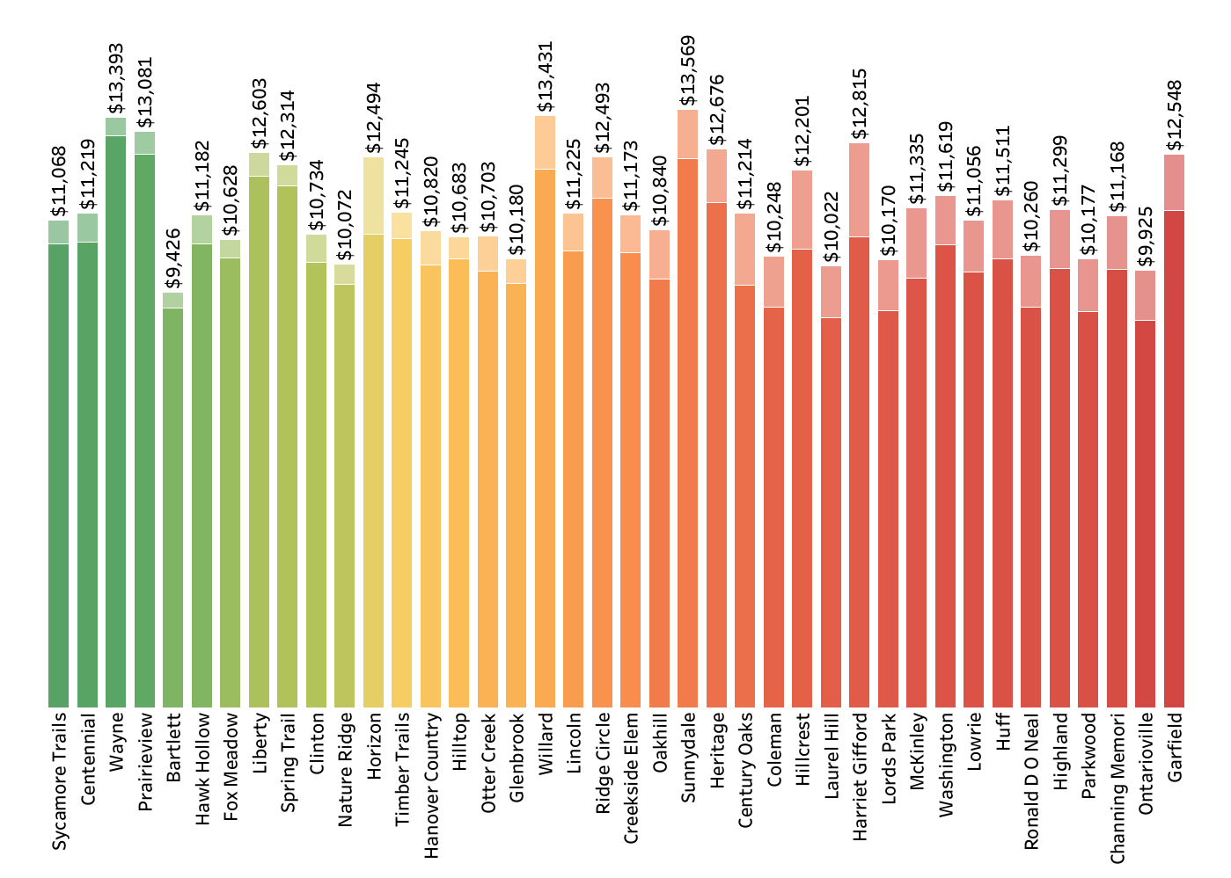
Public data will show how federal $/student were ultimately spent on each school.

Slide 14
POLL: Which is likely to drive more dollars per pupil to lower-income schools:
An across-the-board raise of 4%
Add a new counselor to each school
Extend school day by 30 minutes, paying $2K per teacher
Deliver $250 per student to each school plus an extra $100 per low-income or EL student for principals to use to increase engagement

Slide 15
Six potential mistakes districts might be making with federal relief funds
Spending in a way that creates a disruptive fiscal cliff
Offsetting lost funds due to permanent enrollment declines
Issuing problematic contracts that come back to haunt leaders
Deploying funds inequitably across schools
Failing to make sure community sees/values investments
Investing without demonstrating real results for students
Community: Where’d that money go?
Principal: Who knows how they spent it? All I know is we didn’t get any.
Parent: I’m not sure if the money any real difference.
Teacher: They always spend it on central office and then blame us when kids do poorly.

Slide 16
Six potential mistakes districts might be making with federal relief funds
Spending in a way that creates a disruptive fiscal cliff
Offsetting lost funds due to permanent enrollment declines
Issuing problematic contracts that come back to haunt leaders
Deploying funds inequitably across schools
Failing to make sure community sees/values investments
Investing without demonstrating real results for students
Low outcomes happen when leaders take their eye off the ball!

Slide 17
What’s the role of the SEA?
SEAs got some dough too. (Like a lot!).
SEAs are tasked with:
Supporting LEAs in their planning
Approving plans (but may not add any additional restrictions)
Tracking spending
Evaluating effectiveness

Slide 18
How did SEAs say they’ll support LEAs?
Contract w/ partners to deliver support
SEA will craft materials, emails, memos
AZ, CA, CT, FL, MN, MS, ND, PR, VT, WV
AK, AL, AR, AZ, CA, CO, CT, DC, IA, ID, IN, LA, MA, MS, MT, ND, NE, NV, OK, OR, PA, TX, UT, VA, WI, WV
Support provided in-house via SEA staff
Give $ to LEAs for planning, TA
SEA will lead webinars, calls, convenings, PD, TA
TN
AK, AL, AR, AZ, CA, CO, CT, DC, DE, FL GA, IA, ID, IN, IL, KY, MA, MD ME, MI, MN, MS, MT, ND, NE, NH*, NM, NV,OH, OK, PA, PR, RI, SC, SD, TN, TX, UT, VA, VT*, WI
Compliance requirements via “assurances” ”audits” “monitoring” etc.
CHAT: How’s that going? Are LEAs up to the task?
Pretty much everyone
*Includes SEA-convened communities of practice

Slide 19
So, SEAs are approving LEA plans, eh?
How’s that going?
POLL: Anna-Jonesboro CHSD 81 (IL) plans to spend nearly half of $1.9M in federal relief on artificial turf for the football field and to resurface the track. Community members are upset saying they weren’t consulted and the investment doesn’t benefit all students. If you were the SEA, would you approve the district plan?
Yes
No
POLL: Tennessee is using its ESSER dollars to pay for tutoring for those districts who agree to match.
Sounds reasonable
I’m less comfortable with this

Slide 20
What’s ESSER buying in your neck of the woods?
States with public-facing ESSER$ tracking systems (that we could find):
AL, GA, KS, MT, NC, NM, OH, RI, WA
What’s reported varies:
Amount spent
Object
Activity
Function
Other Category
CHAT: Did we miss your state’s tracker?
Chat us the link.
One state tracks the 20% for learning loss:
_____% Summer
_____% Extended year
_____% Extended day
_____% After-school compensatory services
_____% Other
Have you taken stock of what you’re seeing in ESSER spending data?
33
5
5
1
44

Slide 21
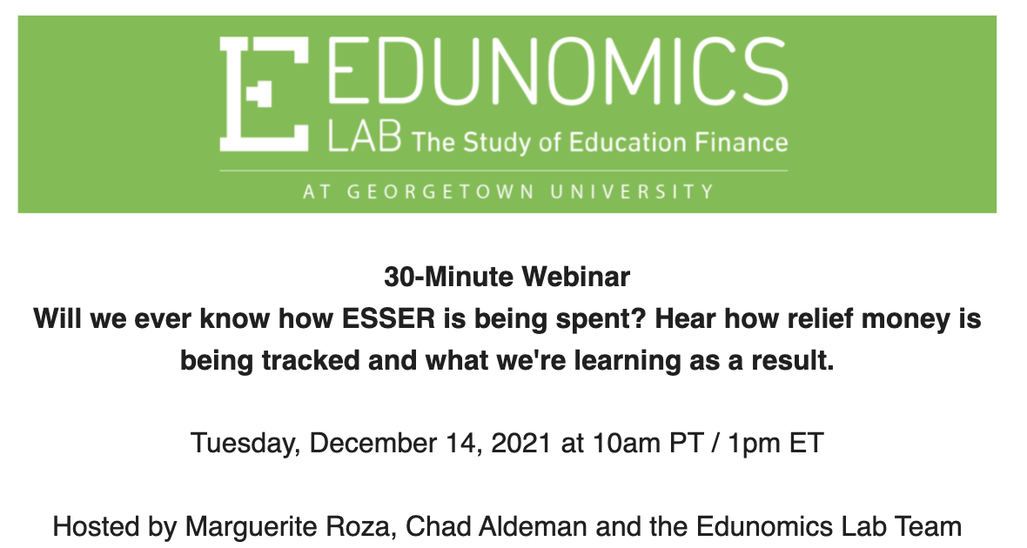
Q&A
Got questions? We’re here!
Marguerite Roza
mr1170@Georgetown.edu
@MargueriteRoza
Hannah Jarmolowski
HJ254@Georgetown.edu
Happy holidays and happy New Year!
We’ll see you in 2022!

Slide 22
This presentation is in the public domain. While permission to reprint is not necessary, publication should be cited. The presentation is prepared by the National Comprehensive Center under Award #S283B190028 for the Office of Program and Grantee Support Services (PGSS) within the Office of Elementary and Secondary Education (OESE) of the U.S. Department of Education and is administered by Westat. The content of the presentation does not necessarily reflect the views or policies of the PGSS or OESE or the U.S. Department of Education nor does mention of trade names, commercial products, or organizations imply endorsement by the U.S. Government. © 2019 Westat.

